Slide 1

CRCOG
STRATEGIC
PLAYBOOK
CRCOG Executive Meeting
September 13, 2023

Slide 2
Overview
Introduction
Mission Statement
Values and Guiding Principles
Strategic Framework
Eight Strategic Priorities

Slide 3
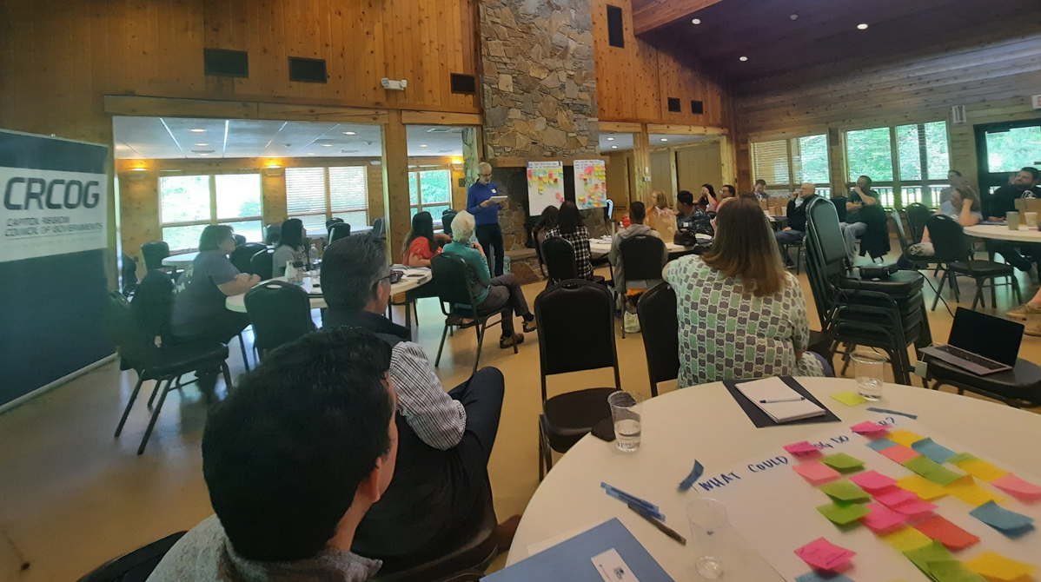
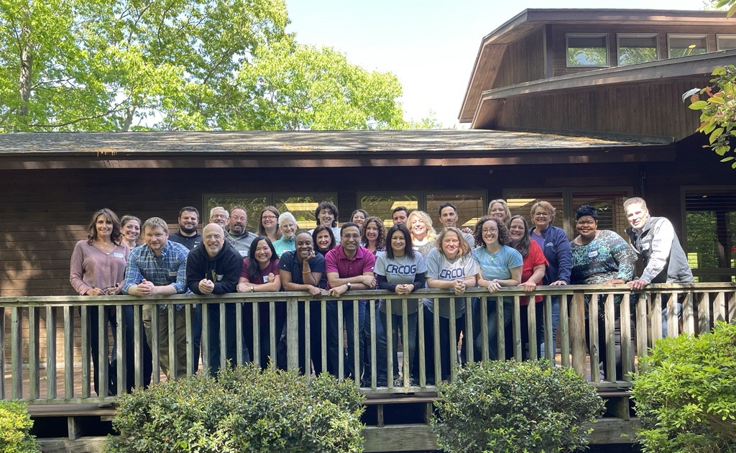
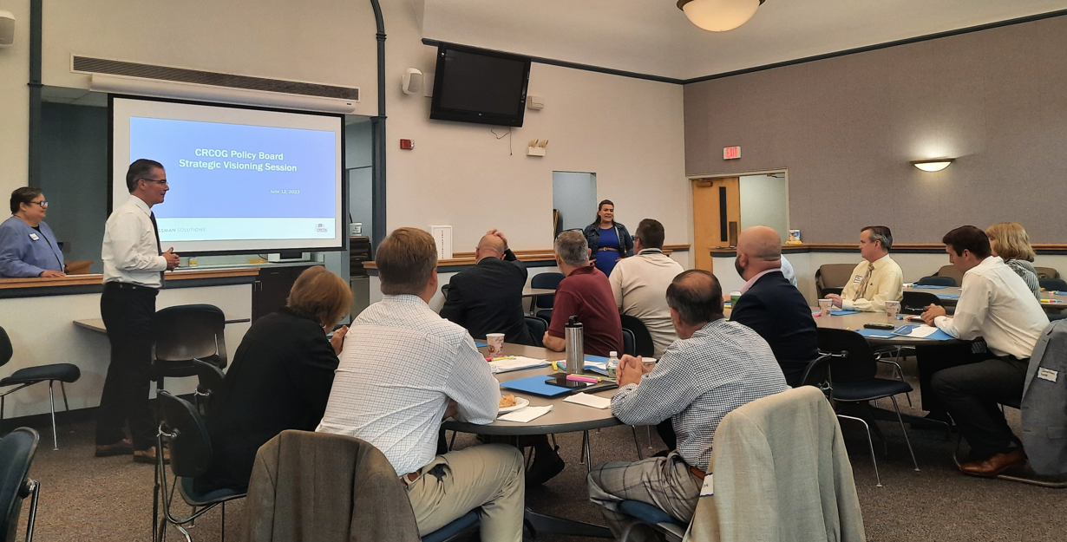
Introduction
CRCOG’s Strategic Visioning Process began Spring 2023.
Think about where our organization is now, where we would like to go, and how we can best serve our members in the future, while still providing established programs and services in our core plans and required by law.
Retained Grossman Solutions to assist this effort.
Conducted nearly 30 stakeholder interviews.
Created survey questionnaires and reviewed responses from over 30 participants.
Engaged CRCOG staff, key stakeholders, and the majority of our member municipalities.
Findings comprise CRCOG’s Strategic Playbook.
Notes:
PY: Consider skipping this slide. Or just saying, we started our process in the spring and the culmination is going to be the Strategic Playbook. I'm going to present the major components of that. (Keep slide is, but staff already knows most of it)
Findings from Interviews, Surveys, Staff Retreat, Visioning Session with the Policy Board were assessed in creating a Strategic Playbook, which will be summarized next. CRCOG plans to use this Strategic Playbook to guide work and decisions over the next few years.

Slide 4

Mission Statement
The Capitol Region Council of Governments (CRCOG) works to enhance the quality of life, vibrancy, and vitality of its members, the 38 municipalities in Greater Hartford. CRCOG provides planning and other shared services to its members and is the region’s designated metropolitan planning organization (MPO). CRCOG is a strong advocate for its capital city and the region and leads as a convener and a catalyst for regional approaches and solutions.
Notes:
Often both the first and last step in developing a strategic plan is to define and refine the mission statement. This new mission statement is much shorter than our prior mission, and is meant to be concise but informational, inspiring but realistic.
[Space to activate animation]
I promise not to read all the slides, but want to read this statement aloud because it is so important to the work we do.

Slide 5




Core Values
Derived from our mission, work, and commitment to municipalities and residents.
We are dedicated to improving the quality of life throughout the region, and continuously strive to be:
Member-focused
Impactful and High Performing
Collaborative and Inclusive
Innovative
Notes:
Another step in the strategic planning process was defining our organization’s core values. These four values resonated strongest throughout this planning process. Each of these values encompass other key words and phrases, like our ability to be non-partisan when being member-focused, and visionary through innovation.

Slide 6

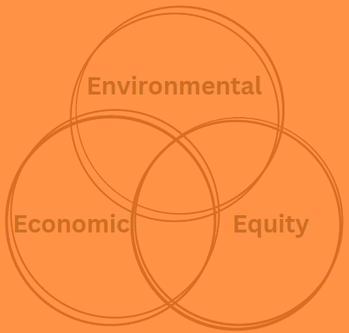


Guiding Principles
These supplement our Core Values
We are committed to:
Use Sound Planning Practices and Data-based Solutions to incorporate Best Practices
Embrace Diversity and Promote Equity, Inclusion, and Belonging
Apply a Lens of Sustainability – Environmental, Economic, and Equity
Recognize That the Success of Individual Municipalities Depends On the Success of Our Region
Notes:
We also established a set of guiding principles to supplement our core values. These further helped refine our mission statement, and strengthen the new strategic framework, which we will go through next. I'll give you a minute to read through these.
(PY Note, let people sit with it and read through in silence without you talking)
Principles like Sound Planning Practices, Data-driven solutions; Diversity, Equity, Inclusion and Belonging; Sustainability; and the importance of working together to achieve better results.

Slide 7
Strategic Framework
Each new initiative should align with several elements:
Be compatible with CRCOG’s mission and fall within our capacity and capability, either with existing or new resources.
Be member-focused and designed to help our members serve their communities more efficiently and effectively.
Present an opportunity to innovate, collaborate or partner with key stakeholders or other entities.
Be impactful for several CRCOG communities, including municipalities of different sizes and demographics.
Promote equity and environmental and economic sustainability.
Comply with state and federal requirements.
Notes:
A major goal of this strategic planning process was to identify key priorities that we can take on to improve our region. To help with this, a strategic framework was developed. This framework is a tool to determine if a proposed initiative (like a project, program, or service) warrants an allocation of resources. Collectively, the mission, values, principles, framework, along with

Slide 8
Long-Term Next Steps
Each Priority includes stated Goals and a series of Action Steps designed to achieve them.
CRCOG Staff will work to implement Action Steps to meet Goals.
From time to time, CRCOG Leadership will review the Action Steps, Goals, and/or Priorities to ensure the organization is meeting the needs of our members.
CRCOG will use this Strategic Playbook to guide decisions for the next three to five years.
Notes:
More information about each priority follows, but before getting into details here is a review of the overall purpose of the strategic playbook and long-term steps. CRCOG plans to use this Strategic Playbook to guide work and decisions over the next few years. Each priority includes stated goals and a series of action steps to achieve them. CRCOG stall will work to implement action steps to meet goals. CRCOG Leadership will periodically review the Playbook to ensure it is still meeting the needs of our members.

Slide 9

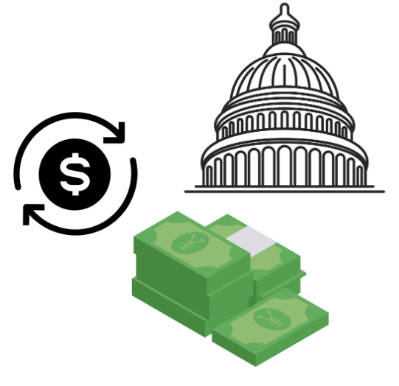






Eight Strategic Priorities
Governance and Communications
Federal Infrastructure Funding
Economic Vitality
Regional Housing Strategy
Regional Environmental Services
Coordinated Approach to Road Safety, Complete Streets, and Multi-use Trail Projects
Enhanced Rail and Bus Service
Public Sector Workforce Development, Shared Services, and Direct Services
Notes:
An assessment of findings from this strategic planning process (like the hours of interviews, survey results, post-retreat and visioning session reports, etc.) resulted in identification of several priorities. After a run through the Strategic Framework eight priorities emerged that we can focus on over the next few years. These are in addition to work we currently do to meet commitments made in core plans and state/federal mandates.
Each priority includes stated goals and a series of action steps to achieve them. CRCOG stall will work to implement action steps to meet goals. CRCOG Leadership will periodically review the Playbook to ensure it is still meeting the needs of our members. More information about each priority follows.

Slide 10
Strategic Priorities
Goals:
Create a forum for substantive policy discussions related to key issues, challenges and opportunities facing our members and the region.
Refine CRCOG’s communications strategy to promote awareness of CRCOG’s work and services, build our professional network, and elevate issues of critical regional importance to the attention of elected officials, municipal staff, and other key stakeholders.
Governance and Communications
Notes:
Governance and Communications. There are two goals for this priority. The first focuses on creating space to have substantive policy discussions that will help position our region for greater success.
The second goal of this priority focuses on refining CRCOG’s communications strategy to increase awareness about who we are, what we do, and why we do it so we can achieve better results.

Slide 11
Strategic Priorities
Goals:
Create a forum for substantive policy discussions related to key issues, challenges and opportunities facing our members and the region.
Action Steps:
Schedule periodic in-person Policy Board meetings to discuss a substantive policy topic, such as housing, workforce development, or Complete Streets.
Schedule substantive policy discussions with CRCOG’s Legislative Committee at key points throughout the legislative session to track and respond to relevant legislation.
Governance and Communications
Notes:
Governance and Communications. There are two goals for this priority. The first, shown here, focuses on creating space to have substantive policy discussions that will help position our region for greater success.

Slide 12
Strategic Priorities
Goals:
Refine CRCOG’s communications strategy to promote awareness of CRCOG’s work and services, build our professional network, and elevate issues of critical regional importance to the attention of elected officials, municipal staff, and other key stakeholders.
Action Steps:
Build a network of local public information officers and communications staff to share information across the region.
Continue CRCOG Who, CRCOG What, CRCOG Why campaign.
Continue CRCOG staff visitation program with member municipalities.
Governance and Communications
Notes:
The second part of this priority focuses on refining CRCOG’s communications strategy to increase awareness about who we are, what we do, and why we do it so we can achieve better results.

Slide 13
Strategic Priorities
Goals:
Assist our members with leveraging maximum funding from BIL, IRA, and related infrastructure grant programs.
Federal Infrastructure Funding
Notes:
Another top priority identified was the need to increase awareness of and access to Federal Infrastructure Funding to plan and implement projects throughout the region.
Action steps related to this include: identifying funding opportunities for priority projects, increasing communications and education about programs, assisting with grant applications, advocating to help members overcome barriers preventing them from applying, and CRCOG serving as lead applicant for projects of regional significance.

Slide 14
Strategic Priorities
Action Steps:
Continue to assist CRCOG members with preparing competitive applications for funding under the BIL and screen local infrastructure projects for potential funding sources.
Build relationships with funding agencies and host workshops and seminars to feature best practices and new technologies.
Add services to assist members with the application process, such as a grant newsletter and resources to conduct a benefit-cost analysis (BCA).
Advocate for concerns expressed by member municipalities to assist them with overcoming barriers that hinder their participation in federal funding opportunities.
Apply for planning grants and implementation grants for regionally significant projects and to accomplish CRCOG’s strategic priorities.
Federal Infrastructure Funding

Slide 15
Strategic Priorities
Goals:
Implement the key recommendations in the CEDS (Comprehensive Economic Development Strategy), including:
  support for workforce development,
  support and facilitation of mixed-use and mixed-income developments and transit-oriented development, and
  development of a regional business recruitment and retention program focusing first on the business sectors that are identified in the CEDS.
Economic Vitality
Notes:
Economic Vitality is another top concern. There is one goal here - to implement the region’s Comprehensive Economic Development Strategy (the CEDS) – which is further broken down into specifics. As many of you know, we are in the process of updating the CEDS, and recently received Economic Development District designation from the federal Economic Development Administration.
Action Steps to implement the CEDS include adding resources, continuing CRCOG’s Brownfields Remediation Program, establishing a committee to pursue priority goals in the CEDS and identifying funding opportunities to achieve these, and building and supporting a network of local economic development professionals.

Slide 16
Strategic Priorities
Action Steps:
Add resources to coordinate implementation of the CEDS.
Continue to develop CRCOG’s Brownfields Remediation Program.
Establish an implementation committee and core CRCOG team that meets regularly to pursue priority CEDS goals as well as identify and apply for funding or other opportunities that enable implementation of the CEDS.
Build and support a network of local government economic development professionals and other regional stakeholders, including arts and cultural institutions.
Economic Vitality

Slide 17
Strategic Priorities
Goals:
Assist member municipalities across the region with increasing access to quality housing for people of varying income levels.
Regional Housing Strategy
Notes:
Developing a regional housing strategy is another top priority. Increasing access to quality housing for people of varying income levels is critical for improving quality of life for all. Action Steps include developing a housing toolkit that includes model regulations and policies; seeking support and funding to implement recommendations made within the strategy; seeking funding to address crumbling foundations; and prioritizing brownfields remediation, particularly within Transit-oriented development corridors.

Slide 18
Strategic Priorities
Action Steps:
Develop a comprehensive housing strategy for our region in partnership with housing-based organizations and other stakeholders.
Develop a housing toolkit, including model regulations and policies, based on recommendations outlined in the strategy.
Seek support and funding to implement strategy recommendations and related initiatives.
Implement the HUD-funded grant assistance program for Low to Moderate Income (LMI) homeowners with crumbling foundations.
Increase housing supply by continuing to implement CRCOG’s Brownfields Remediation Program, prioritizing brownfields redevelopment within transit-oriented corridors.
Regional Housing Strategy

Slide 19
Strategic Priorities
Goals:
Implement key recommendations in CRCOG’s waste management study to develop a more sustainable waste management system for the region.
Develop a long-term plan to dramatically improve stormwater infrastructure across the region, implementing nature-based solutions where appropriate.
Work to meet goals set by state and federal governments to address climate change.
Regional Environmental Services
(Recycling and Waste Management, Pollution Reduction Planning, and Stormwater Management)
Notes:
Regional Environmental Services is a 3-part priority, with goals related to Recycling & Municipal Waste Management, stormwater management, and other environmental issues such as pollution reduction planning.
Action steps include re-establishing the Central CT Solid Waste Authority (CSWA) to implement recommendations within CRCOG’s Waste Management Study to develop more sustainable waste management system;
Conducting a stormwater management study to assess existing conditions and identify needed improvements; Preparing climate action plans and seeking funds to implement recommendations to reduce Greenhouse Gas Emissions; and abate pollution through Brownfields Remediation Program, particularly in disadvantaged communities.

Slide 20
Strategic Priorities
Goals:
Implement key recommendations in CRCOG’s waste management study to develop a more sustainable waste management system for the region.
Action Steps:
Re-establish the Central CT Solid Waste Authority (CCSWA) to help implement the recommendations outlined in CRCOG’s recent waste management study.
Regional Environmental Services
(Recycling and Waste Management, Pollution Reduction Planning, and Stormwater Management)
Notes:
Regional Environmental Services is a 3-part priority, with 3 goals each related to different aspects of Recycling & Municipal Waste Management, stormwater management, and other environmental issues that include pollution reduction planning.
Action steps include re-establishing the Central CT Solid Waste Authority (CSWA) to implement recommendations within CRCOG’s Waste Management Study to develop more sustainable waste management system;
Conduct a stormwater management study to assess existing conditions and identify needed improvements
Prepare climate action plans and seek funds to implement recommendations to reduce Greenhouse Gas Emissions and abate pollution through Brownfields Remediation Program, particularly in disadvantaged communities.

Slide 21
Strategic Priorities
Goals:
Develop a long-term plan to dramatically improve stormwater infrastructure across the region, implementing nature-based solutions where appropriate.
Action Steps:
Re-establish the Central CT Solid Waste Authority (CCSWA) to help implement the recommendations outlined in CRCOG’s recent waste management study.
Regional Environmental Services
(Recycling and Waste Management, Pollution Reduction Planning, and Stormwater Management)

Slide 22
Strategic Priorities
Goals:
Work to meet goals set by state and federal governments to address climate change.
Action Steps:
Utilize the Natural Hazards Mitigation Plan and CPRG to prepare climate action plans for the region and seek funds to implement key recommendations.
Continue to implement the brownfields program and proactively seek projects that abate pollution, particularly in our disadvantaged communities which are often disproportionately impacted from pollution and heat island effects.
Regional Environmental Services
(Recycling and Waste Management, Pollution Reduction Planning, and Stormwater Management)

Slide 23
Strategic Priorities
Goals:
Work to dramatically improve safety for all road users and to promote micromobility and Complete Streets.
Coordinated Approach to Road Safety, Complete Streets, and Multi-use Trail Projects
Notes:
As the region’s Metropolitan Planning Organization (MPO),we are ideally situated to coordinate an approach to road safety, Complete Streets, and multi-use trail projects that will help our region grow sustainably.
Action steps include incorporating an interdisciplinary approach to achieve Vision Zero, focusing on planning, engineering, enforcement, and education; completing the region’s Roundabout Screening Study, the East Coast Greenway Gap Closure Study, and various corridor studies; and seeking funding to implement recommendations made in our studies and Complete Streets projects.

Slide 24
Strategic Priorities
Goals:
Work to dramatically improve safety for all road users and to promote micromobility and Complete Streets.
Action Steps:
Incorporate a Vision Zero approach into the Regional Transportation Safety Plan update.
Complete the Roundabout Screening Study, the East Coast Greenway Gap Closure Study, and various corridor studies.
Take on new initiatives such as the Regional Bicycle/Pedestrian Priority Network Plan, offer bike/ped count and walk audit as additional services.
Continue to help member municipalities seek funds for Complete Streets and related implementation projects.
Coordinated Approach to Road Safety, Complete Streets, and Multi-use Trail Projects

Slide 25
Strategic Priorities
Goals:
Collaborate with CTDOT, member municipalities, the Pioneer Valley Planning Commission (PVPC), and other stakeholders to improve passenger service on the Hartford Line.
Help shape the Greater Hartford Mobility Study (GHMS) and advocate for the implementation of recommended projects.
Work with CTDOT and transit operators to enhance bus service, including paratransit throughout our region.
Enhanced Rail and Bus Service
Notes:
Again as MPO, we play a significant role in transit planning, with focus on rail and bus service. Collaborating with key stakeholders like CTDOT, Pioneer Valley Planning Commission, and others will help us improve passenger service on the Hartford Line and support investments in these assets. Continuing to participate in the development of the Greater Hartford Mobility Study and implementation of recommended projects is also important as our region must address aging infrastructure and plan for future growth sustainably. Enhancing bus services by conducting a comprehensive service analysis, analyzing needs around the region, including rural and underserved areas is another action step to accomplish goals related to this priority.

Slide 26
Strategic Priorities
Goals:
Collaborate with CTDOT, member municipalities, the Pioneer Valley Planning Commission (PVPC), and other stakeholders to improve passenger service on the Hartford Line.
Action Step:
Re-establish the CTfastrak/Hartford Line Corridor Advisory Committee to support continued state investment in these transit assets.
Enhanced Rail and Bus Service

Slide 27
Strategic Priorities
Goals:
Help shape the Greater Hartford Mobility Study (GHMS) and advocate for the implementation of recommended projects.
Action Step:
Continue to participate in the development and implementation of the GHMS.
Enhanced Rail and Bus Service

Slide 28
Strategic Priorities
Goals:
Work with CTDOT and transit operators to enhance bus service, including paratransit throughout our region.
Action Step:
Conduct a comprehensive service analysis to analyze transit needs around the region, including rural and other underserved areas.
Assist member municipalities with grant opportunities to improve service.
Enhanced Rail and Bus Service

Slide 29
Strategic Priorities
Goals:
Work with member municipalities and other key stakeholders to develop a talent pipeline for key municipal occupations.
Help member municipalities share services to capture economies of scale and improve service quality.
Provide direct services through CRCOG where desired and feasible.
Public Sector Workforce Development, Shared Services, and Direct Services
Notes:
Consistent feedback from member municipalities about difficulty recruiting and maintaining staff in a variety of local government jobs led to this priority for Public Sector Workforce Development, Shared Services, and Direct Services. The goals for this priority focus on developing a talent pipeline for key municipal occupations; capturing economies of scale and improved quality of service through shared services; and providing direct services where desired and feasible, like through our enhanced GIS & Data Center which provides mapping and data to support CRCOG’s and member municipalities’ projects and initiatives.
Key Action Steps include: successfully implementing the three RPIP -funded projects for animal control, assessment, and code enforcement/building inspection; developing a municipal resource library with toolkits, model regulations and policies, best practices, and other information to help member municipalities meet needs in their communities; collaborate with state agencies and other key stakeholders to develop an action plan to address workforce recruitment and retention within the regions Emergency Medical Services (EMS) systems.

Slide 30
Strategic Priorities
Goals:
Work with member municipalities and other key stakeholders to develop a talent pipeline for key municipal occupations.
Action Steps:
Continue to coordinate the work of the Public Sector Workforce Task Force to develop a talent pipeline for key municipal occupations.
In collaboration with State agencies and other key stakeholders, assess workforce recruitment and retention within the region’s Emergency Medical Services (EMS) systems and develop an action plan to implement desired improvements.
Public Sector Workforce Development, Shared Services, and Direct Services

Slide 31
Strategic Priorities
Goals:
Help member municipalities share services to capture economies of scale and improve service quality.
Action Steps:
Successfully implement the three Regional Performance Incentive Programs (RPIP)-funded projects.
Public Sector Workforce Development, Shared Services, and Direct Services

Slide 32
Strategic Priorities
Goals:
Provide direct services through CRCOG where desired and feasible.
Action Steps:
Refine and build out CRCOG’s GIS & Data Center to serve our members and CRCOG staff.
Develop a municipal resource library with toolkits, model regulations and policies, best practices, and other information to serve member municipalities..
Public Sector Workforce Development, Shared Services, and Direct Services

Slide 33

Thank
You.

