Slide 1

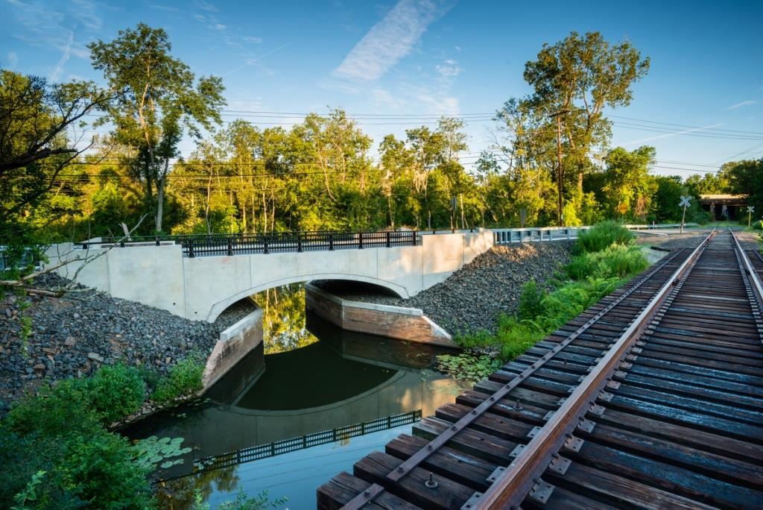

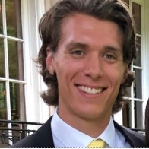

STATE LOCAL BRIDGE PROGRAM – CLE BRIDGE GROUP
Principal Engineer:
Derick M. Lessard, P.E.
Supervising Engineer:
Marc P. Byrnes, P.E.
Project Engineer:
Andrew C. Shields, E.I.T.
Project Engineer:
Michelle M. Rame
Division of Bridges – CLE Unit – Local Bridge Program

Slide 2
WHO ARE WE AND WHAT DO WE DO?
June 8, 2023 State Local Bridge Program Status
STATE
LOCAL
BRIDGE
PROGRAM
CONSULTANT
LIAISON
ENGINEERING
BRIDGE DIVISION
CONNECTICUT DEPARTMENT OF TRANPORTATION
HOW CAN IT HELP YOU?
Dollar for dollar matching grant to rebuild failing bridges in Connecticut (State General Statute – Ch 240, Sect 13a-175q)
Municipality runs their own job, while the state helps pay for 50%
Municipality’s responsible for day-to-day operations to keep things moving. SLBP oversees milestones only.
A bridge can currently already be in design and can still apply for funding (it just cannot be in construction)
Asking us questions is free versus a consultant
Division of Bridges – CLE Unit – Local Bridge Program

Slide 3




ELIGIBILITY
June 8, 2023 State Local Bridge Program Status
Municipally owned (not on a state route) bridge
Serves a public roadway
6'-0" or more clear span
Poor condition
6'-0" +
Note: Bridges not eligible for SLBP may be eligible for Federal Local bridge Program, we encourage you to inquire within
Division of Bridges – CLE Unit – Local Bridge Program

Slide 4
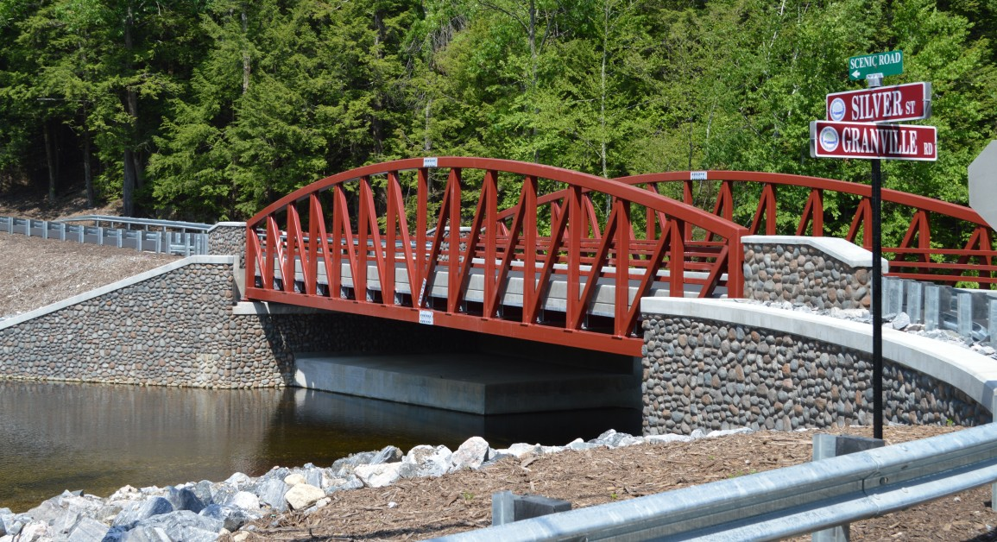
PROGRAM GENERAL FUNCTIONALITY HIGHLIGHTS
June 8, 2023 State Local Bridge Program Status
SLBP acts as a steward to apply grants in volume
SLBP cannot review all jobs very closely due to project volume (currently 100+ active)
Municipalities assume all liability of design as their own representatives sign and seal
OEP/EPC, ROW, and SLBP are the only CTDOT departments that deal directly with projects
Division of Bridges – CLE Unit – Local Bridge Program

Slide 5
PROGRAM CHANGES SINCE 2022 Q4 PERSONELL TRANSITION
June 8, 2023 State Local Bridge Program Status
Old Processes:
Compile Annual Eligible Bridge List manually
Compute bridge sufficiency/priority ratings for program applications
Closing documents
Attorney General review and signoff prior to grant issuance
Municipalities alert CTDOT at design completion of NBI bridge status
$10,000,000.00 annual funding allotment
Supplemental Application due in 12 months, not requiring construction bidding
Annual class acceptance to program prior to confirmation of funding allotment
Open ended individual project budgets
Amended Processes:
Live updating automated Eligible Bridge List (performed alongside Bridge Management)
Application process formalization notices issued to all municipalities and consultants
Closing documents eliminated from program
Attorney General review and signoff prior to grant issuance eliminated from program
Municipalities must alert CT DOT if current or new structure will be on NBI and must provide a 60% design submission
$20,000,000.00 annual funding allotment
Supplemental Application due in 18 months, after construction bidding
Annual class acceptance pushed back until funding allotment guaranteed
Project cost cap introduced at CTF phase
Division of Bridges – CLE Unit – Local Bridge Program

Slide 6
STANDARD SLBP PROJECT PROCESS
6. Initiate project in CORE
7. Issue MOD to encumber funding
8. Sign & Execute Grant Agreement
9. Prepare ISP Memo for payment
10. Issue grant payment
11. Complete construction*
12. Submit as-builts, site inspection
13. Audit request and audit
14. Project Closeout
Eligible Bridge List sourced
Review submitted applications, allocate funds accordingly
Issue Commitment to Fund Letters
Receive environmental review forms & submit for OEP/EPC review
Receive Supplemental Application with revised budgets, timeline, PS&E, municipal proof of funds, bidder list, signed construction contract with builder Certificate of Insurance, load rating package, permits, ROW, Hydraulics
Note: Municipality performs all construction administrative milestones at their own pace (not a state-managed project)
Division of Bridges – CLE Unit – Local Bridge Program

Slide 7

OLD PROJECT GENERAL STATISTICS
Between Commitment to Fund (Acceptance Letter to SLBP) date and Supplemental Application date, projects have been averaging a 25% increase in cost and took an average 2-3 years to advance to this phase (if project is starting from scratch and not previously designed prior to SLBP Acceptance)
Main projects experiencing increases are 3+ years old
When increases are granted, it takes from program savings & future commitments
Division of Bridges – CLE Unit – Local Bridge Program

Slide 8

EXPEDITING OF OLD PROJECTS
Municipalities were contacted in order from oldest projects (2013 class) up to 2018 class (so far) requesting the following (specifically those who have not been in regular contact with CTDOT SLBP):
  Time Extension Requests – Update in project milestone timeline & costs subject to our approval for increases (if any)
  Outstanding Items Lists – Remaining items needed by SLBP provided accordingly
Municipalities given window to respond to email requesting the above items until the following:
  Project Cancellation Notices – Withdraw funding from town due to no response, project inactivity, significant scope change, or per Municipality cancellation request
Division of Bridges – CLE Unit – Local Bridge Program

Slide 9
RECENT PROGRAM COMMITMENTS
Fiscal Year | Applications | Applications Accepted | % Projects Committed | Total Requested Combined Project Cost | Average Project Cost | Total Requested SLBP Funds | Available Funds for Commitment | SLBP Funds Committed | % Requested Funds Committed
2016 | 19 | 19 | 100.00% | $16,290,646.72 | $857,402.46 | $7,928,361.17 | $10,000,000.00 | $7,928,361.17 | 100.00%
2017 | 16 | 16 | 100.00% | $25,519,322.00 | $1,594,957.63 | $12,759,661.00 | $10,000,000.00 | $12,759,661.00 | 100.00%
2019 | 36 | 33 | 91.67% | $74,176,118.52 | $1,825,028.68 | $37,088,059.26 | $24,000,000.00 | $33,500,559.76 | 90.33%
2020 | Congress St, Bridgeport | 1 | N/A | $16,600,000.00 | $8,300,000.00 | $8,300,000.00 | $10,000,000.00 | $8,300,000.00 | N/A
2021 | 49 | 49 | 100.00% | $78,455,606.84 | $1,601,134.83 | $39,227,803.42 | $10,000,000.00 | $39,227,803.42 | 100.00%
2023 | 55 | 12 | 21.82% | $123,151,900.88 | $2,239,125.47 | $61,575,950.44 | $10,000,000.00 | $11,050,837.50 | 17.95%
2024 | 51 | 18 | 35.29% | $112,663,883.19 | $2,209,095.75 | $56,331,941.60 | $20,000,000.00 | $16,361,025.79 | 29.04%
Division of Bridges – CLE Unit – Local Bridge Program
Notes:
Increasing popularity in the program over the last few years led to a few things:
General trend increasing with program applications as SLBP gains popularity
Increase in project cost
$20,000,000 2024 commitment allowed us to commit 1/3 of projects instead of 18% program acceptance
Committed 16.4 million of 20 million, let 20-25% of funds sit in reserves for project cost increases (first come first serve basis)
Program had surplus over many years because of low program interest in the past, so reserve fund was large
Committed many projects on reserve funding in past years, and has since dwindled
We allocate as many projects as we responsibly can now so as to not overspend and be fiscally responsible for future years

Slide 10
OBSERVED SLBP SOLICITATION METHODS
APPLICATIONS ON SLBP WEBISTE
1
CONSULTANT FIRMS
2
MUNICIPAL ENTITY
4
3
STATE LOCAL BRIDGE PROGRAM
Division of Bridges – CLE Unit – Local Bridge Program
Notes:
We noticed the trend of municipalities being approached by consultant firms to apply to SLBP
- Not always given full program information, so municipalities are operating as a dependent

Slide 11
PROPOSED SLBP SOLICITATION METHODS
APPLICATIONS ON SLBP WEBISTE
1a
1b
CONSULTANT FIRMS
2a
MUNICIPAL ENTITY
2b
4
3
STATE LOCAL BRIDGE PROGRAM
Division of Bridges – CLE Unit – Local Bridge Program
Notes:
We propose empowering the muni’s to be able to reach out to us at the SLBP so they can get the most accurate and up to date info about our program
- If muni’s have the info they need on their bridges they can solicit and compare consultants for best fit

Slide 12
OPTIMAL SLBP SOLICITATION METHODS
APPLICATIONS ON SLBP WEBISTE
1
CONSULTANT FIRMS
2b
MUNICIPAL ENTITY
3
2a
STATE LOCAL BRIDGE PROGRAM
Division of Bridges – CLE Unit – Local Bridge Program
Notes:
If muni’s initiate projects, it will help keep cost down and keep towns in the loop on their projects

Slide 13

SLBP MESSAGE
Our goal is to improve CT roadways, help us spread the word from a trusted government source, not a private sector firm looking for business
We want YOU to take what you learned and report to your representative Municipalities about SLBP and have them apply with any deficient bridges
Division of Bridges – CLE Unit – Local Bridge Program

Slide 14
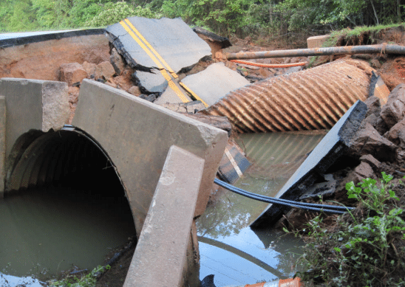
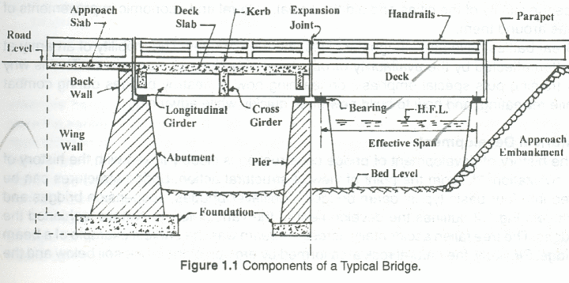
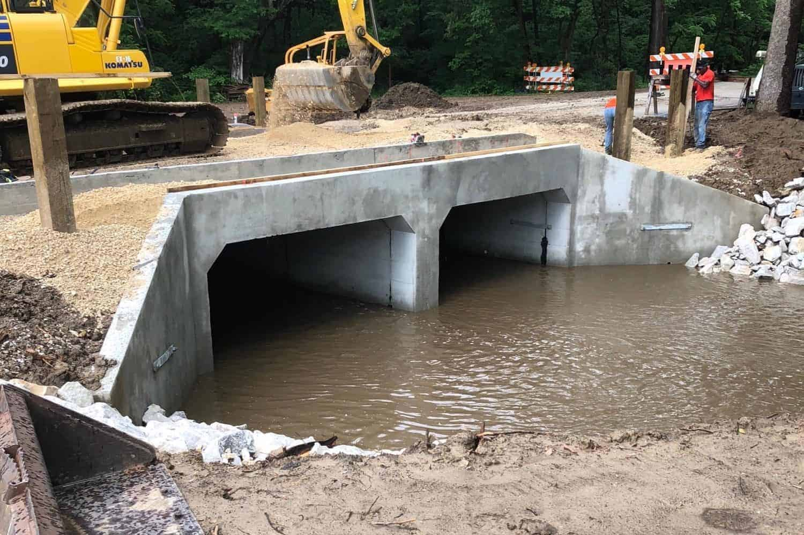

QUESTIONS OR COMMENTS?
Supervising Engineer:
Marc P. Byrnes, P.E.
Marc.byrnes@ct.gov
Project Engineer:
Andrew C. Shields, E.I.T.
Andrew.shields@ct.gov
Thank you for your time and consideration.
Visit us online at:
CTDOT Local Bridge Program
Division of Bridges – CLE Unit – Local Bridge Program

