Slide 1
Regional Planning Commission
Welcome to a CRCOG Zoom Meeting
We have muted attendees upon entrance. We will unmute people either individually or for everyone depending on the situation.
For our public meetings, we will be taking a roll-call of attendance based on who we identify as being on the call and then ask those we cannot identify to state their name and town.
Each time you speak, you must identify yourself with your name and town prior to making your point.
If you are abstaining or objecting to an action item, please state your name and town.
Meeting materials are available at CRCOGCT.gov

Slide 2
Regional Planning Commission
Welcome and Introductions
Adoption of Minutes: September 4, 2025 (attachment)
Approval of 2026 Meeting Dates
A Presentation by CRCOG: Third Places – Social Infrastructure in the Capitol Region
CRCOG Updates
Report on Zoning and Subdivision Referrals
What's New in My Town
Other Business

Slide 3
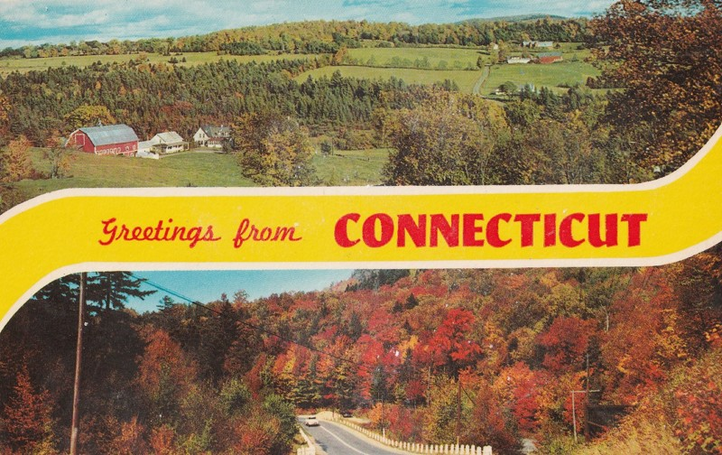
1. Welcome & Introductions

Slide 4
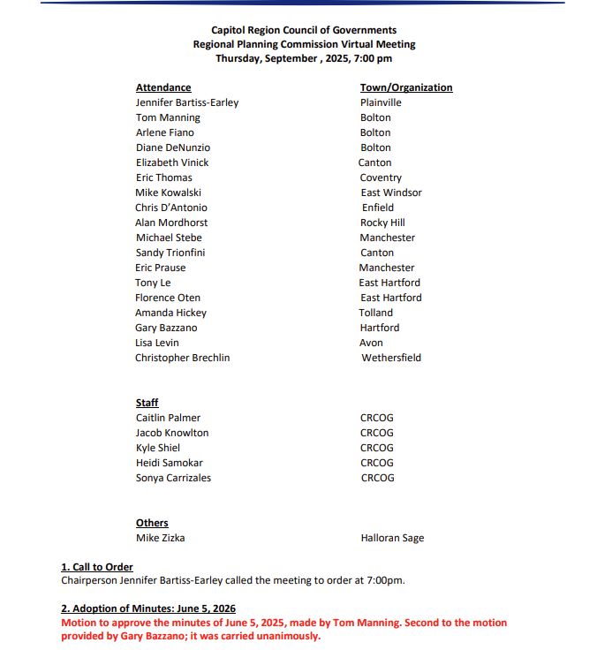
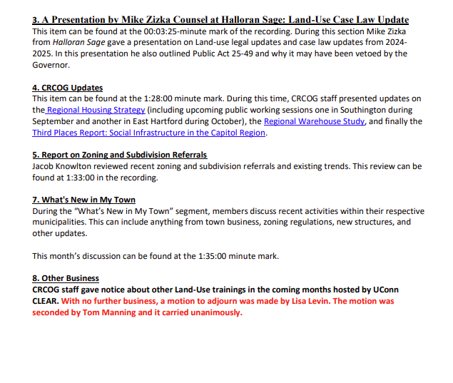
2. Adoption of Minutes: 9/4/2025

Slide 5
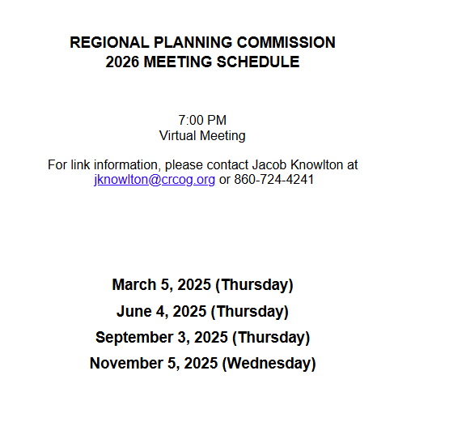
2. Adoption of 2026 Meeting Date

Slide 6
4.
A Presentation by CRCOG
Third Places: Social Infrastructure in the Capitol Region

Slide 7
5. CRCOG Updates
FYI – CRCOG is now @crcogct.gov!

Slide 8
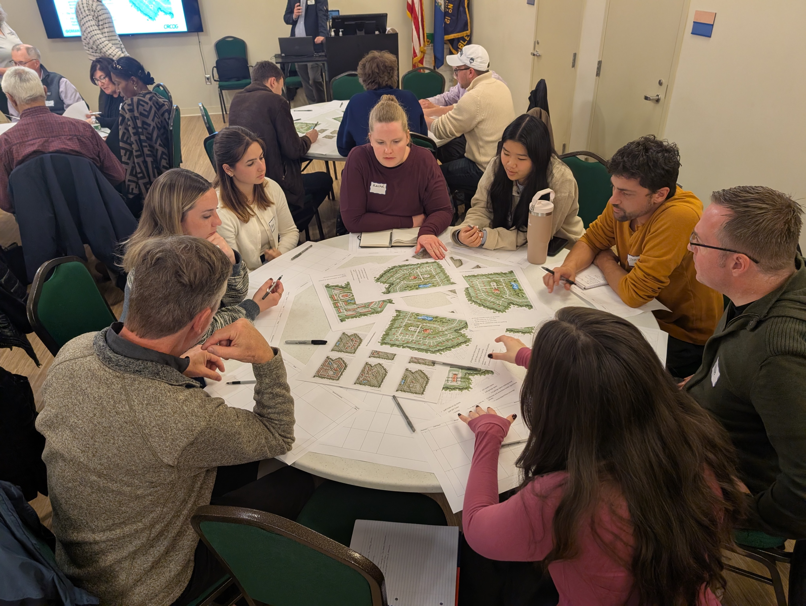
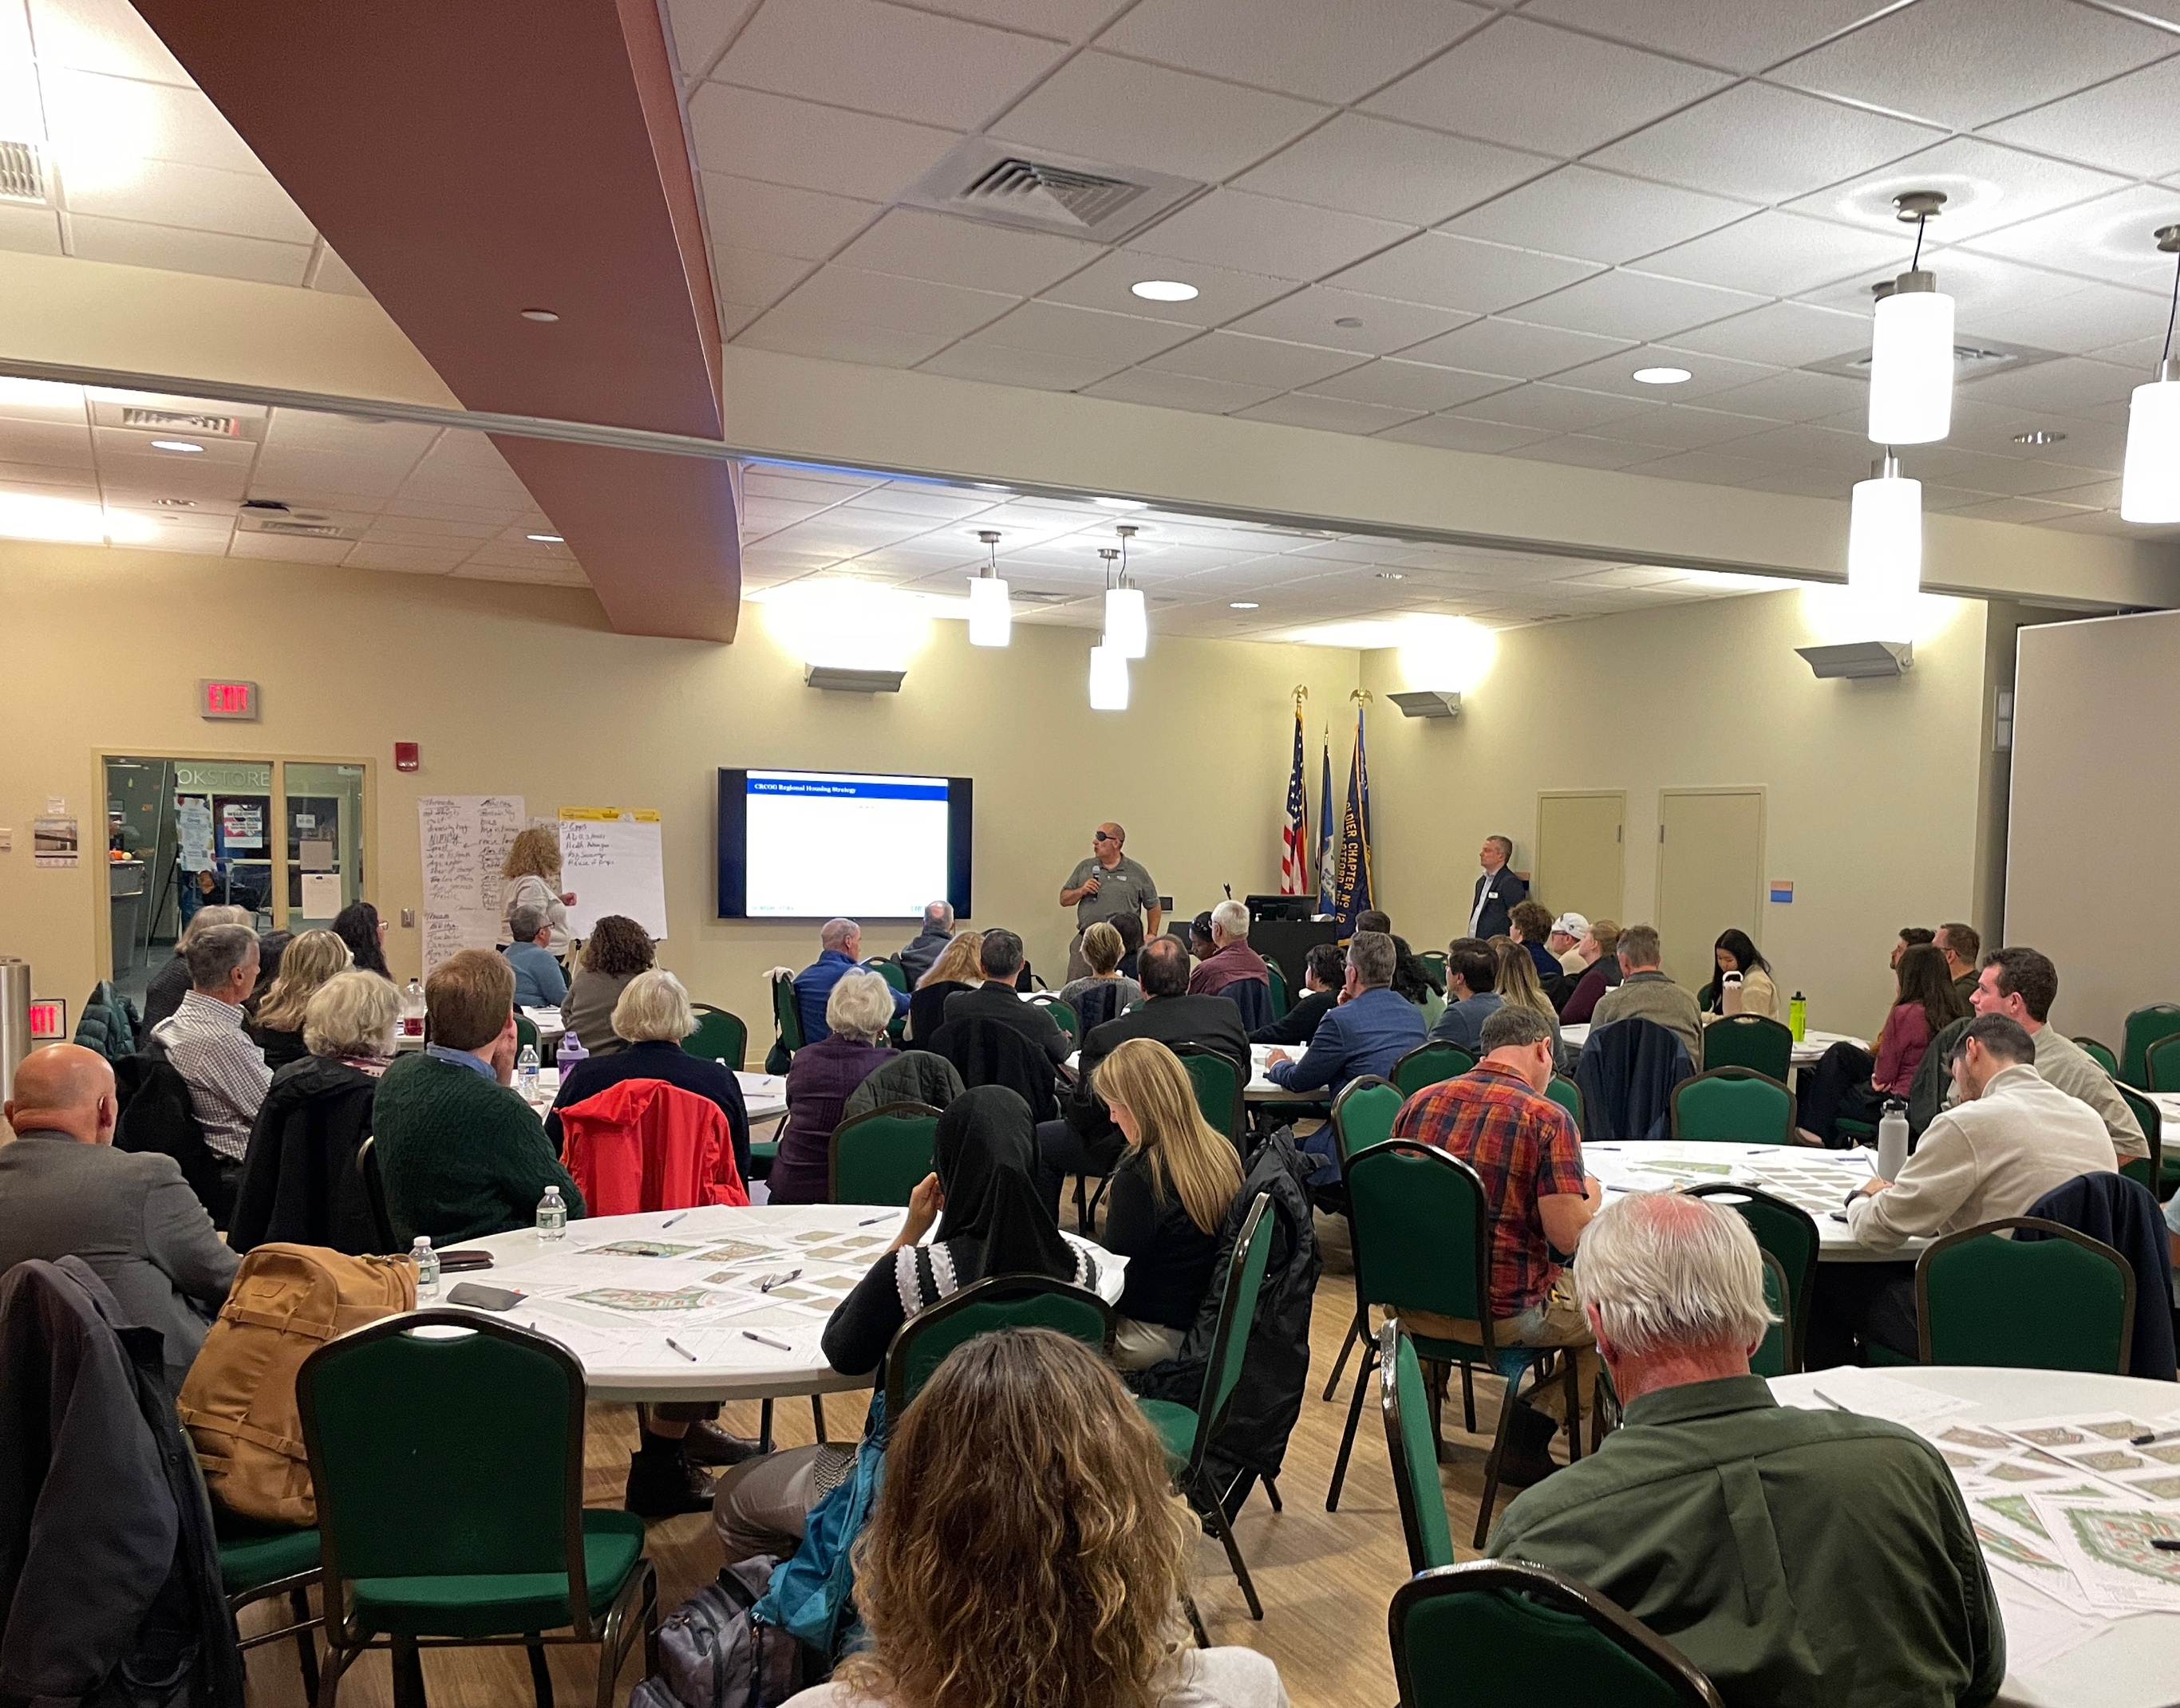
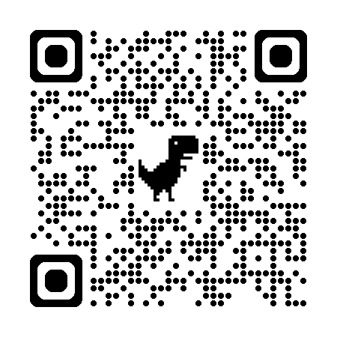
Regional Housing Strategy
Thank you for joining us at our Fall “Let’s Talk Housing” meetings.
Up next:
Dive into the Data (virtual workshop)
Wednesday, December 3 at 6:30 pm
Register here: https://us02web.zoom.us/meeting/register/5ka-I9z8S-KprbqjrIfyIw#/registration
Contact Heidi Samokar:
hsamokar@crcogct.gov
Notes:
https://crcogct.gov/regional-planning-and-development/housing/regional-housing-strategy/

Slide 9
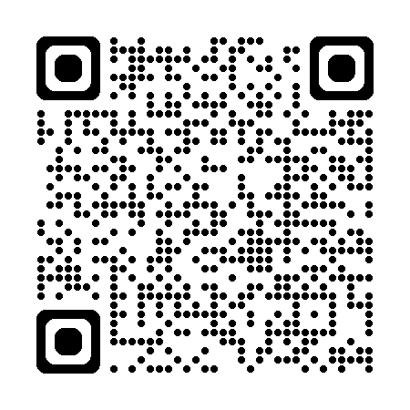
SB-9 Summary – Climate Resilience Bill
Section 11: Municipal POCD preparation
POCDs adopted on/after October 1, 2027, shall consider current hazard and climate projections
Section 12: Municipal POCD submission and consistency with regional POCD
Municipal planning commissions must submit their Plan, including geospatial data to OPM
Describe inconsistencies with the regional POCD
Section 16: Zoning regulations
Zoning must mitigate and avoid potential public health, welfare, and environmental consequences of sea level change
Read the full SB-9 summary here:
CRCOG SB-9 Summary
Contact Sonya Carrizales:
scarrizales@crcogct.gov

Slide 10

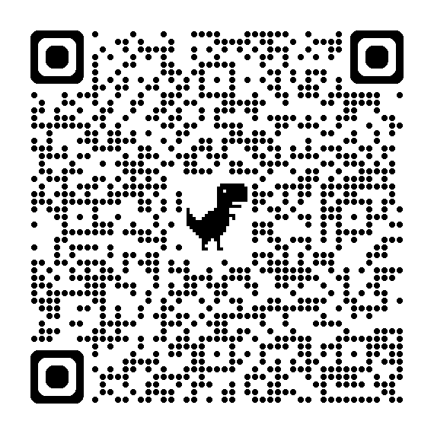
Free multi-day virtual conference on housing affordability, creation, choice, and stability across the state.
Register Here:

Slide 11
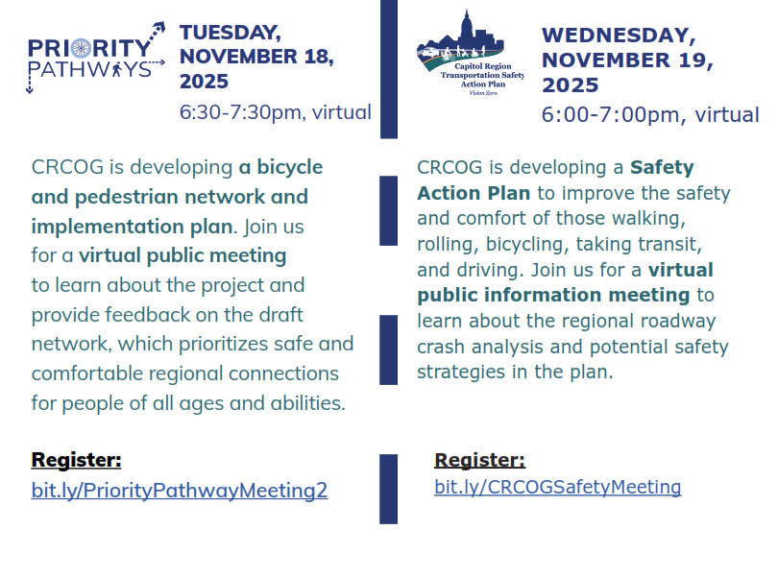
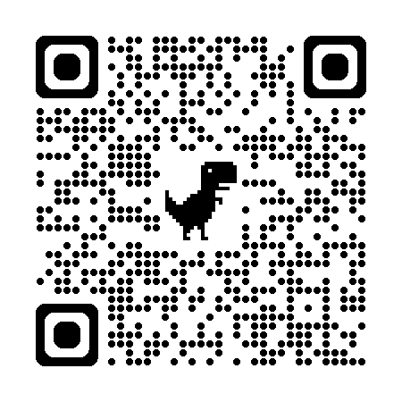
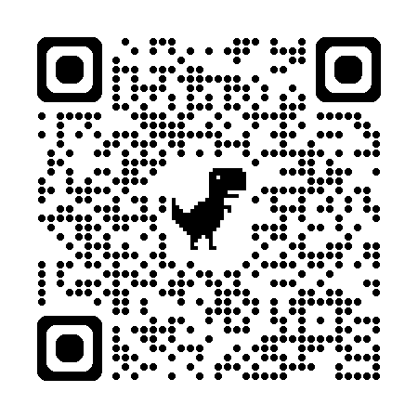
Register for the November 18th Meeting here
Register for the November 19th Meeting here
Notes:
https://crcogct.gov/warehousing-study/

Slide 12
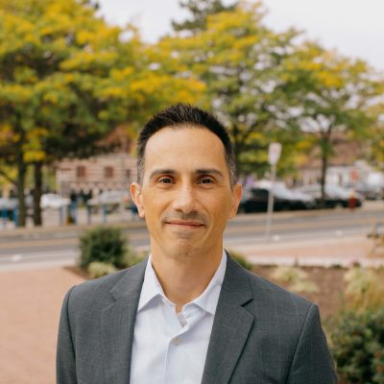
Connecticut Municipal Development Authority
(CMDA)
CMDA is a statewide initiative to create more housing in your downtowns and TOD areas.
CRCOG has designated Kyle Shiel to be primary liaison
Contact Kyle Shiel:
kshiel@crcogct.gov
Notes:
https://crcogct.gov/regional-planning-and-development/housing/regional-housing-strategy/

Slide 13
RPC Appointments
Need to have appointments in by the first RPC meeting of 2026
If you would like to renew your appointment let your planning staff know
We're going to switch to collecting all commissioners contact information
Notes:
https://crcogct.gov/warehousing-study/

Slide 14
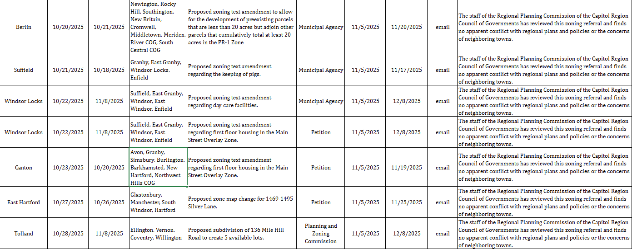
6. Report on Zoning and Subdivision Referrals

Slide 15

7. What’s New in My Town

Slide 16
8. Other Business
Training Opportunities sent via Email:
November 15, 2025: Land Use Academy Advanced Training (In-Person), hosted by UConn CLEAR
This training is eligible for all four (4) commission training hours.
Cost $60

