Slide 1
Regional Planning Commission
Welcome to a CRCOG Zoom Meeting
We have muted attendees upon entrance. We will unmute people either individually or for everyone depending on the situation.
For our public meetings, we will be taking a roll-call of attendance based on who we identify as being on the call and then ask those we cannot identify to state their name and town.
Each time you speak, you must identify yourself with your name and town prior to making your point.
If you are abstaining or objecting to an action item, please state your name and town.
Meeting materials are available at CRCOGCT.gov

Slide 2
Regional Planning Commission
Welcome and Introductions
Adoption of Minutes: June 5, 2025 (attachment)
A Presentation by Mike Zizka Counsel at Halloran Sage: Land-Use Case Law Update 2023-2025
A CRCOG Update
Report on Zoning and Subdivision Referrals
What's New in My Town
Other Business

Slide 3
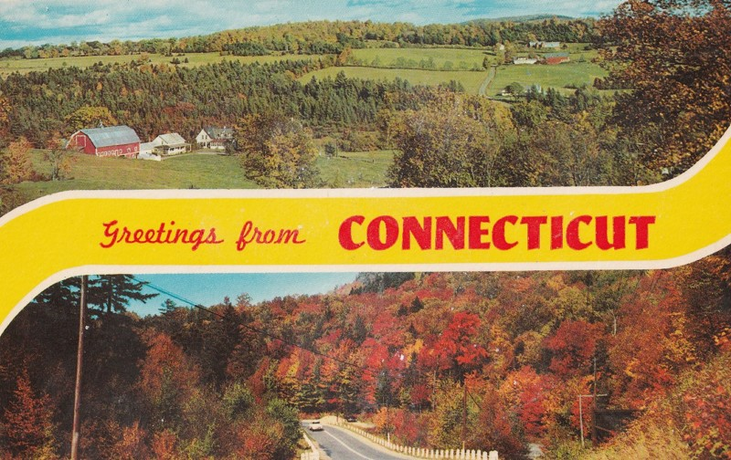
1. Welcome & Introductions

Slide 4
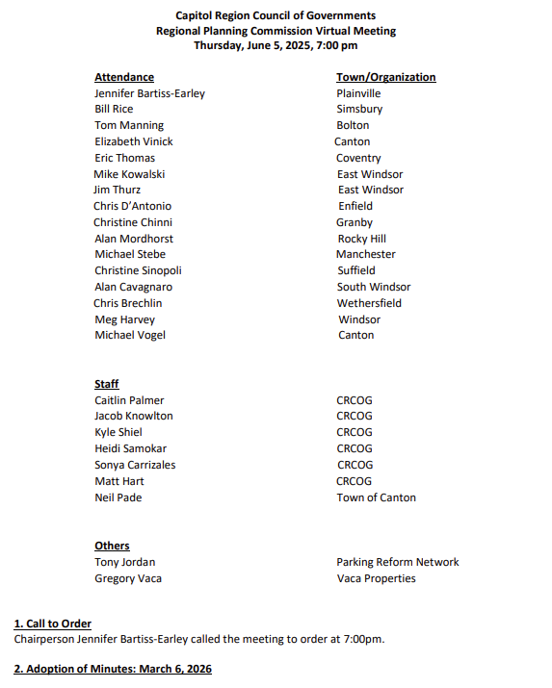
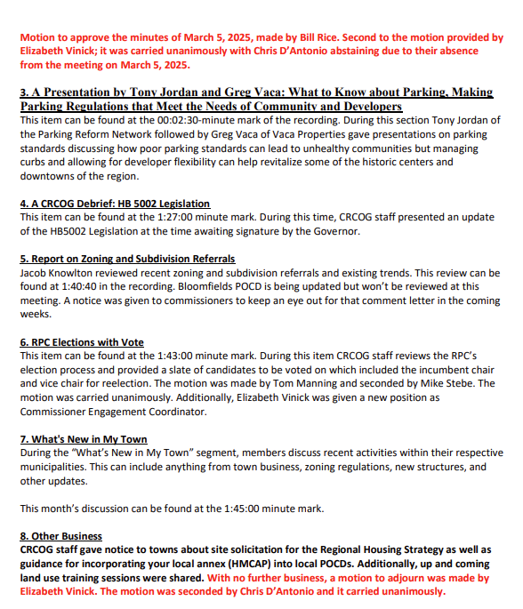
2. Adoption of Minutes: 6/5/2025

Slide 5
3.
A Presentation by Mike Zizka
Counsel at Halloran Sage:
Land-Use Case Law Update 2023-2025

Slide 6
4. CRCOG Updates
FYI – CRCOG is now @crcogct.gov!

Slide 7
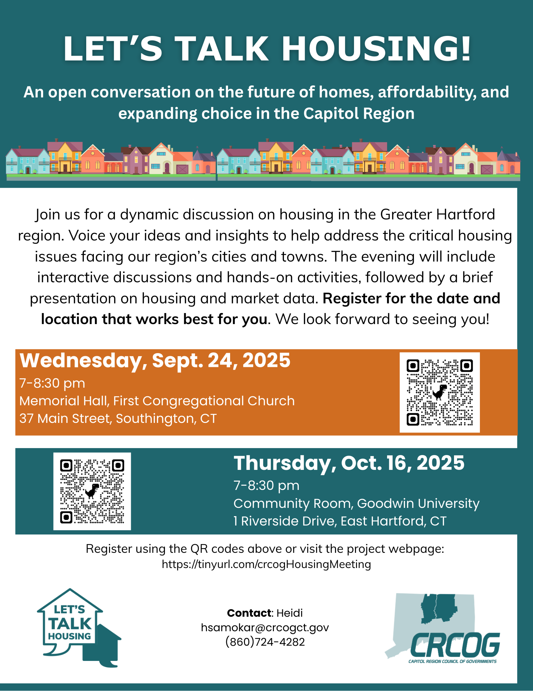
Regional Housing Strategy
Fall housing workshops – sign up to attend and help spread the word!
Register at: https://crcogct.gov/regional-planning-and-development/housing/regional-housing-strategy/
Contact Heidi Samokar:
hsamokar@crcogct.gov
Notes:
https://crcogct.gov/regional-planning-and-development/housing/regional-housing-strategy/

Slide 8
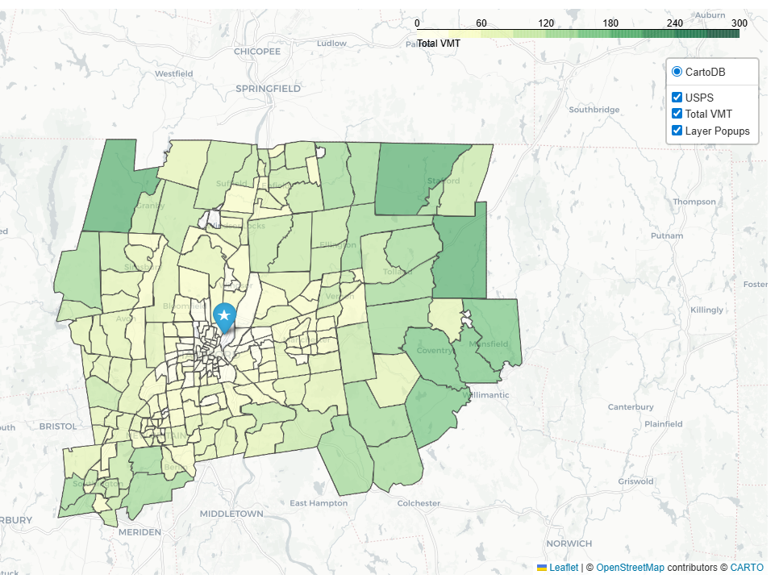
Regional Warehousing Study
Goal to better understanding of trip generation, environmental, brick-and-mortar retail impacts as well as transportation infrastructure and land development needs for warehouse and distribution centers
Tasks completed to date:
  Economic analysis and market projections
  Traffic counts
  Last Mile Analysis
Contact Kyle Shiel:
kshiel@crcogct.gov
Notes:
https://crcogct.gov/warehousing-study/

Slide 9

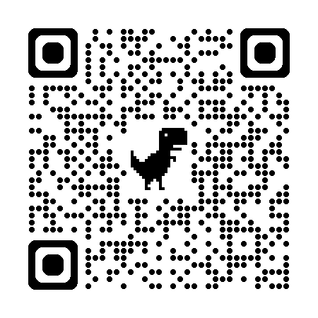
Third Places Topical Report
Home is the first place; work is the second place. Third Places are where we like to hang-out, make friends and connect with community. Third places are coffee shops, bars, bingo halls, clubs, and other spots often where conversation and laughter fill the space.
This report:
  Highlights what a third place is and where you may have seen one
  The benefits of third places for social well-being
  Outlines the lonliness epidemic
  Presents tiered solutions to support existing and invite new third places to the region
Contact Jacob Knowlton:
jknowlton@crcogct.gov
Notes:
https://crcogct.gov/warehousing-study/

Slide 10
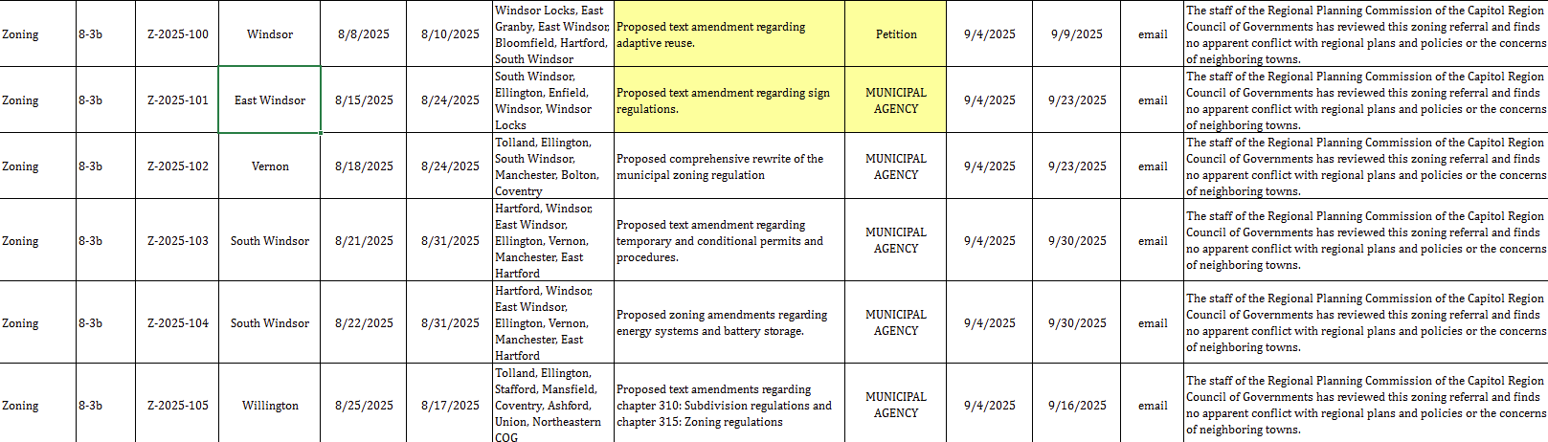
5. Report on Zoning and Subdivision Referrals

Slide 11
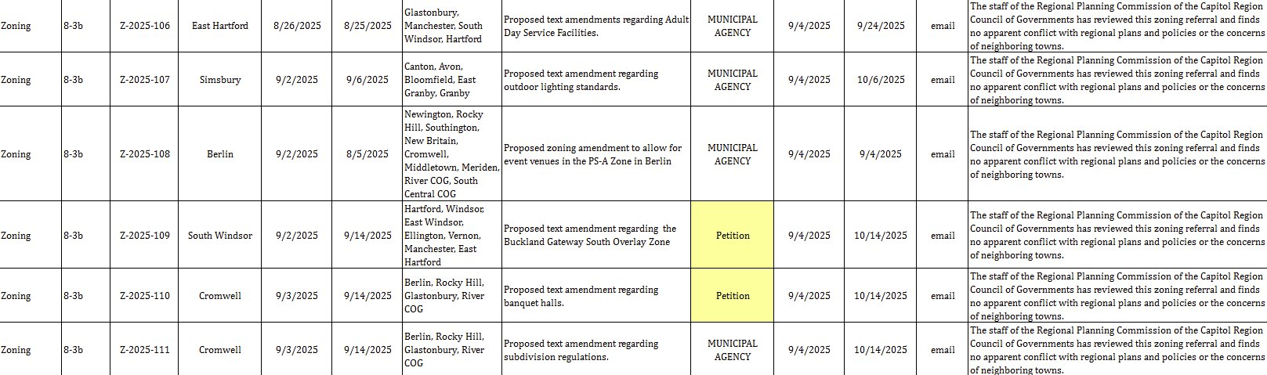
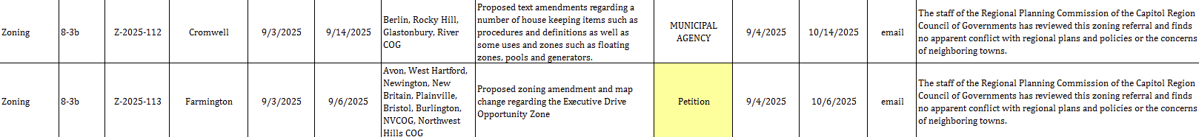

Slide 12

6. What’s New in My Town

Slide 13
8. Other Business
Training Opportunities sent via Email:
September 10, 2025: Community Renewable Energy Siting Tool (CREST) Introduction and Demonstration, presented by DEEP
This training may be eligible for one (1) commissioner training hour as per CGS Sec. 8-4c.
October 2025 Virtual Basic Training for New Commissioners Lunch Series
Thursday at 12pm
Most helpful to newly elected or appointed land use commissioners and board members. Each session may be eligible for one (1) hour of general commissioner training.
November 15, 2025: Land Use Academy Advanced Training (In-Person), hosted by UConn CLEAR
This training is eligible for all four (4) commission training hours.
Cost $60

