Slide 1
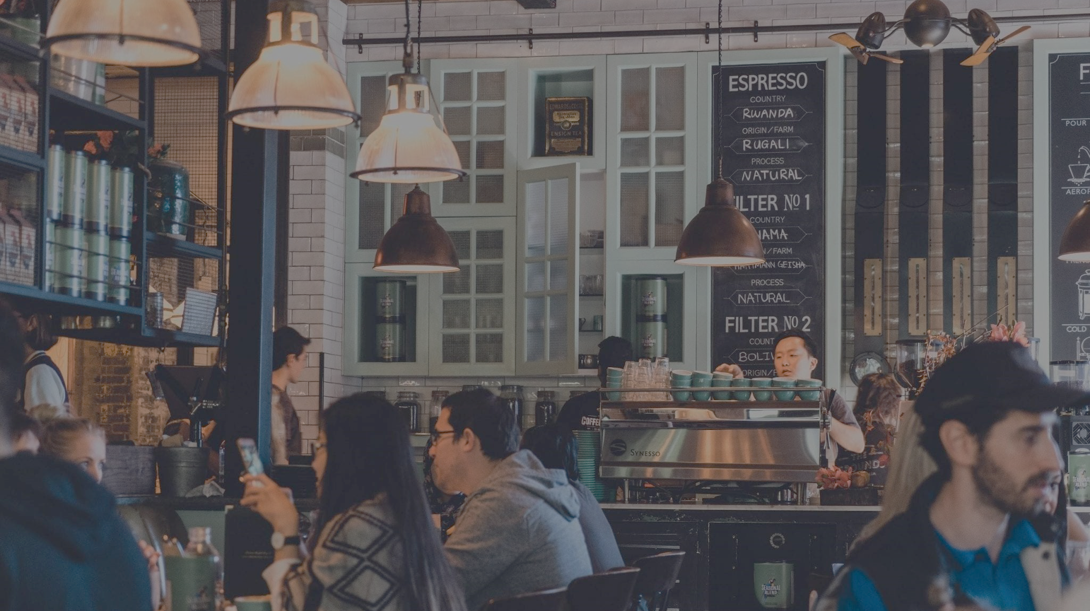
Third Places as Social & Economic Infrastructure

Slide 2
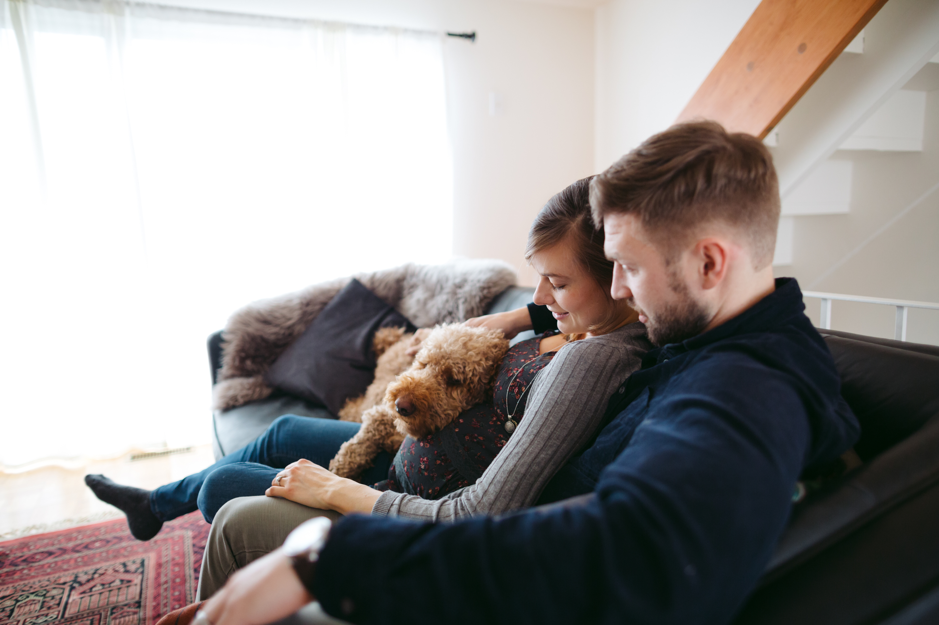

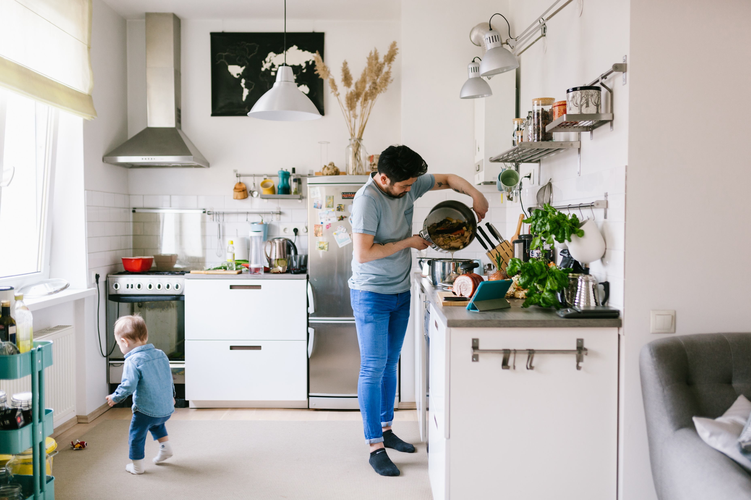

What’s A Third Place?
Home (1st Place)
Work or School (2nd Place)
Third Place
A social environment where you can enjoy the company of others
Separate from the home (the first place) and the workplace/school (the second place)

Slide 3
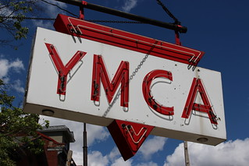
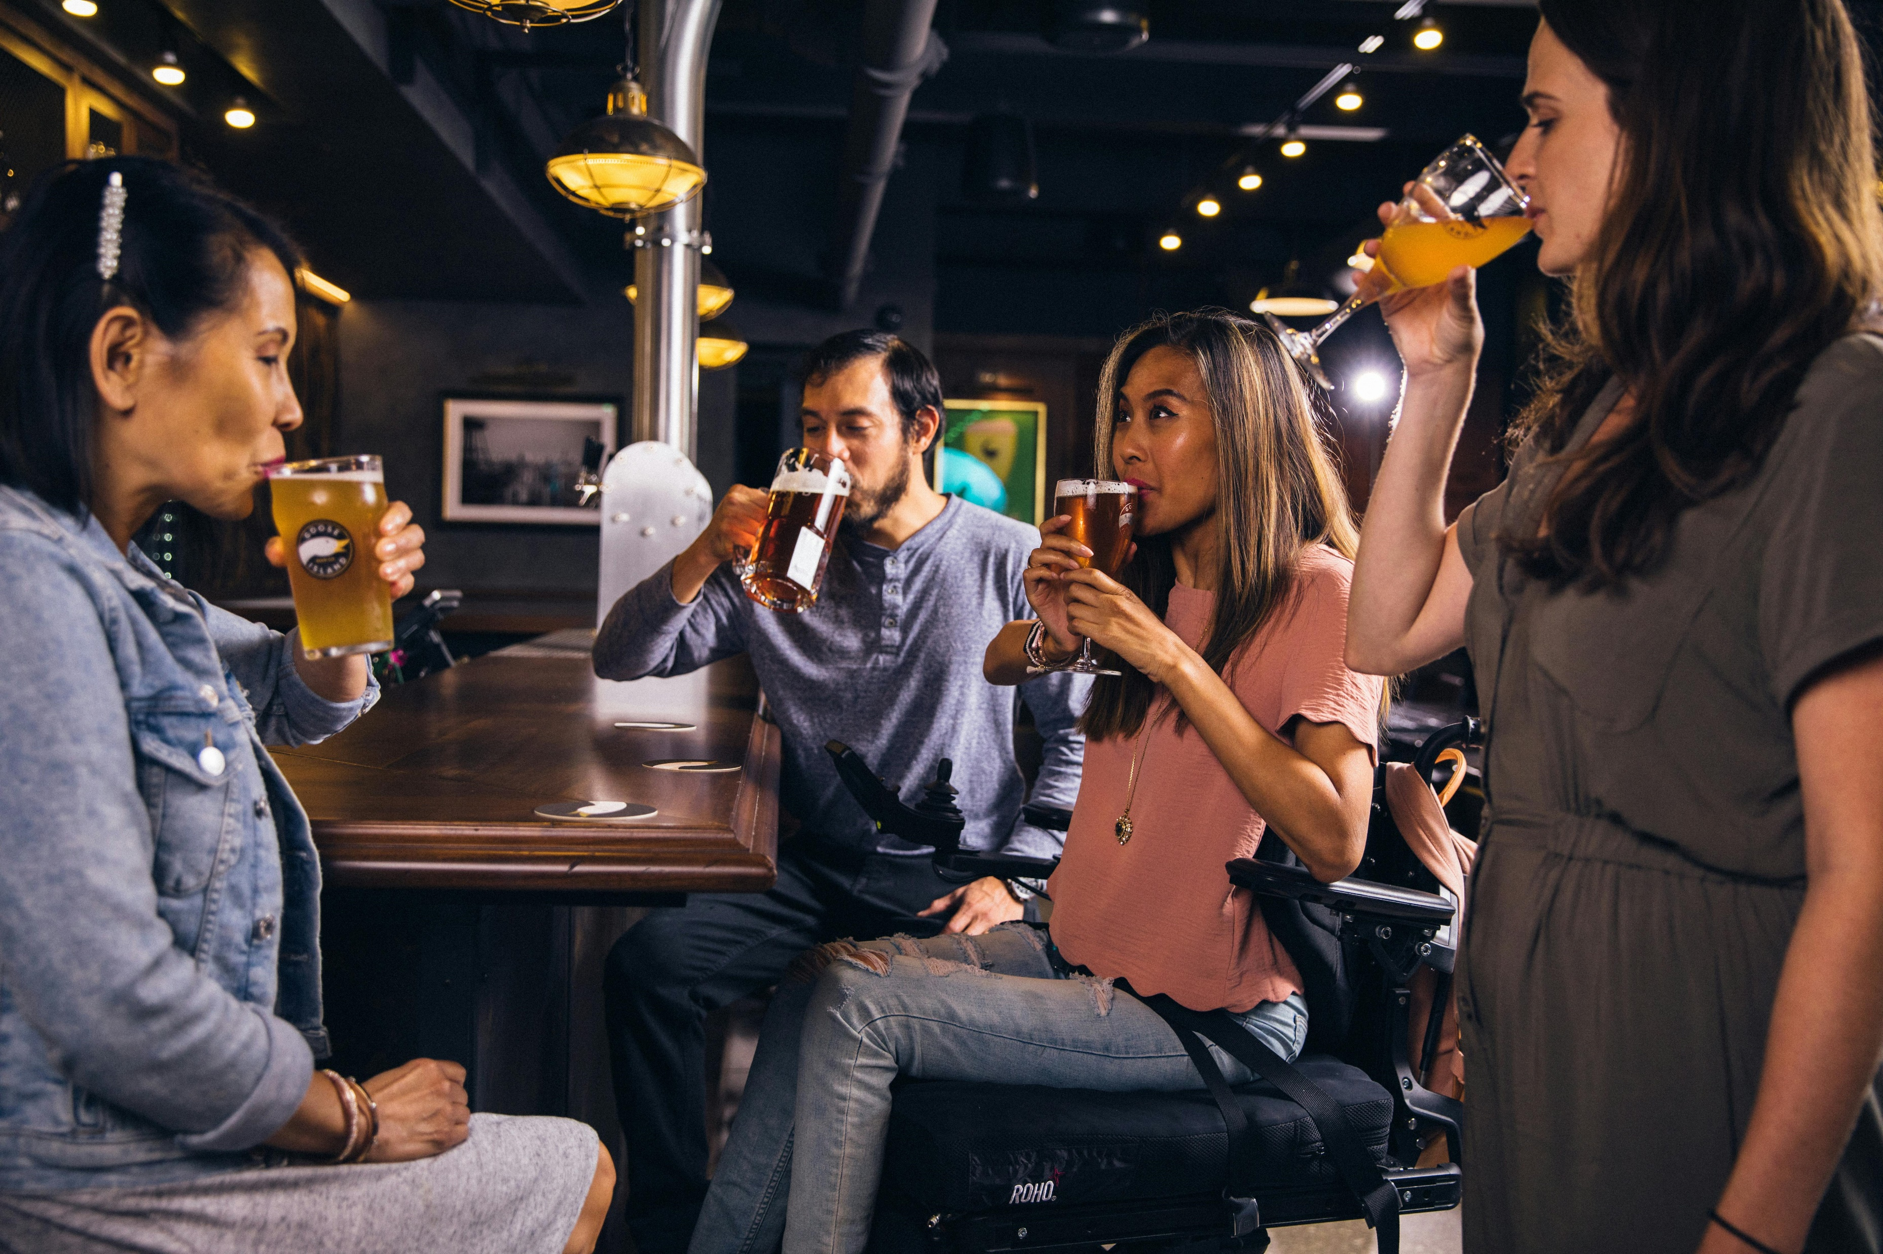

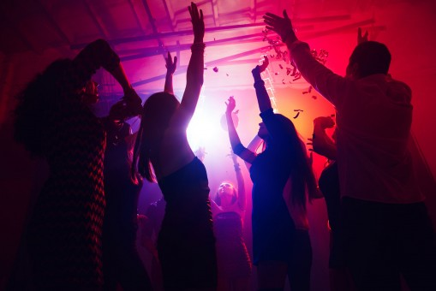
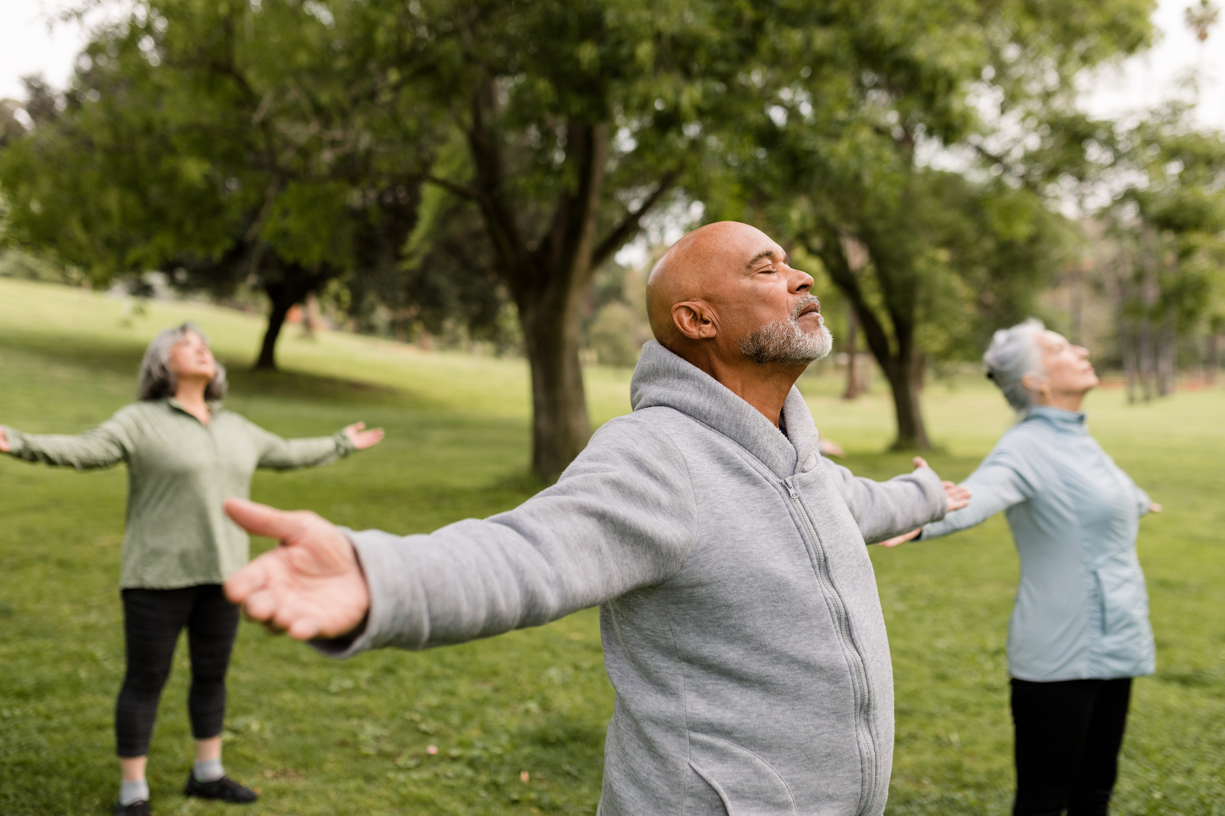
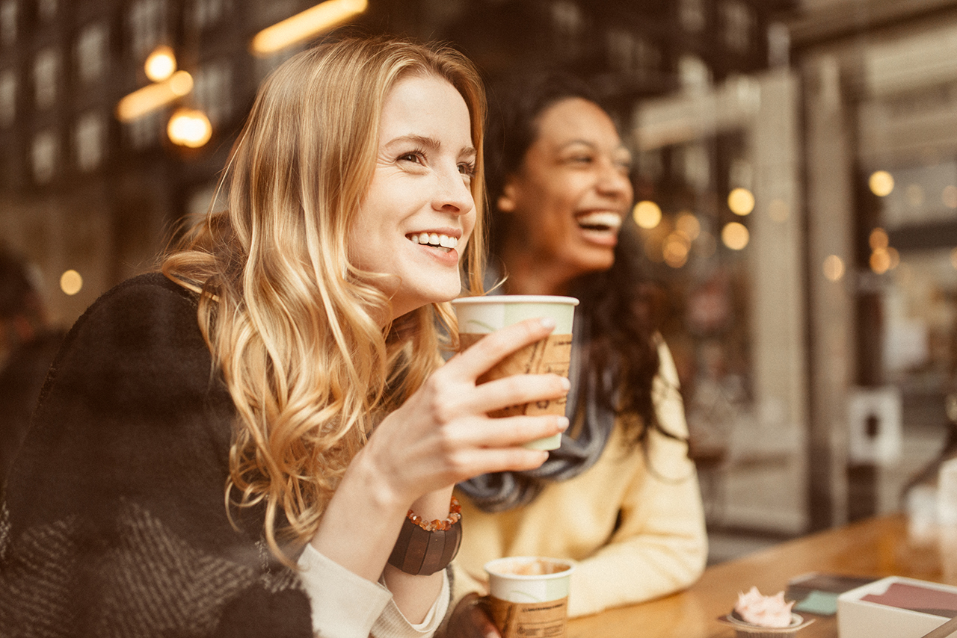
Examples of Third Places
Community Centers
Bars/Breweries
Libraries
Clubs
Public Parks
Cafes

Slide 4
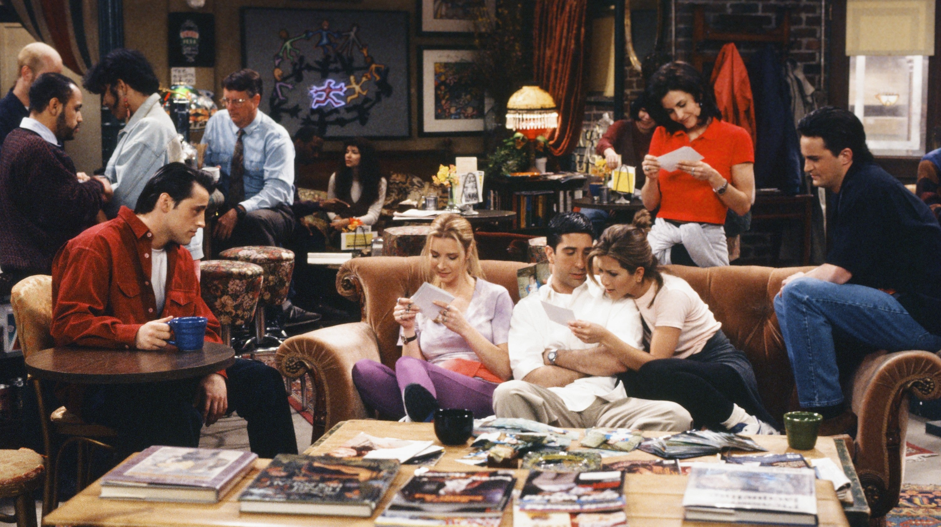
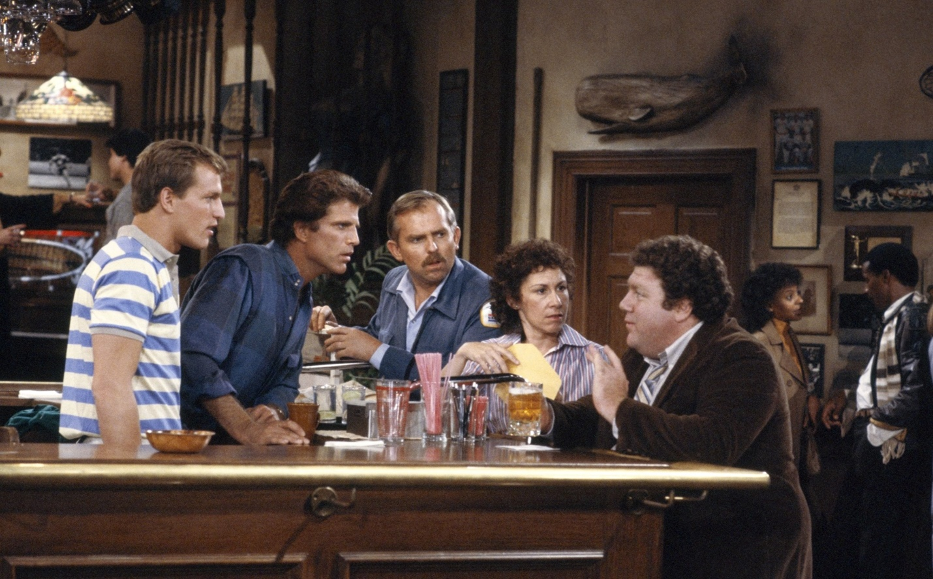
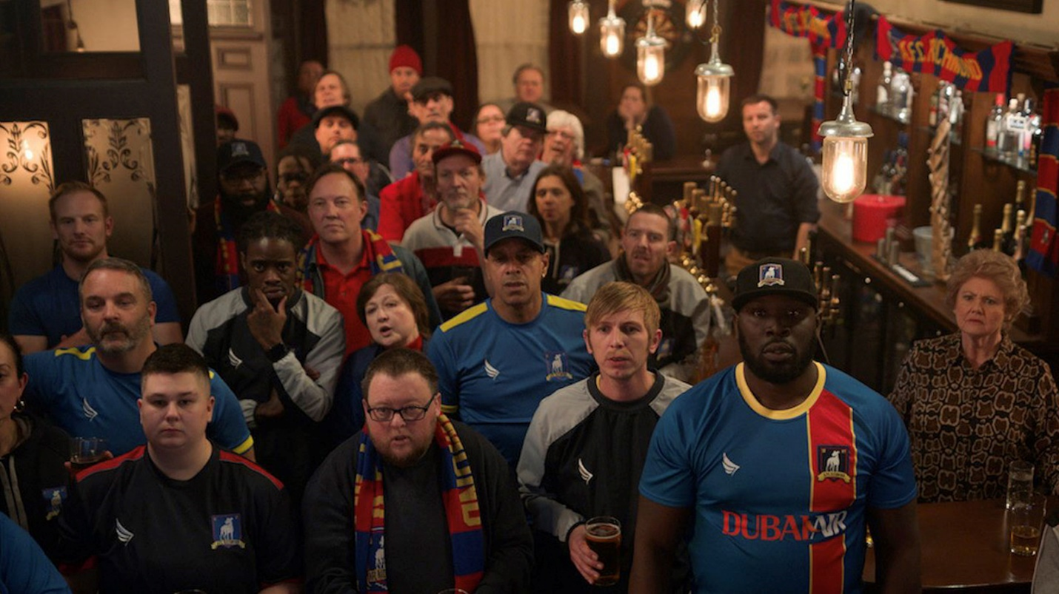
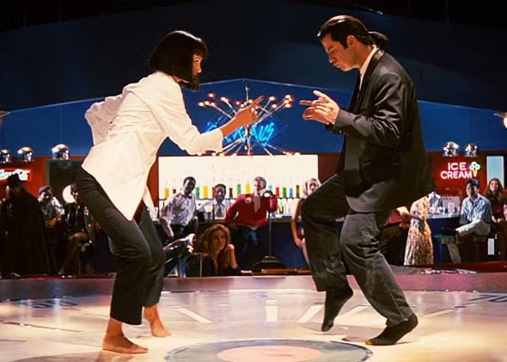
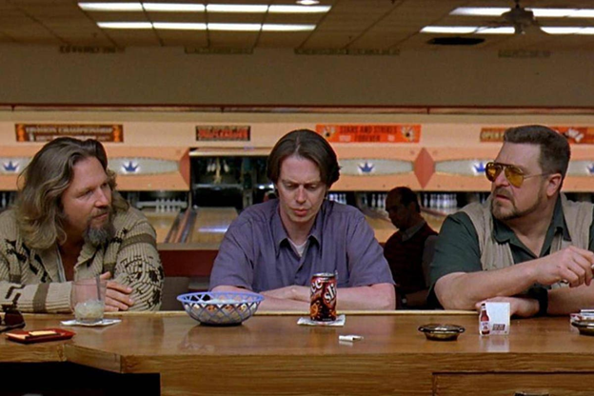
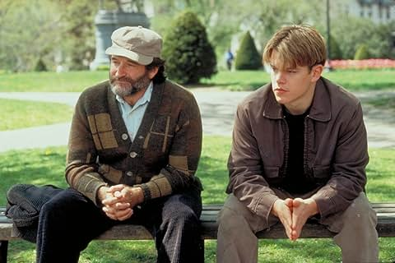
Third Places in Pop Culture
Friends
Cheers
Ted Lasso
Pulp Fiction
The Big Lebowski
Good Will Hunting

Slide 5
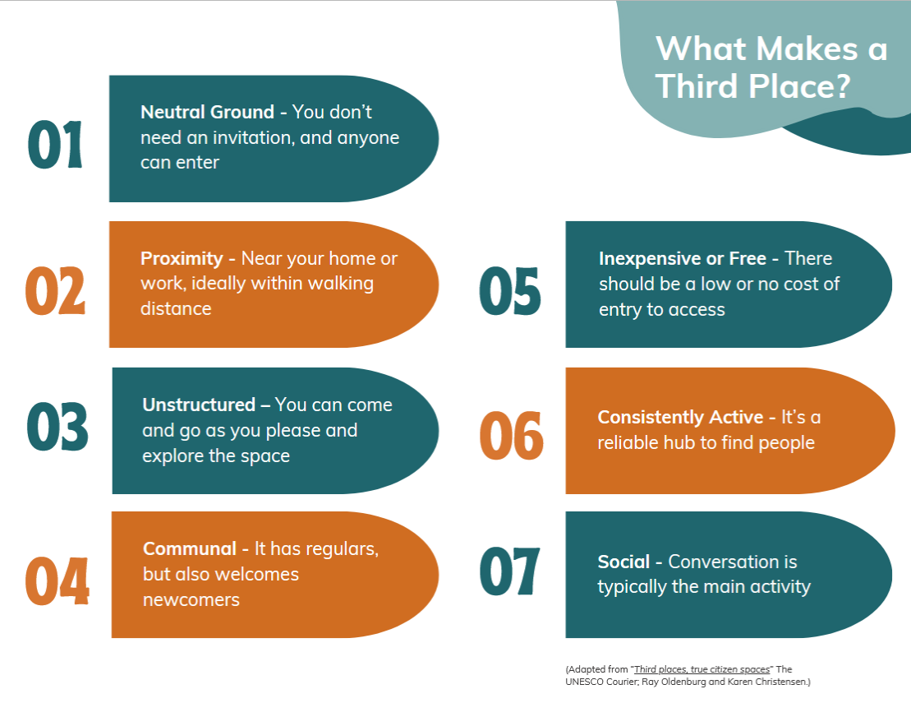

Slide 6

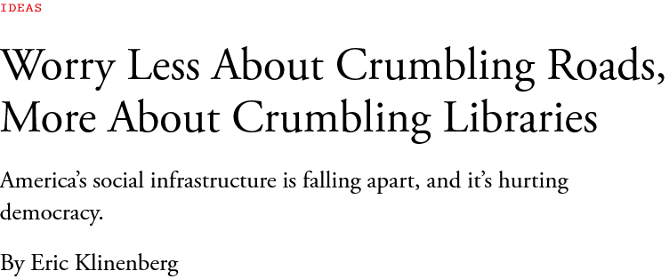

What is Social Infrastructure?
“Social infrastructure is not “social capital”— {…} —but the physical places that allow bonds to develop. When social infrastructure is robust, it fosters contact, mutual support, and collaboration among friends and neighbors; when degraded, it inhibits social activity, leaving families and individuals to fend for themselves.”

Slide 7
One-Person Households Have Doubled Since 1960
Source: US Census Bureau

Slide 8
Increased Screentime
Source: BOND Internet Trends (2019)

Slide 9
We spend more time alone…
And less with friends.
Source: Viji Diane Kannan, Peter J. Veazie, US trends in social isolation, social engagement, and companionship ⎯ nationally and by age, sex, race/ethnicity, family income, and work hours, 2003–2020

Slide 10
Source: American Perspectives Survey, May 2021; Gallup, 1990.

Slide 11

Public Health Impacts of Isolation
Approximately half of U.S. adults report experiencing loneliness, with some of the highest rates among young adults
Loneliness and isolation are more widespread than:
Smoking (12.5% of U.S. adults)
Diabetes (14.7%)
Obesity (41.9%)
Lacking social connection can increase the risk for premature death as much as smoking up to 15 cigarettes a day.

Slide 12
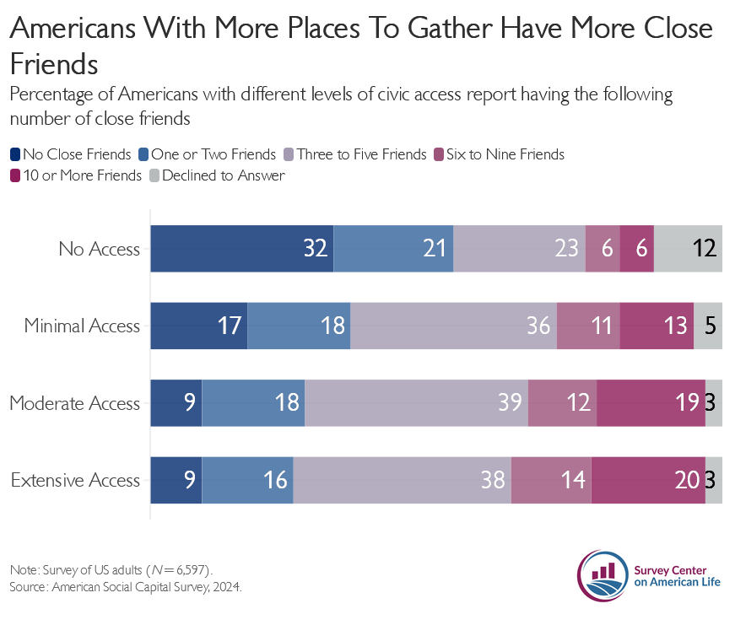

Slide 13
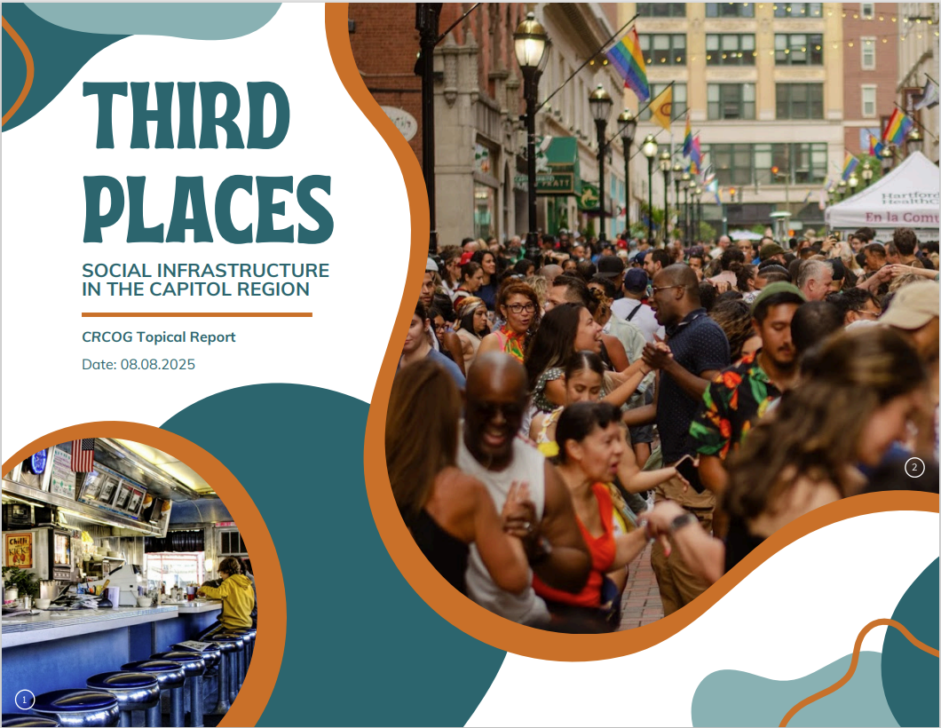
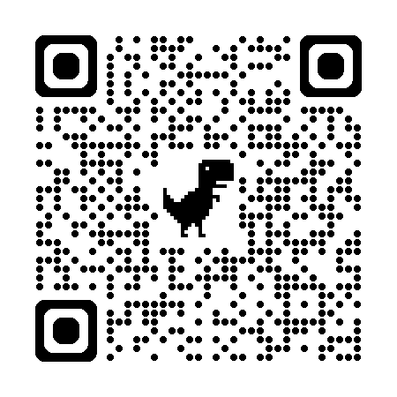
Getting Started: ​
Tasks requiring little time or financial commitment that can be completed by individual staff or small commission working groups​
Taking the Next Step:​
For communities willing to invest more staff and commission time to reducing third places barriers​
“All In” Actions:​
For communities exploring significant regulatory changes or capital investment that would likely require broader community buy-in

Slide 14
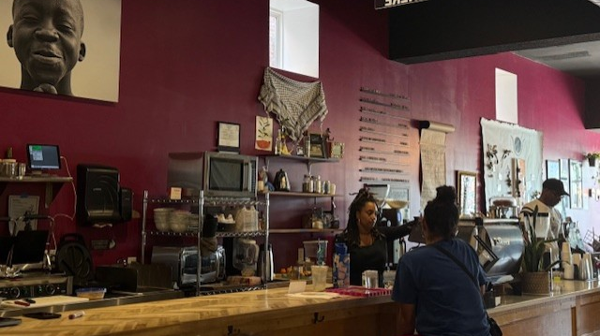
Getting Started:
Inventory What Exists
Take Time to Brainstorm What Third Places You Want
What type of spaces might you need more of?
What would make the area a place where you would hang out?
Does your community have demographics or social groups that would benefit from dedicated spaces?
Is there a lack of public seating?
Is there a need for shade?
Is the light in the area too dim to feel safe at night?
Meet with the owners & ask about their needs/pain points
Talk with Residents about Third Places
Bring Folks together to socialize about socializing

Slide 15
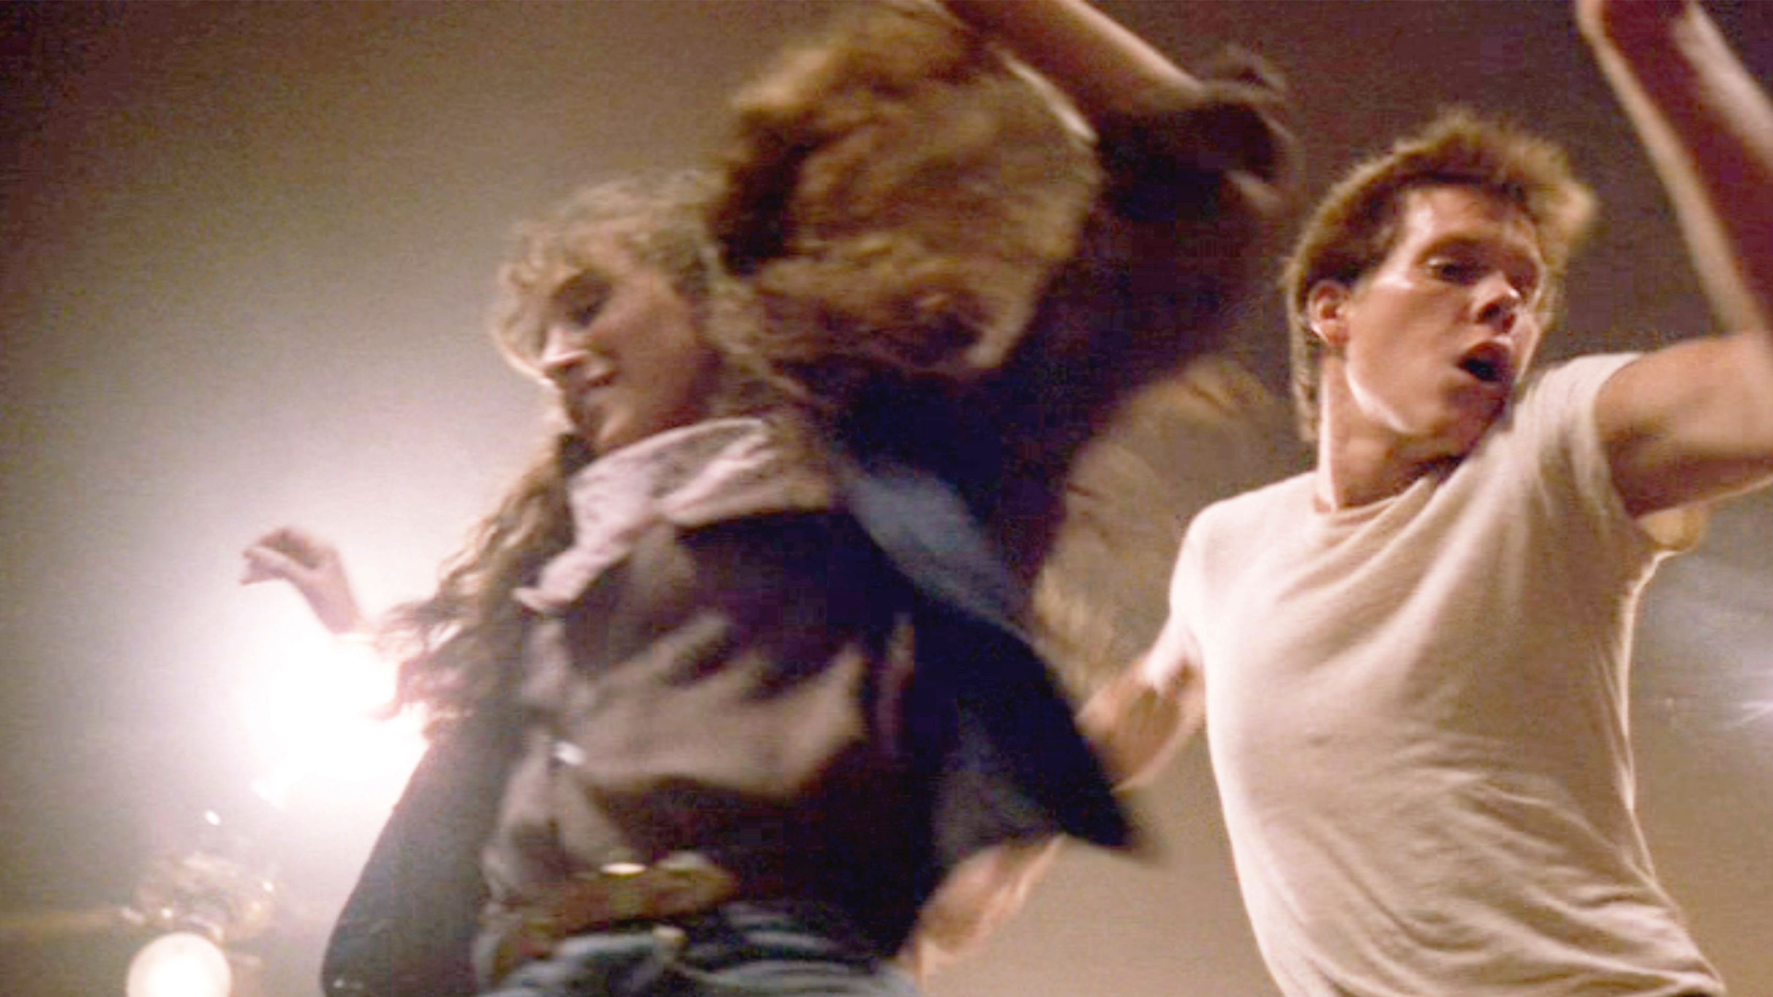
Taking the Next Step:
Review Design Standards to Encourage Unofficial Third Places as Part of Private Developments
Public Access points with seating and shade
Pocket Parks, Gardens, Plazas and Greens
Audit Zoning Regulations to Identify Barriers
Does your town resemble footloose? Is dancing indirectly outlawed?
Allows bars near Transit
Mix uses, not just in Mixed use building... Do I have to drive across town for coffee or can I get it on a morning walk?
Can I live within walking distance of where existing third places are?
Update Your Plan of Conservation and Development
Adopt (and Measure) Social Connection as an Outcome
Are people hanging out longer in your public space?
How many conversations do you see happening in these spaces?

Slide 16
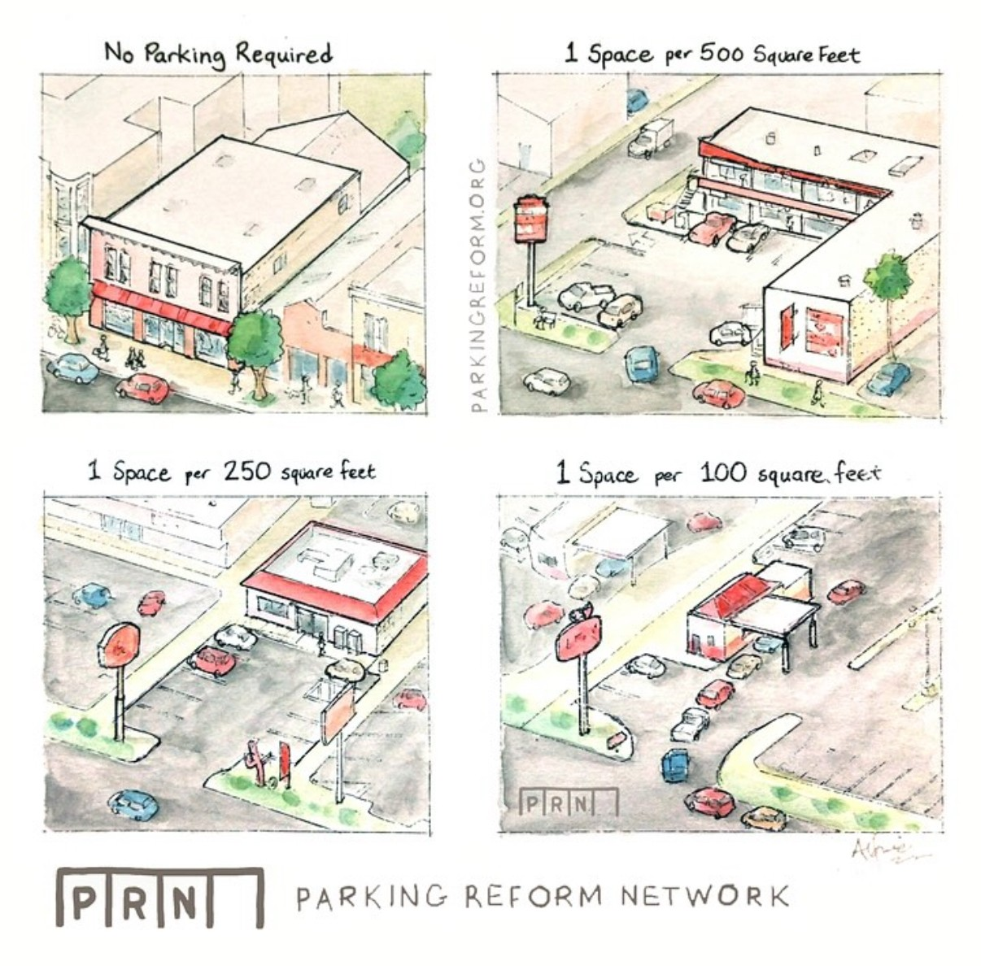
"All In" Actions:
Reduce or Find Alternative to Minimum Lot Sizes or Floor Areas
Ramen shop in Japan -> 385 sq ft
Café in NYC -> 600 to 1000 sq ft
Eliminate or Significantly Reduce Parking Mandates
Proactive Public Investment
Widen your sidewalks
Shovels in the ground: Parks, Plazas etc.
Comprehensively Evaluate Your Permitting Process for Unintended Roadblocks
Support Programs to Prevent Quality of Life Concerns

Slide 17
Thank You
To Read More Scan Here

Slide 18
