Slide 1
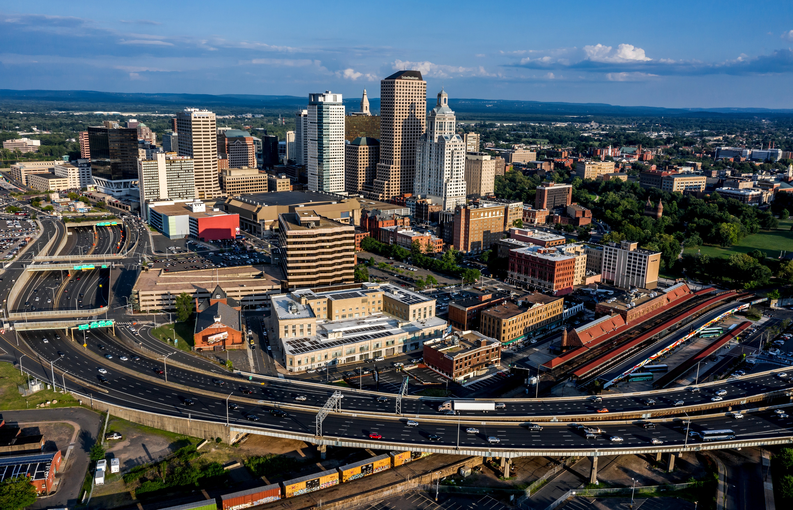



CCSWA Full Membership Meeting​
RWA Planning & Implementation Project​
October 20, 2025​
Planning Phase Progress​ Update

Slide 2
Our Team
H2M is a full-service engineering, environmental and architecture firm that provides design, construction and environmental monitoring consulting services for solid waste facilities and management programs.
Role:
Project management
Stakeholder outreach
Report development
We are planners, engineers, environmental specialists, designers, and communication experts driven by a passion to enhance communities while helping our clients advance projects.
Role:
Stakeholder outreach
Report development
Public education
Notes:
Joe

Slide 3

About the Project
CRCOG has been awarded a Connecticut Department of Energy and Environmental Protection (DEEP) Regional Waste Authority (RWA) grant to provide resources for analysis, planning, and implementation of solid waste management & recycling programming and facilities to:
Evaluate the potential for its member municipalities and other municipalities to join the existing Central Connecticut Solid Waste Authority (CCSWA), and
Evaluate waste advisory, support, and other services to be made available through CCSWA to existing and potential member municipalities.
Notes:
JOE: The overarching goal is two-pronged, to grow CCSWA membership and identify what CCSWA can do regionally. Focus on the needs and challenges of local municipalities and the actions that will have the greatest tangible benefits.

Slide 4
Project Tasks
Phase 1: Planning
Purpose
To produce a report which will assess the state of existing waste management and diversion programs, services and infrastructure within the CRCOG region, and develop an action plan to increase CCSWA’s membership and services to support identified needs and service gaps.
Task​ | Description​
A​ | Literature Review & Data Collection​
B​ | Meetings​
C​ | CRCOG Member Survey​
D​ | Plan Development​
E​ | Report Writing – Draft​
F​ | Report Writing – Final​
Phase 2: Implementation
Tasks TBD by Outcome of Phase I

Slide 5
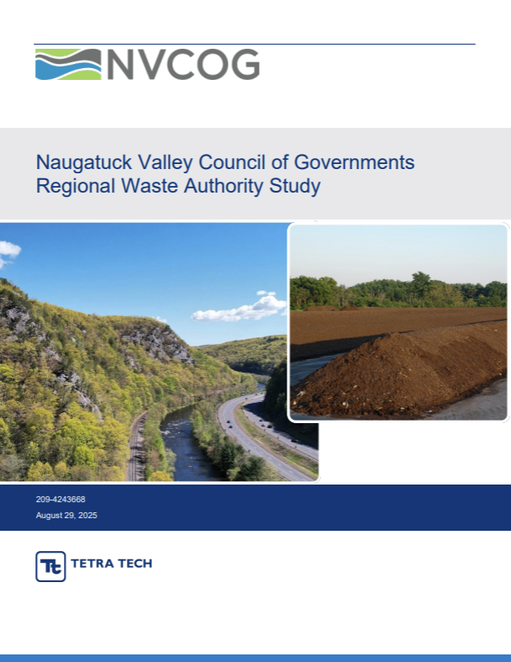
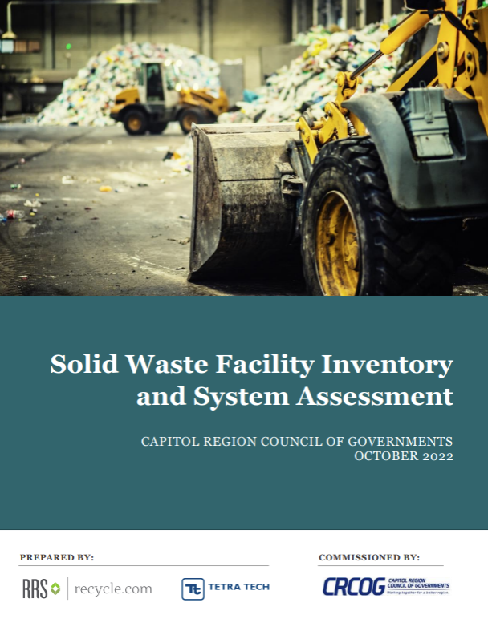
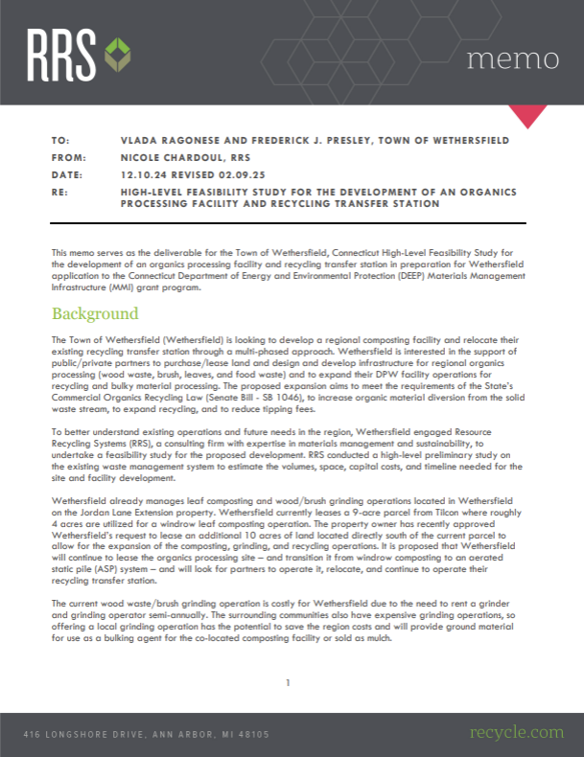
Status: Task A
Phase 1: Planning
Task​ | Description​
A​ | Literature Review & Data Collection​
B​ | Meetings​
C​ | CRCOG Member Survey​
D​ | Plan Development​
E​ | Report Writing – Draft​
F​ | Report Writing – Final​
Literature Review – Complete​
Data Collection – Received from CT DEEP 10/15
Collecting regional data from CRCOG​
Budget – on target​

Slide 6
Status: Task B
Phase 1: Planning
Task​ | Description​
A​ | Literature Review & Data Collection​
B​ | Meetings​
C​ | CRCOG Member Survey​
D​ | Plan Development​
E​ | Report Writing – Draft​
F​ | Report Writing – Final​
Several productive calls with team and Robyn
10/20 CCSWA Full Membership Meeting
Anticipate Monthly Updates to CCSWA Executive Committee in November & December
Budget – close to expended

Slide 7


Status: Task C
Phase 1: Planning
Task​ | Description​
A​ | Literature Review & Data Collection​
B​ | Meetings​
C​ | CRCOG Member Survey​
D​ | Plan Development​
E​ | Report Writing – Draft​
F​ | Report Writing – Final​
Several weeks of survey development
Draft survey shared with CCSWA Executive Committee, feedback incorporated
Developed Communication Plan including teaser, survey notice, and reminders
Survey distributed by CRCOG 10/16, currently live
Budget - complete
If you have not already done so, please complete the survey!

Slide 8
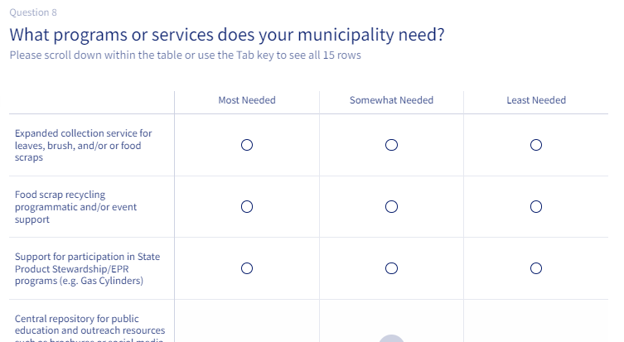
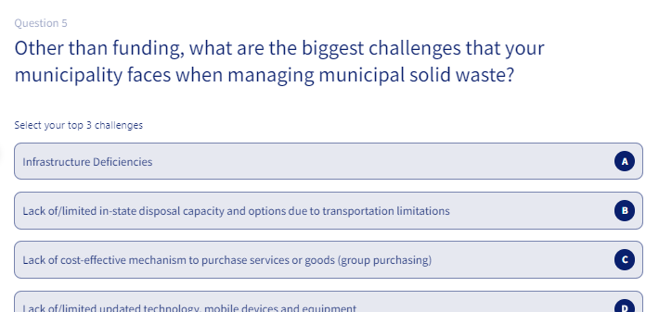
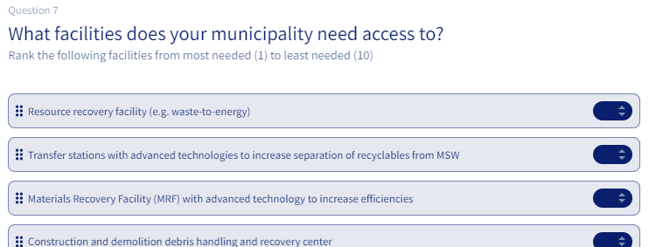
Status: Task C
SURVEY GOAL: to identify local municipal needs & challenges to inform the Planning Report and determine action items for the Implementation Phase.
Notes:
Focus on local municipal needs and challenges, prioritize low hanging fruit. By obtaining input both from municipal leaders, solid waste managers and planners to shape a plan that will implement regional services to support waste management and recycling programs and services, with a focus on organic materials, throughout the CRCOG region. Example of propane tank recycling (new state product stewardship program). Plastic film that can be recycled into benches. Small successes leads to tangible benefits that could help increase membership and show a path for increased cooperation.

Slide 9
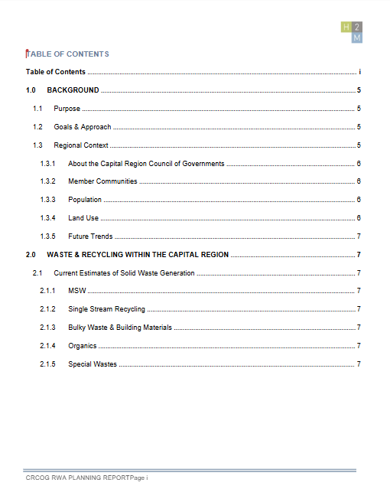
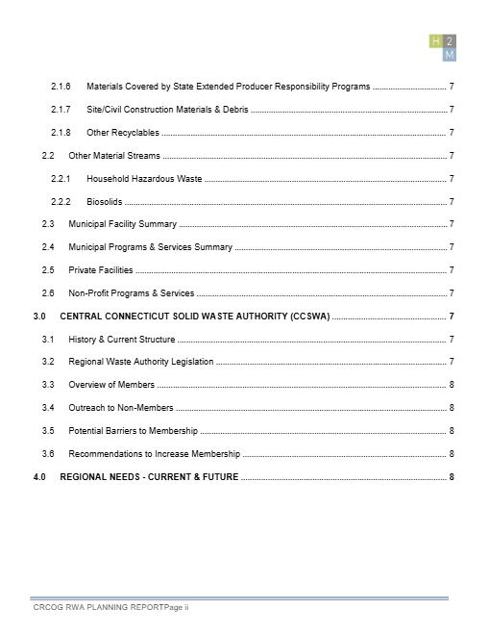
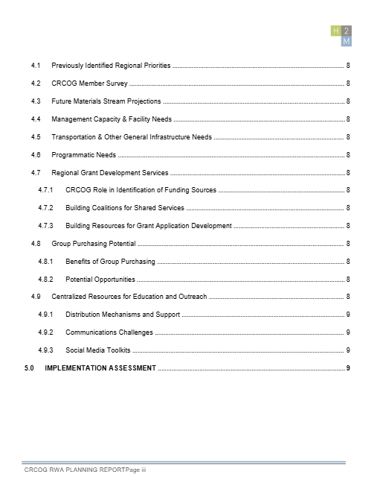
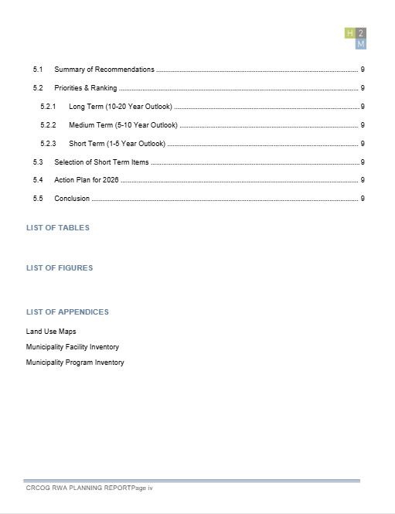
Status: Task D
Phase 1: Planning
Draft TOC (High Level) submitted to Robyn10/10
Final TOC will be informed by survey results & budgetary limitations
TOC will be finalized as survey data analysis is completed, with a goal of a final TOC deliverable by end of October
Budget – On Target
Task​ | Description​
A​ | Literature Review & Data Collection​
B​ | Meetings​
C​ | CRCOG Member Survey​
D​ | Plan Development​
E​ | Report Writing – Draft​
F​ | Report Writing – Final​
DRAFT

Slide 10
Status: Tasks E & F
Phase 1: Planning
Task​ | Description​
A​ | Literature Review & Data Collection​
B​ | Meetings​
C​ | CRCOG Member Survey​
D​ | Plan Development​
E​ | Report Writing – Draft​
F​ | Report Writing – Final​
H2M advancing municipal facility and program inventory for 38 CRCOG members
Team is waiting for Survey Results to finalize report scope
80% Draft with Executive Summary due to Robyn 12/12/2025
Schedule- on target
Budget- planning report content refinement is underway to keep the planning phase budget on track

Slide 11

Thank You​​

