Slide 1

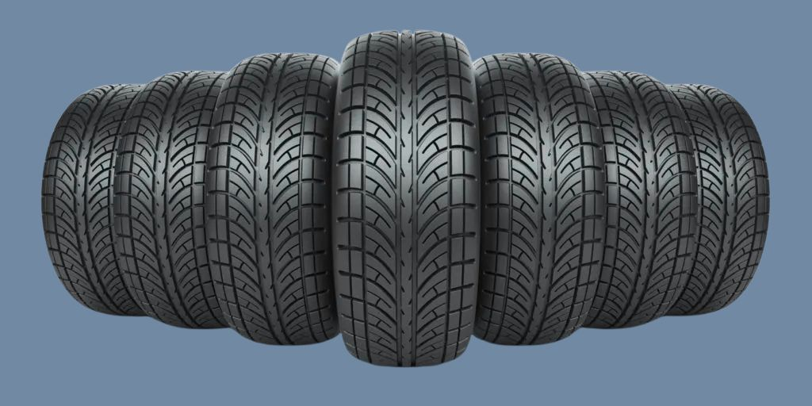
A New Approach to End-of-Life Tire Management
Briefing for the CCSWA Executive Committee
Jesse Schofield
Executive Director
Connecticut Tire Stewardship
NOVERMBER 17, 2025

Slide 2
What is CTS?
Connecticut Tire Stewardship (CTS) is a nonprofit organization created in response to the new state law and is now has an approved Tire Stewardship Organization plan by DEEP.
Formed with support from tire producers and the U.S. Tire Manufacturers Association, though governed independently.
Program was approved by CT DEEP to design, operate, and oversee the system.

Slide 3
Where We Are Now
Plan approved: September 22, 2025 (LINK)
Program launch: March 21, 2026
Current focus: Engaging Producers, briefing key stakeholders, building the statewide network of covered entities, drafting participation agreements, and developing the process for covered entities
Communications and reporting: Launching statewide education and outreach to residents and stakeholders

Slide 4
A New Future for Connecticut’s Tires: Powering the Circular Economy
Hundreds of thousands of tires reach the end of their useful life in Connecticut each year.
Improper disposal can lead to illegal dumping, fire risk, mosquito breeding, and costly cleanups, often paid for by municipalities.
Those same tires are a valuable resource at the center of a thriving and profitable economic ecosystem: they can be retreaded, become roads that improve a state’s infrastructure, be remade into tire-derived aggregate, and everyday commercial products like mats, garbage cans, flooring tiles, automotive parts, and more.
Connecticut passed the first extended producer responsibility law for tires.
(2023 with amendments in 2024)

Slide 5
Building a Statewide Tire Management System
Producers: Fund the program, provide data on tires into CT Market.
Covered Entities: Voluntary drop-off sites including municipal transfer stations, waste facilities, retailers, auto shops, fleets, and distributors.
Transporters/Tire Haulers & Processors: Collect and recycle tires into new products.
CTS: Coordinates partners to create a statewide collection and recycling system.

Slide 6
How Extended Producer Responsibility Works
EPR requires manufacturers, brand/trademark owners, and importers to take responsibility for products at end-of-life.
Tire producers must fund the statewide system for collection, transportation, and recycling. Fees are paid by the PRODUCERS, not a customer point of sale.
The goal: make tire disposal free and convenient for residents, improve environmental outcomes statewide, and advance the circular economy by turning end-of-life tires into new products through smart, scalable recycling (market development).

Slide 7
CTS Responsibilities and Commitments
Establish a free, statewide drop-off network in partnership with covered entities.
Provide compliant storage containers
Provide system to coordinate and/or identify eligible tire pickup vendors.
Contract with qualified collectors and recycling facilities.
Supply signage, educational materials, and communication tools.
Coordinate with municipalities and regulators on measures to help prevent non-eligible tires from entering the system.
Shift financial and logistical responsibility for tire disposal away from municipalities and toward producers, simplifying local operations and improving outcomes statewide.

Slide 8
Which Tires Are Covered by the Program?
Included:
Passenger or Light Truck, commercial vehicle, motorcycle, off-road, including those mounted on rims
Heavy-duty truck and bus tires
Lawn and Garden tractor, golf carts, ATV
Agricultural, construction, mining, and industrial tires
Non-commercial aircraft, trailer, or mobile home tires
Not included:
Tires from toys, bicycles, personal mobility devices, or commercial aircraft

Slide 9
Covered Entities: What Participation Looks Like
Covered entities may include: transfer stations, recycling centers, retailers, auto shops, dismantlers, and fleet facilities.
CTS manages all collection and transportation costs, provided no disposal fees are assessed to residents.
CTS will provide suitable storage containers when necessary.
Participation details, including what types or volumes of tires a site will accept, will be determined in coordination with CTS and participation agreements.

Slide 10
Benefits for Municipalities
Reduces municipal costs for tire collection, hauling, and disposal, freeing up budgets for other priorities.
Reduces staff time spent on logistics while improving service for residents.
Expands free, convenient disposal options that reduce dumping incentives and improve site management.
Improves recycling outcomes and reduces public health and environmental risks from improperly handled tires.
Provides outreach materials and statewide reporting data to support local education, planning, and enforcement efforts.

Slide 11
What’s Next?
Outreach: In late November or December, CTS will share a comprehensive explainer on participation, operations, and site logistics. This will allow your municipality’s solid waste management contact to evaluate joining CTS and determine what your collection site would need in order to participate.
Enrollment: CTS will launch an online data system where municipalities can complete enrollment and submit the information required to establish their collection site.

Slide 12


Q&A
This program represents a major step forward for Connecticut’s communities. Realizing its full potential will depend on your partnership, and your willingness to speak up in support when the time comes.
Jesse Schofield
Jesse@recycletiresct.com
https://recycletiresct.com
To learn more, sign up here:

