Slide 1
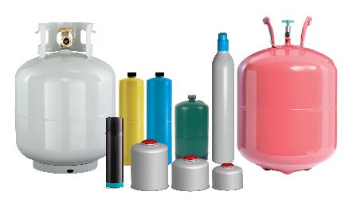
The Cylinder Collective (TCC) Stewardship Program for Pressurized Gas Cylinders in Connecticut
CRCOG Meeting
December 15, 2025
David Keeling
Executive Director
The Cylinder Collective
414-644-0139
DavidKeeling@cylinderindustry.org
www.cylindercollective.org/
Kim O’Rourke
State Program Coordinator
The Cylinder Collective
860-412-4399
kimorourke@cylindercollective.org
www.cylindercollective.org/

Slide 2


Gas Cylinder EPR in Connecticut
Public Act 22-27 passed in 2022; Amendment passed in 2024 (Public Act 24-133)
The Cylinder Collective (TCC) is one of the stewardship organizations developed to responsibly manage gas cylinders
TCC Stewardship Plan was approved by DEEP in 2023
Program Launched: October 2025
What do I do with small gas cylinders?

Slide 3
Why EPR for Gas Cylinders?
Increase free and accessible options for disposal
Increase proper management of cylinders
Reduce the impact on the environment
Reduce the burden on municipalities
Industry funded and managed
Develop communication and partnership among stakeholders
Creates an efficient, sustainable system

Slide 4
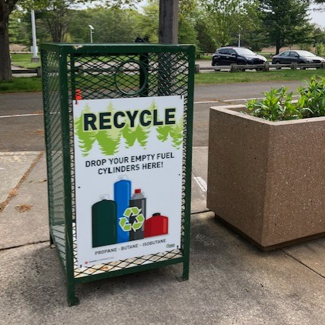
Collection Sites in Connecticut
Campgrounds
HHW Events and Facilities
Transfer Stations
MRFS & Solid Waste Facilities

Slide 5
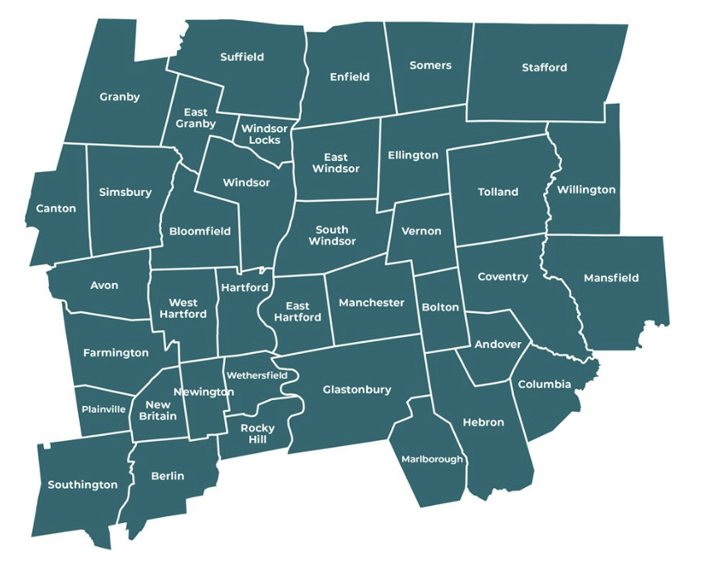
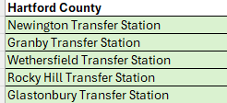

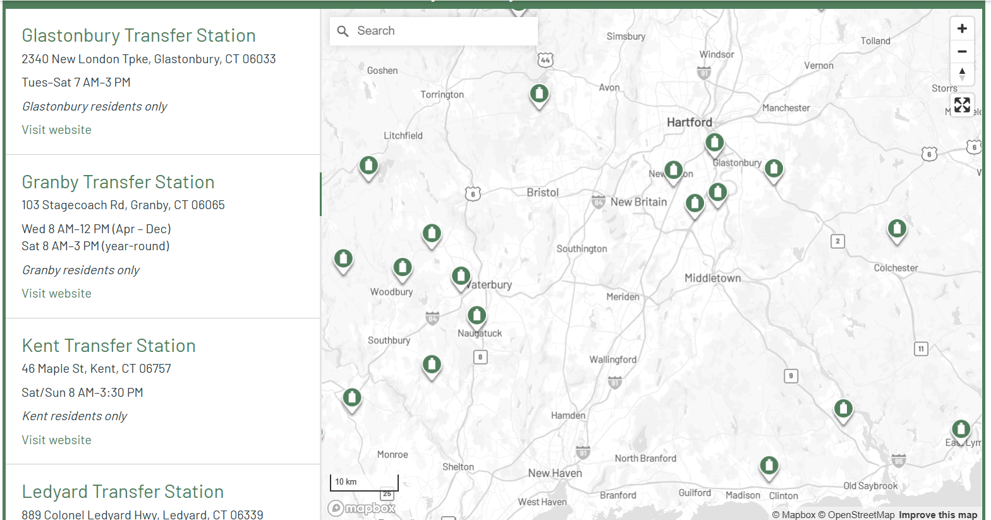
Actively Collaborating with CRCOG Municipalities

Slide 6
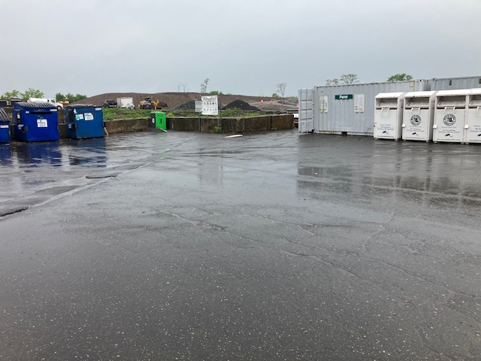
Municipal Transfer Station Collection Site Information

Slide 7
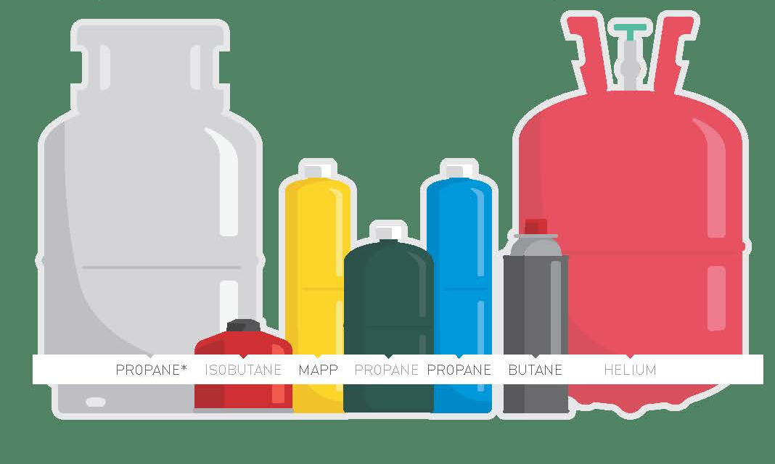
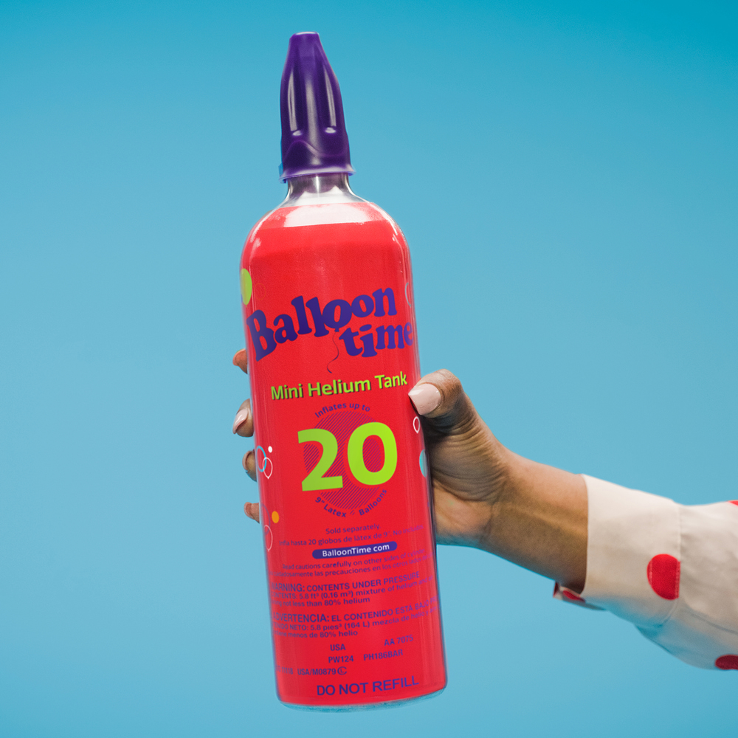
Acceptable Cylinders with TCC Program
Residential cylinders only
Small butane, isobutane, helium, propylene (MAP) and propane cylinders used for camping, torch and balloon inflation
Propane cylinders must be under 20 lbs.
Note: cylinders do not have to be empty
New and Acceptable
2 lb. Helium Cylinder
Notes:
Refillable and non refillable

Slide 8

Unacceptable Cylinders with the TCC Program
NO 20 lb. (BBQ tanks) or larger propane tanks
NO Industrial, commercial and institutional gas cylinders
NO cylinders containing carbon dioxide, oxygen, refrigerants, acetylene, hydrogen, ethylene, nitrous oxide, and spray foam adhesives.
NO fire extinguishers, candle or cigarette lighters
NO Vapes or Nitrous Oxide Cylinders

Slide 9
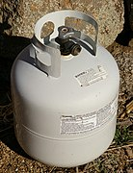
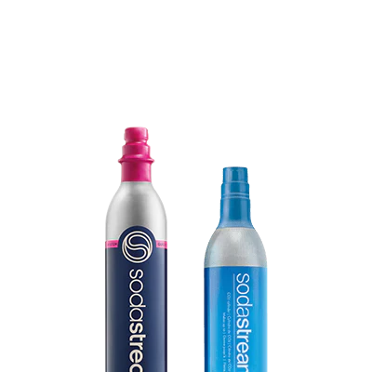
Other CT DEEP approved programs for gas cylinders
Propane Gas Association of New England (PGANE) -
20lb. propane tanks for BBQ grills
Gary Haines, 888-445-1075; gary@pgane.org
pgane.org/safetyandtraining/tankrecycling/
Soda Stream – Refillable CO2 cylinders
Roxanne Parker, 800-727-1835
sodastream.ordersusa@pepsico.com

Slide 10
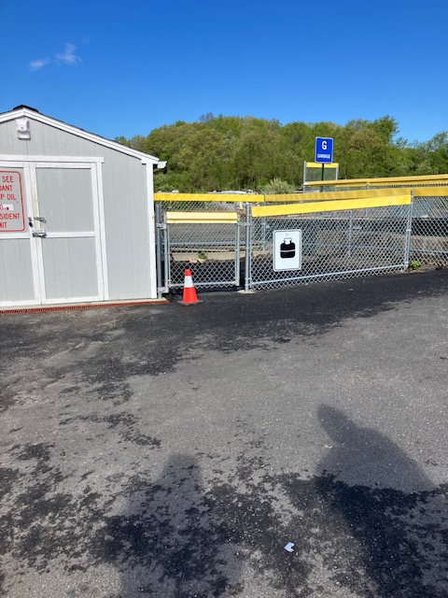
Transfer Station Storage Area
Per DEEP Municipal Transfer Station General Permit
Well ventilated
Secure fencing
Signage

Slide 11
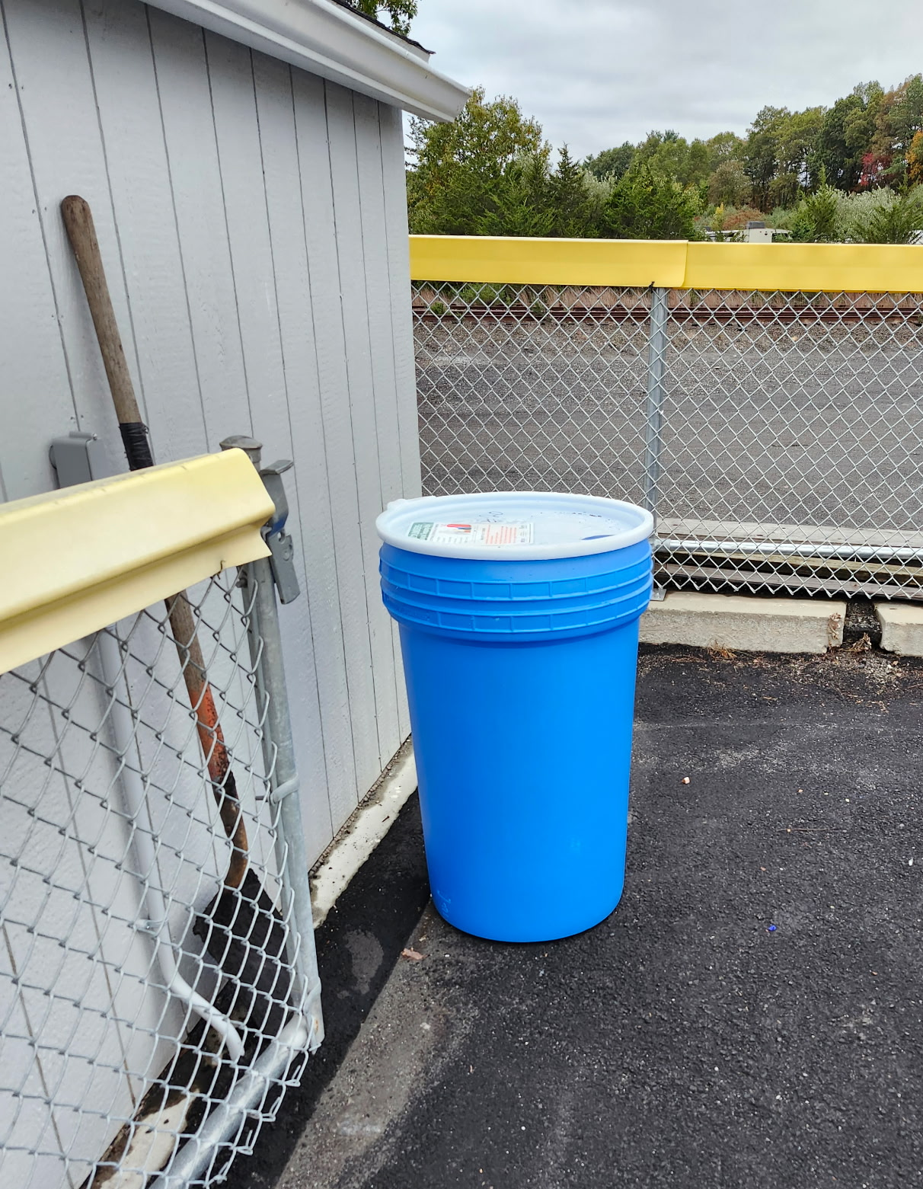
Storage and Collection of Cylinders
Labeled barrel delivered to site
Call 860-412-4399 or use QR code on the barrel when ¾ full for pick up
Place small cylinders in the container
Place larger ones outside, standing up on the ground
Give us a count of how many are on the ground. Pictures are helpful.

Slide 12
Signage and Outreach Materials
Provided by TCC
Outreach Kit Mailing:
Transfer Station Signage, Employee Poster, Resident Information cards
Coming in 2026
Flyers/brochures for residents
Posters for residents
Newsletter content
Banners by request
Employee training & manual
Electronic Delivery:
Website banners, Resident Information, social media

Slide 13
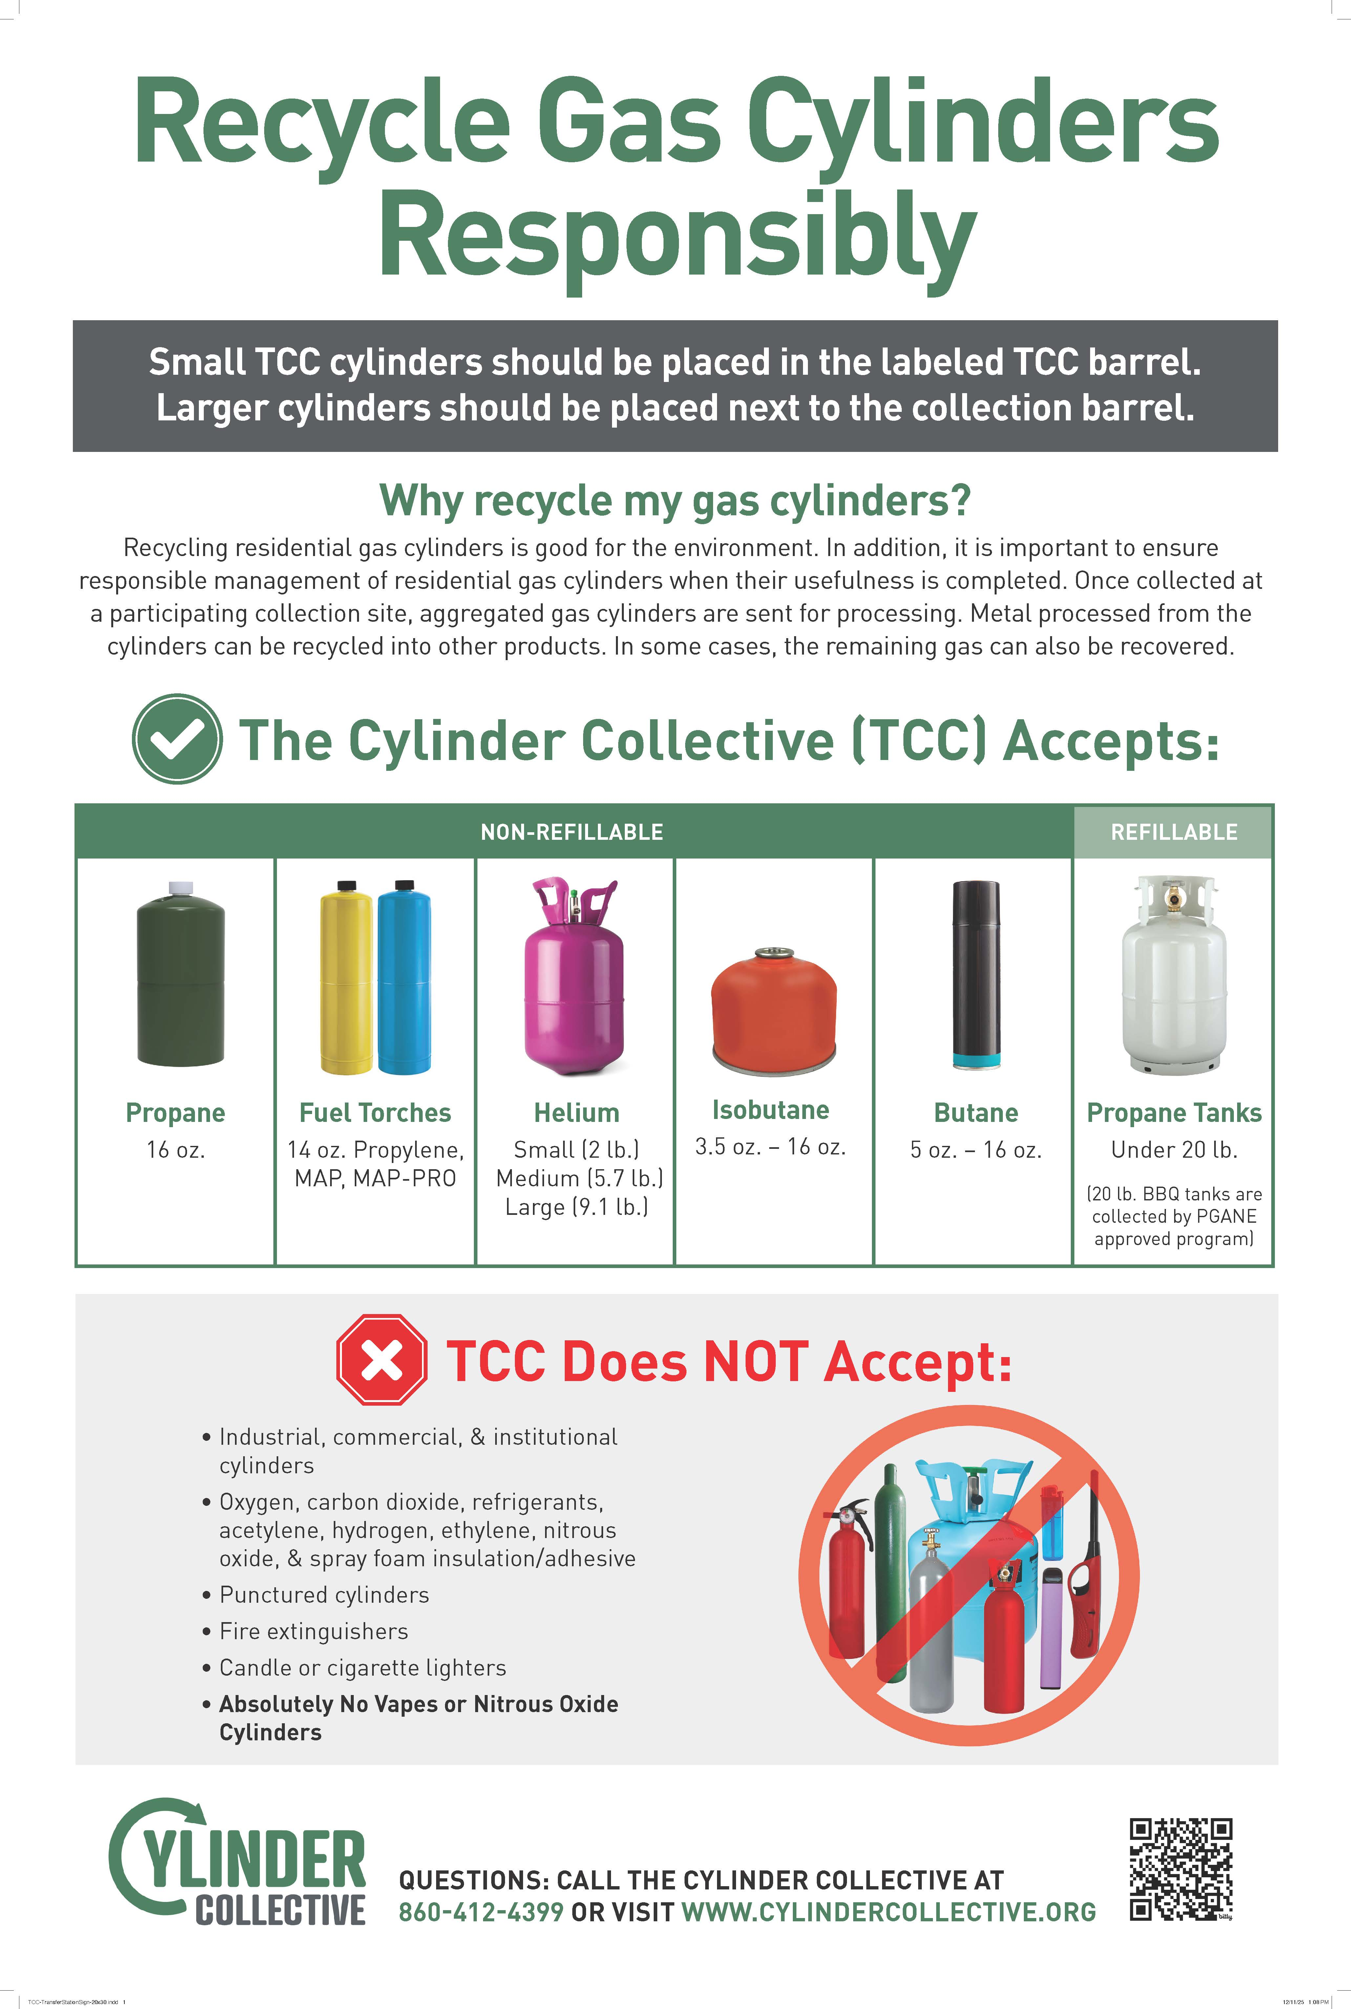

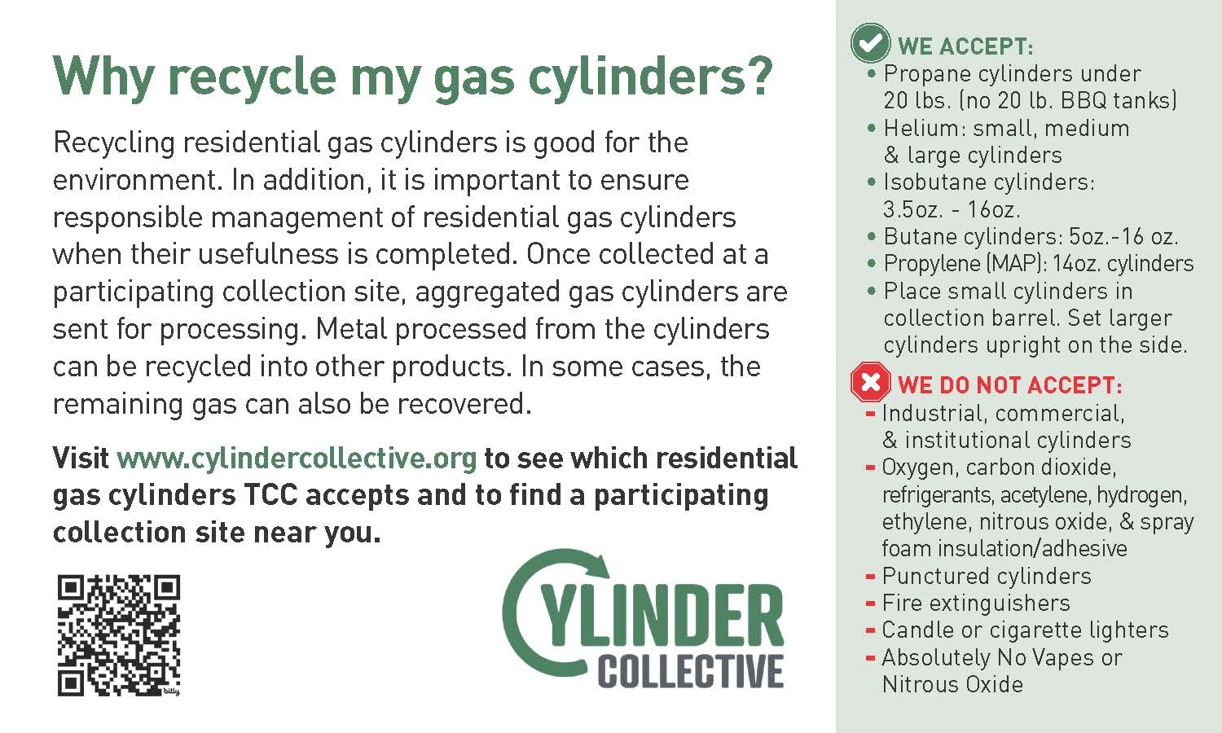
Resident Information Card
Transfer Station Sign

Slide 14
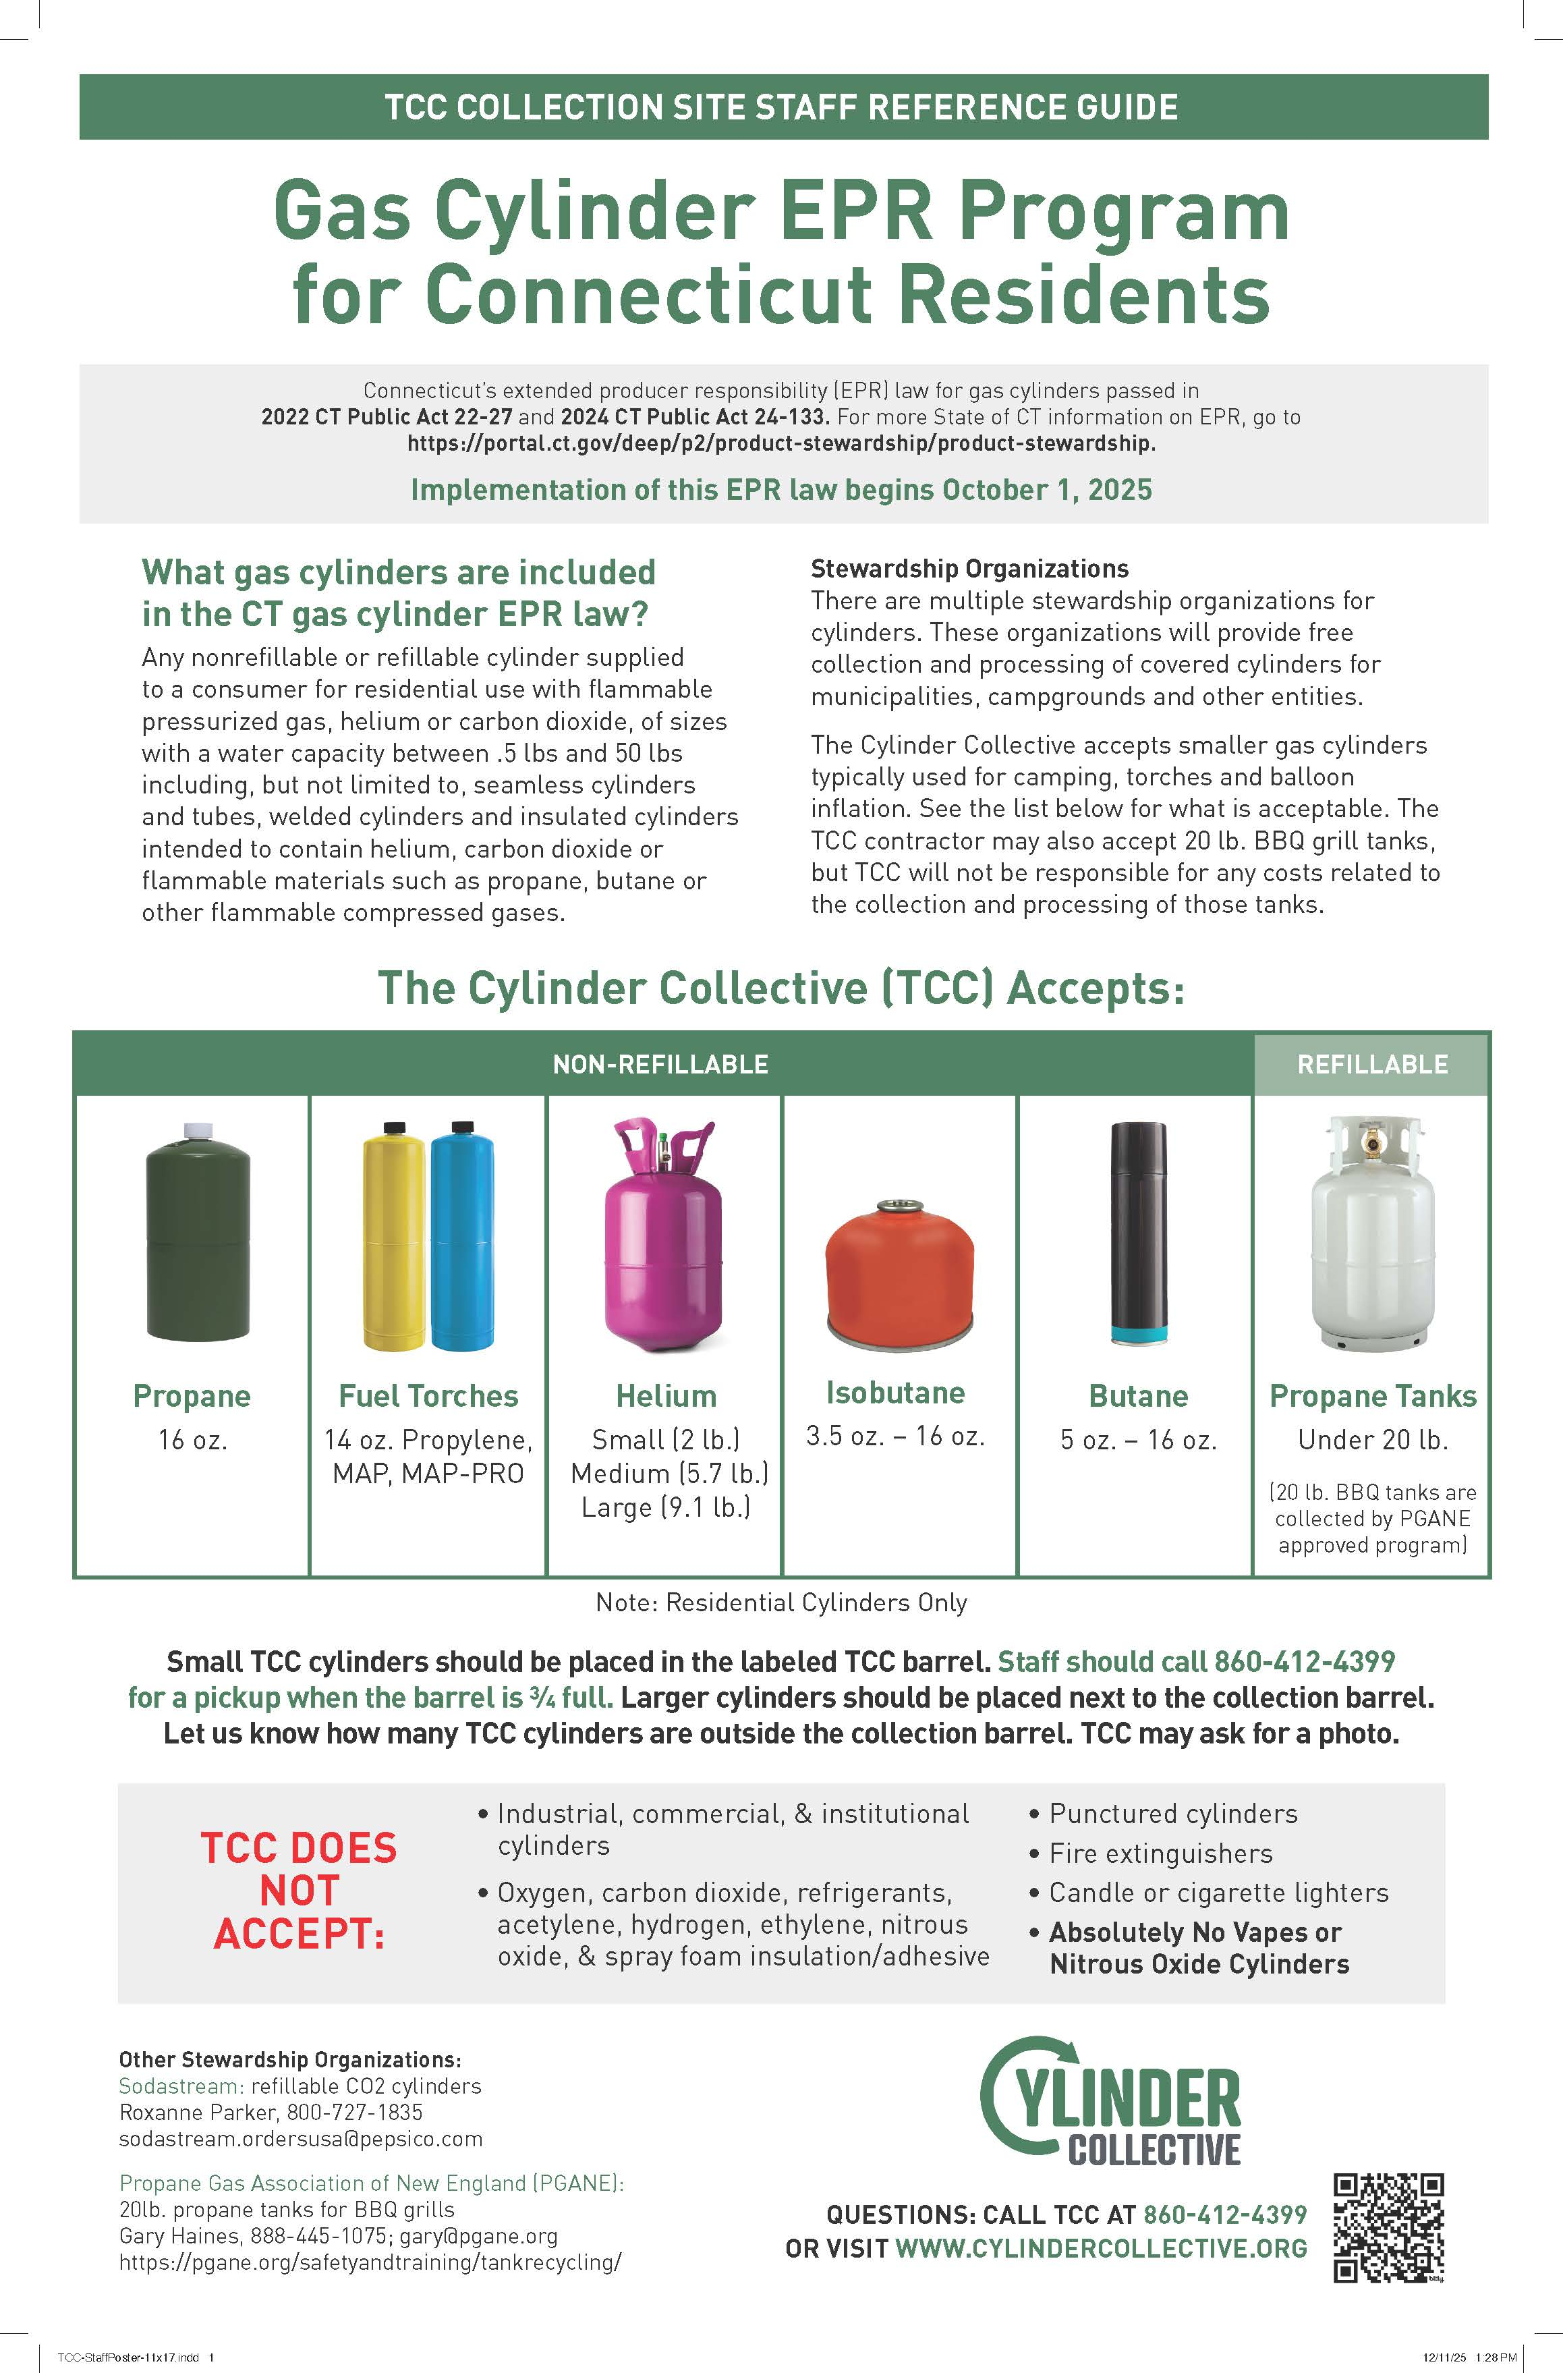
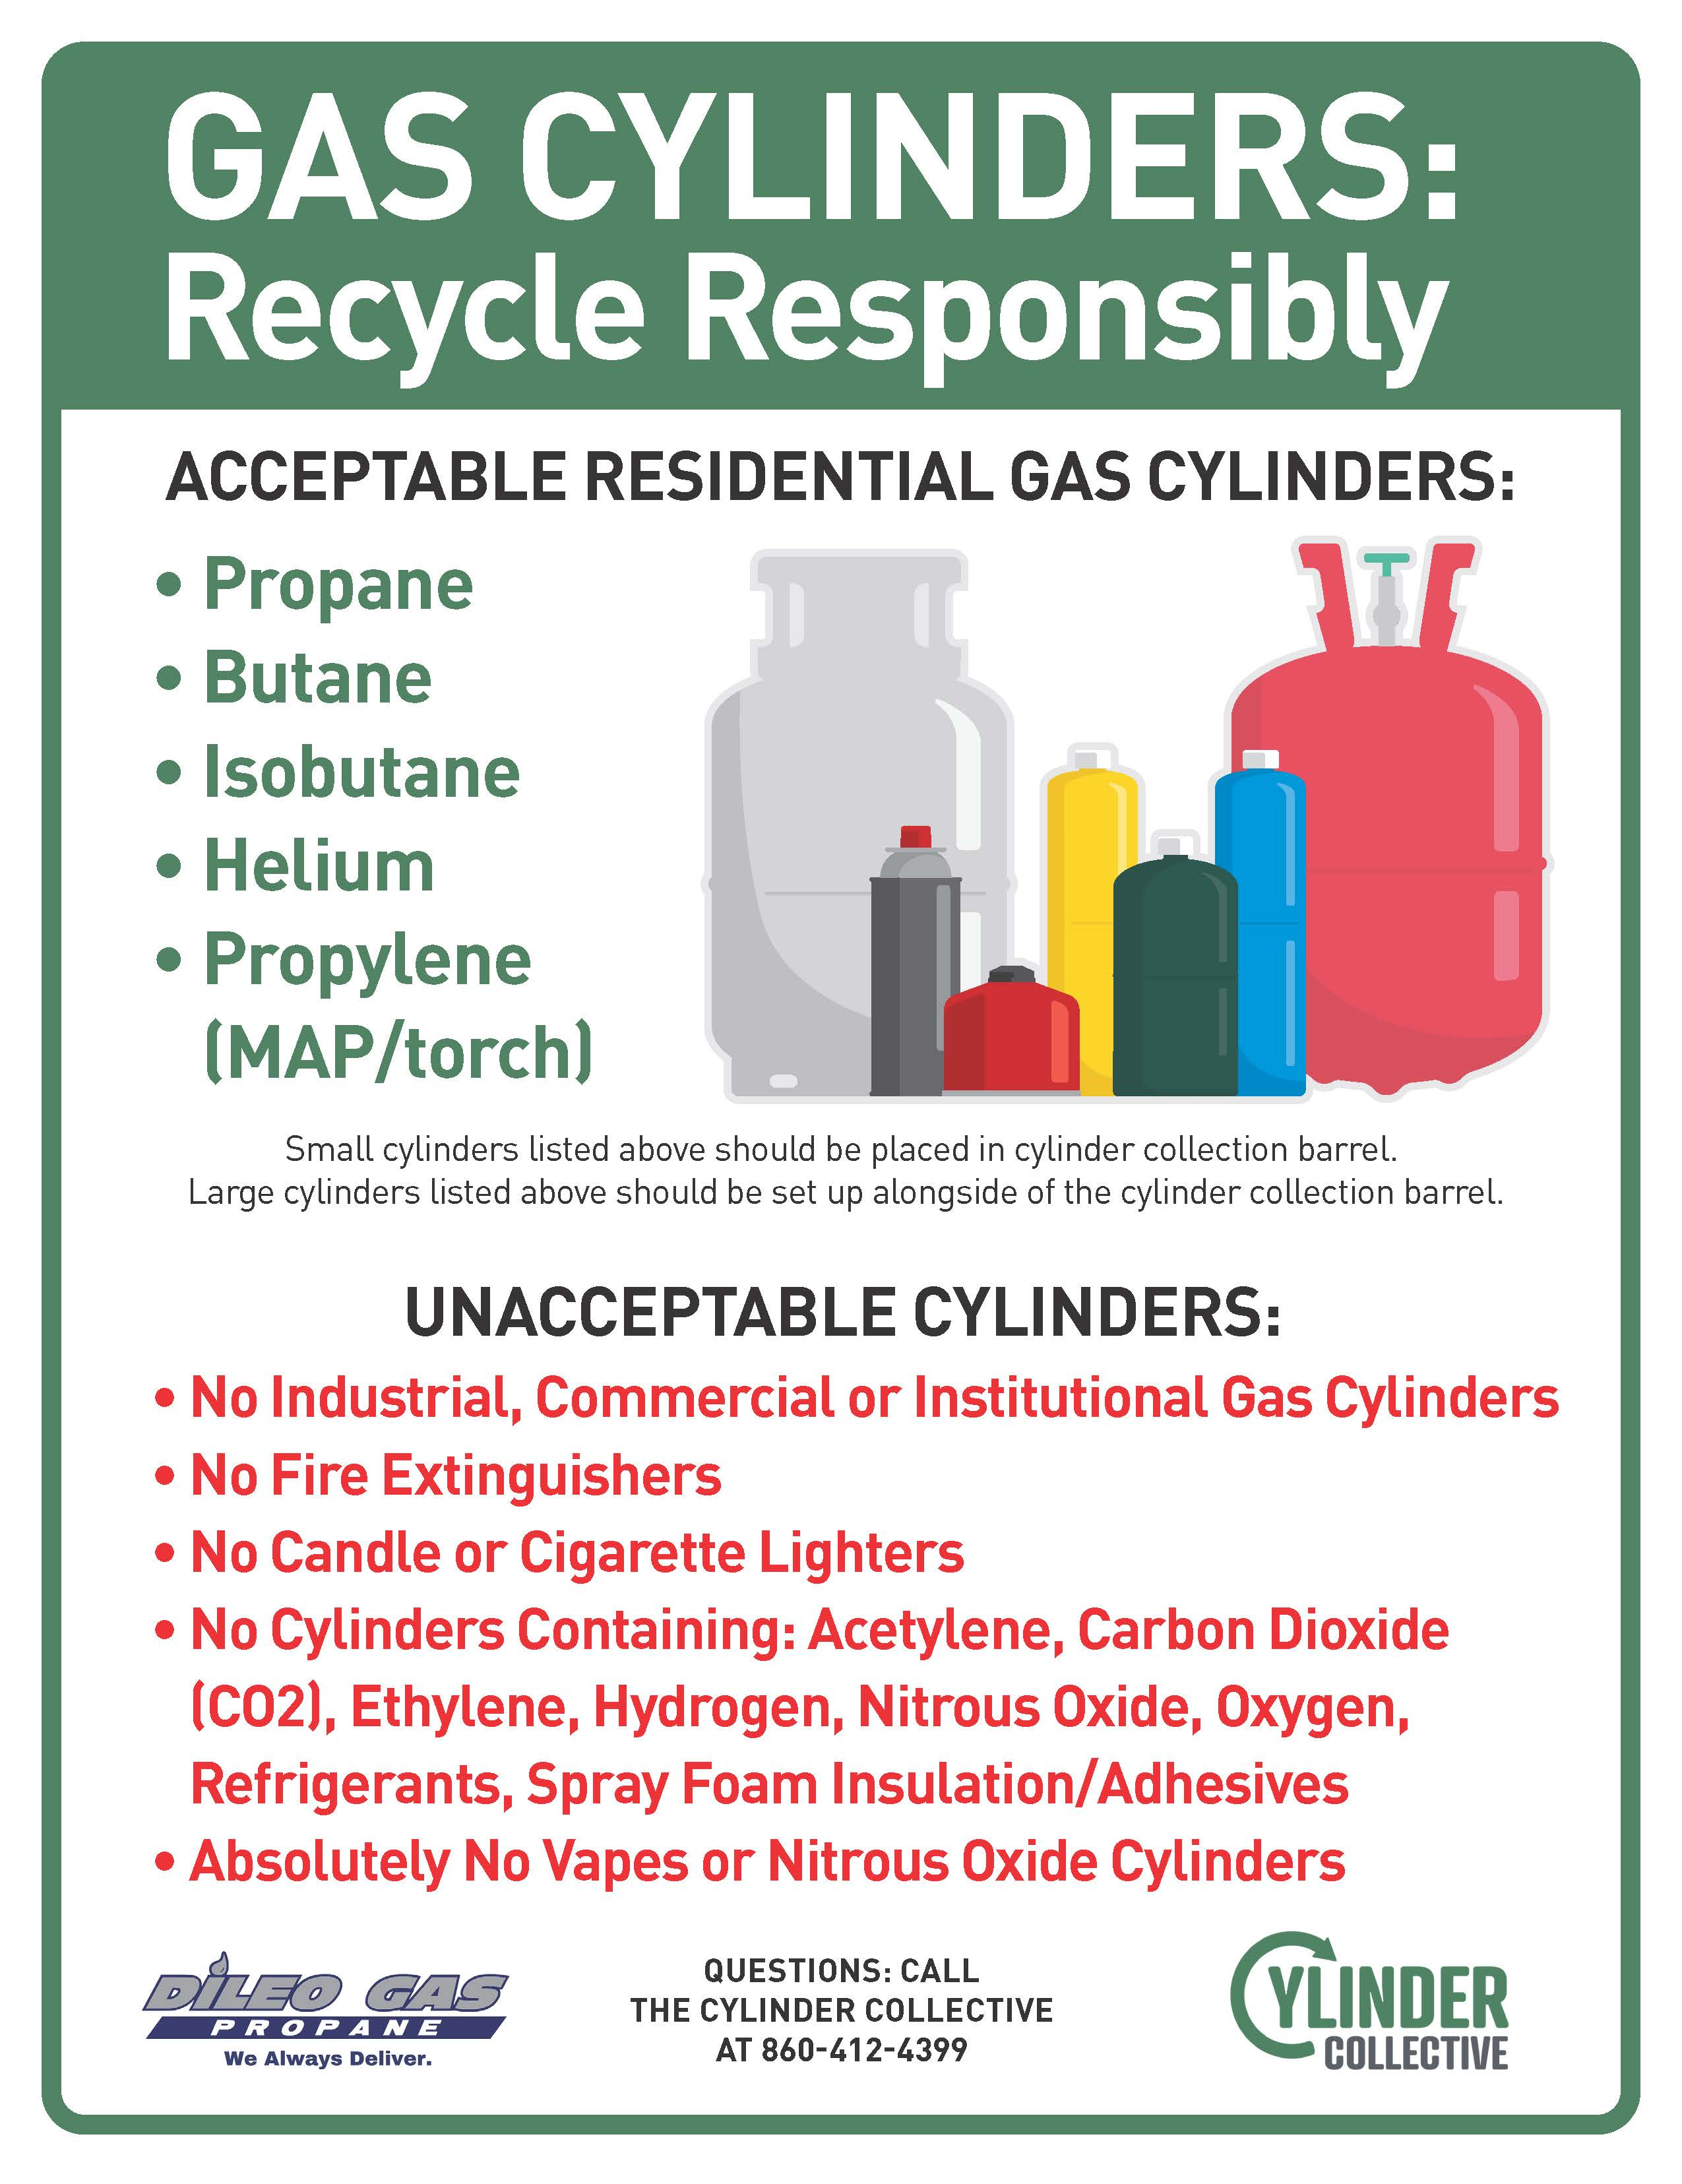
Collection Barrel
Sticker
Collection Site Reference Poster

Slide 15
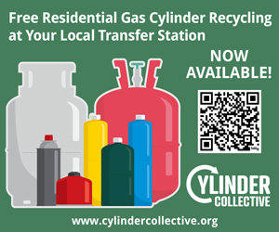

Web Banners

Slide 16
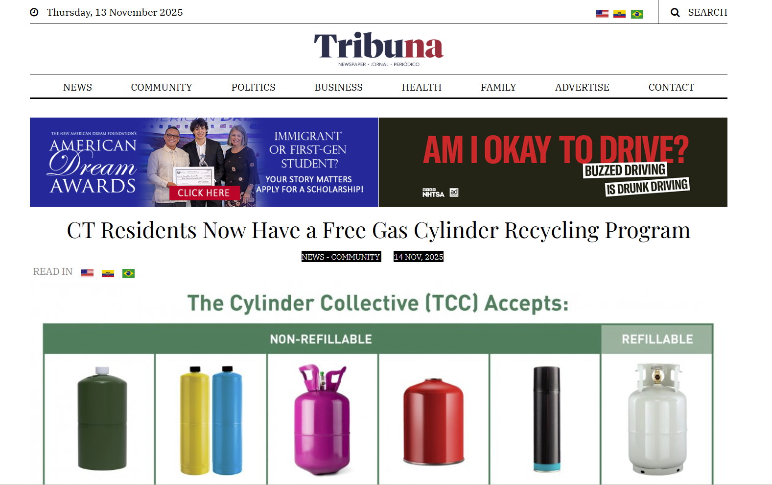
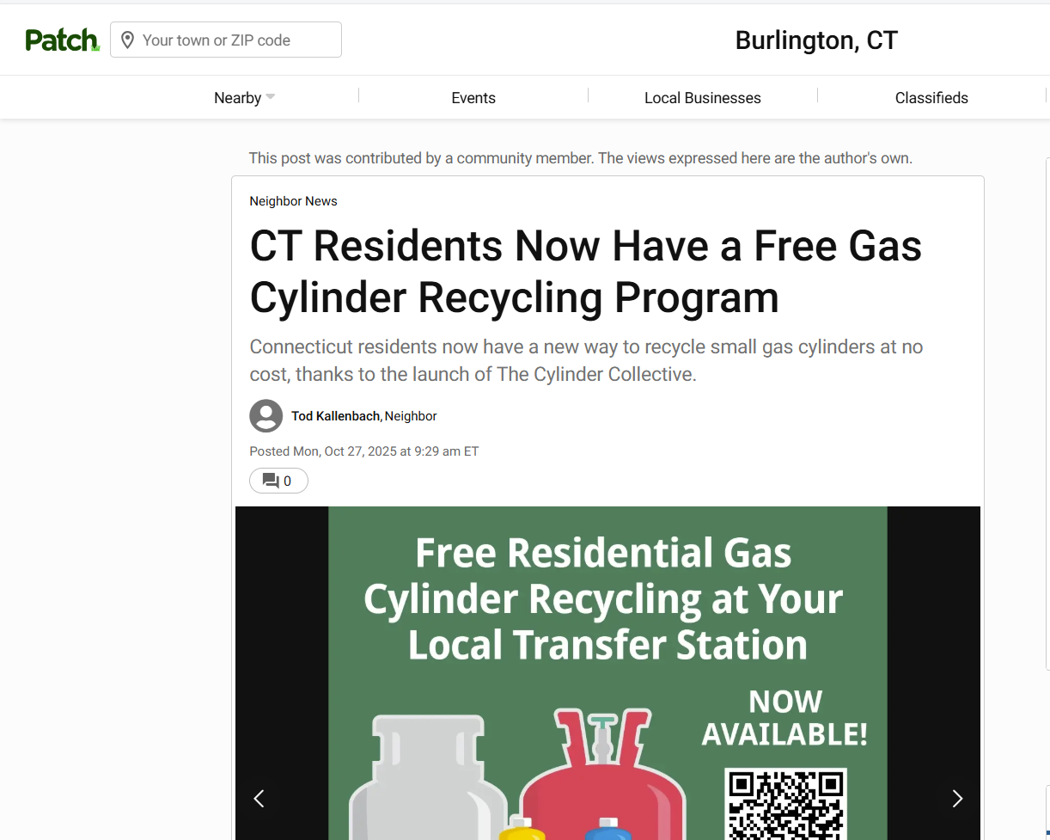
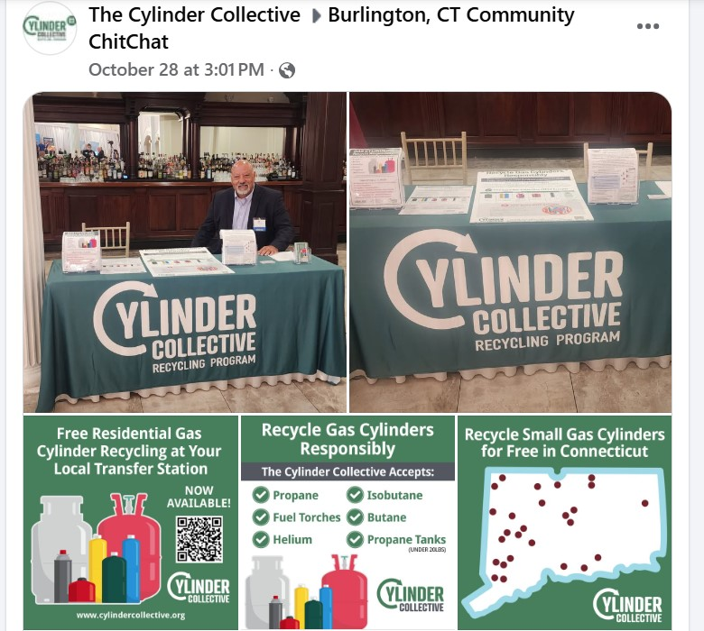
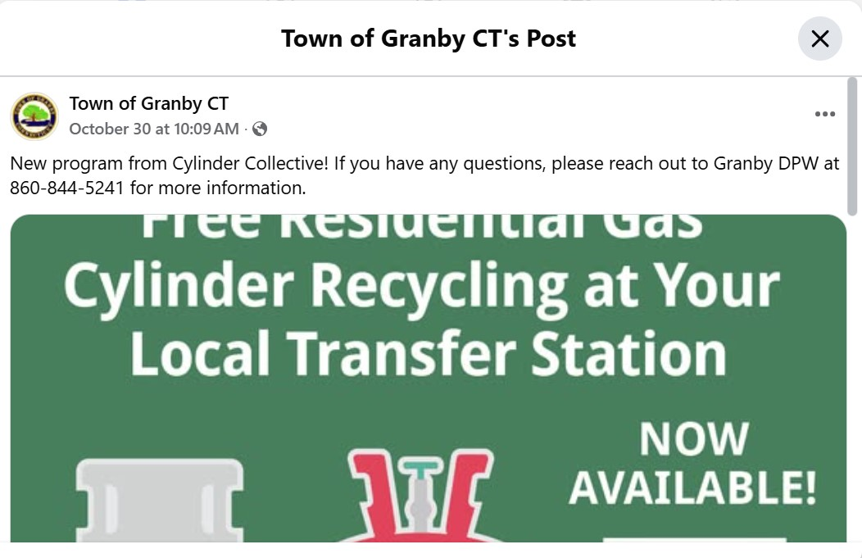
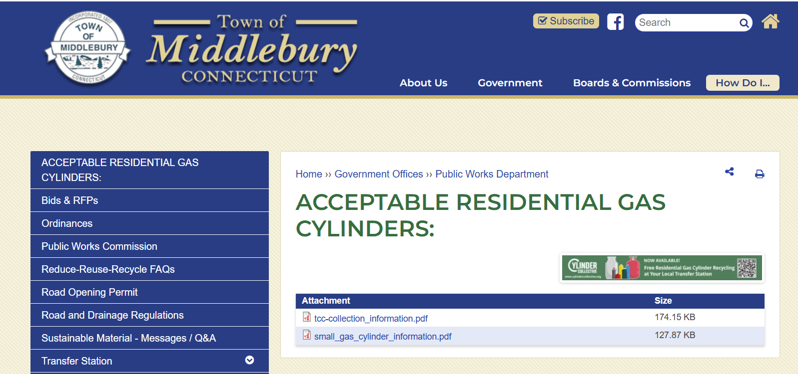
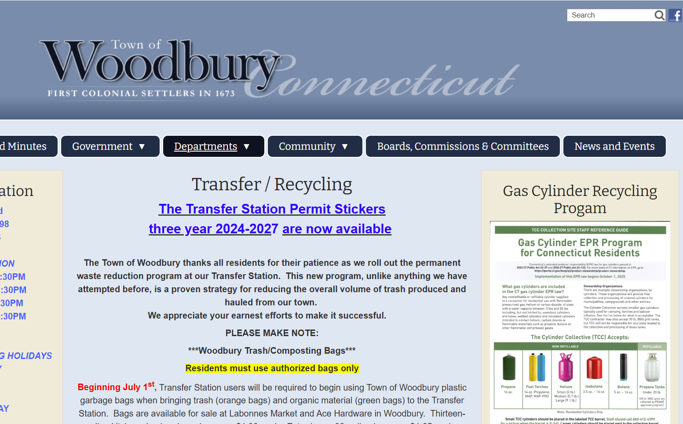
TCC Outreach Activities

Slide 17
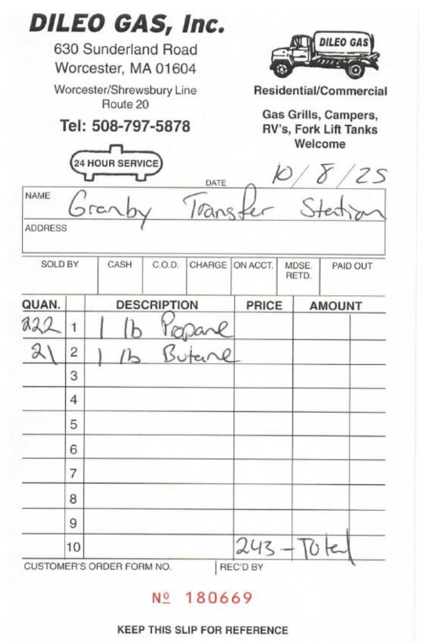
Town/Transfer Station Responsibilities
Compliance with DEEP General Permit
No charge to residents
Maintain records, as with other materials
Contact us when barrel is ¾ full
Notify TCC of any concerns, problems or changes

Slide 18
Thank you for your interest!
David Keeling
Executive Director
The Cylinder Collective
414-644-0139
DavidKeeling@cylinderindustry.org
www.cylindercollective.org/
Kim O'Rourke
State Program Coordinator
The Cylinder Collective
860-412-4399
KimORourke@cylindercollective.org
www.cylindercollective.org/

