Slide 1
Regional Planning Commission
Welcome to a CRCOG Zoom Meeting
We have muted attendees upon entrance. We will unmute people either individually or for everyone depending on the situation.
For our public meetings, we will be taking a roll-call of attendance based on who we identify as being on the call and then ask those we cannot identify to state their name and town.
Each time you speak, you must identify yourself with your name and town prior to making your point.
If you are abstaining or objecting to an action item, please state your name and town.
Meeting materials are available at CRCOGCT.gov

Slide 2
Regional Planning Commission
Welcome and Introductions
Adoption of Minutes: September 4, 2025 & November 5, 2025
Approval of 2026 Meeting Dates
A Presentation by CRCOG: Special Session Public Act 25-1: An Act concerning Housing Growth
CRCOG Updates
Report on Zoning and Subdivision Referrals
What's New in My Town
Other Business

Slide 3

1. Welcome & Introductions

Slide 4
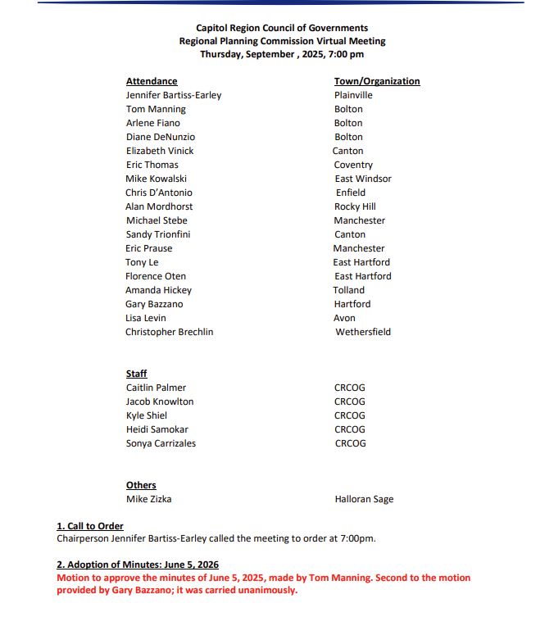
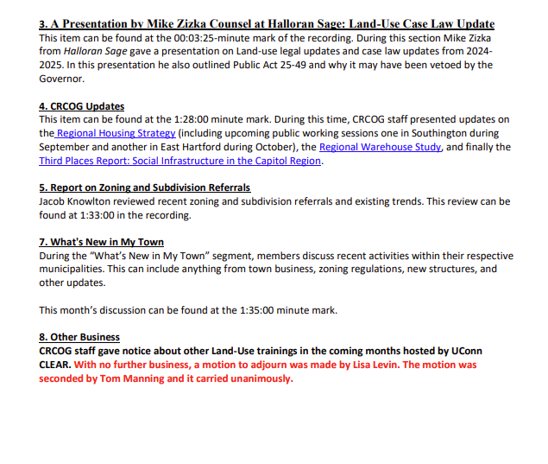
2. Adoption of Minutes: 9/4/2025

Slide 5
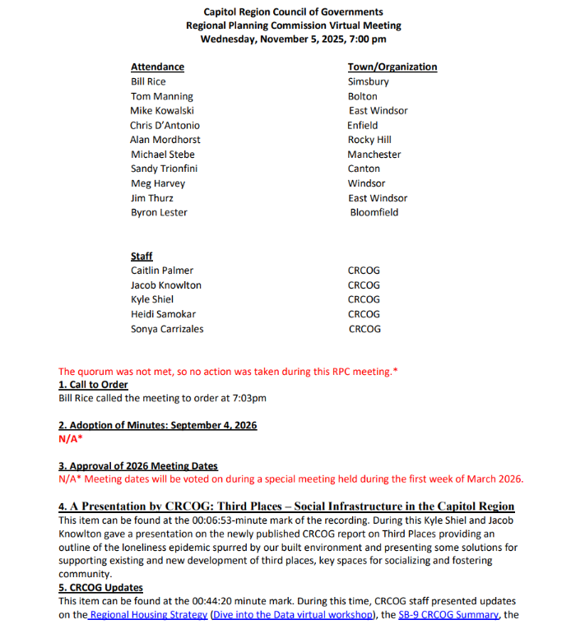
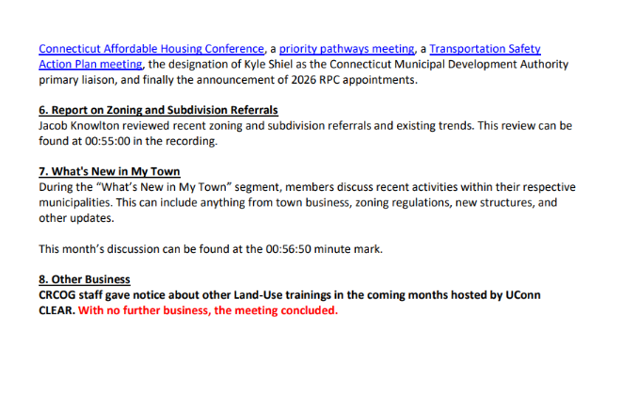
2. Adoption of Minutes: 11/5/2025

Slide 6
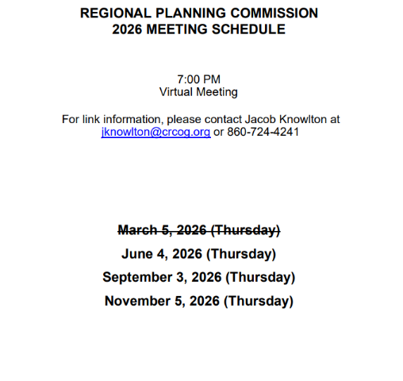
3. Adoption of 2026 Meeting Date

Slide 7
4.
A Presentation by CRCOG:
Special Session Public Act 25-1: An Act Concerning Housing Growth

Slide 8
5. CRCOG Updates
Warehousing Best Practices
Housing Workshops to come this year
Brownfields Funding Available

Slide 9
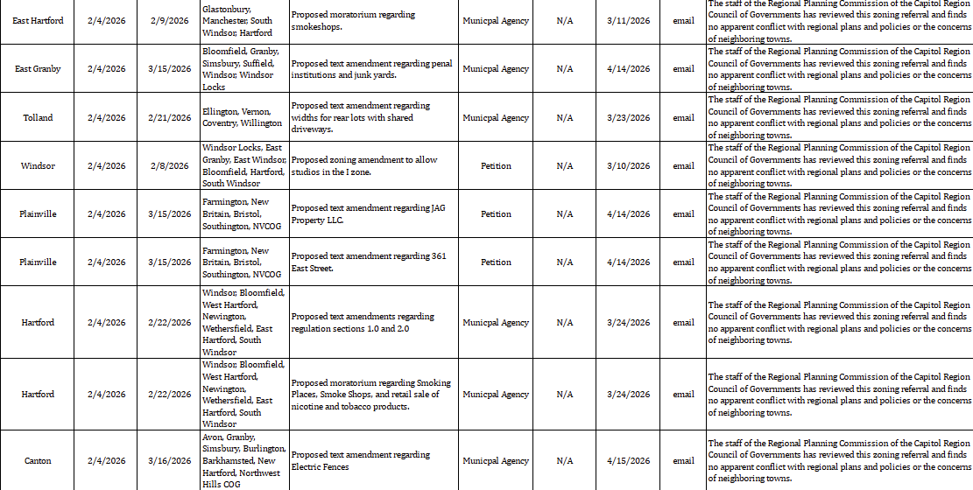
6. Report on Zoning and Subdivision Referrals

Slide 10

7. What’s New in My Town

Slide 11
8. Other Business

