Slide 1
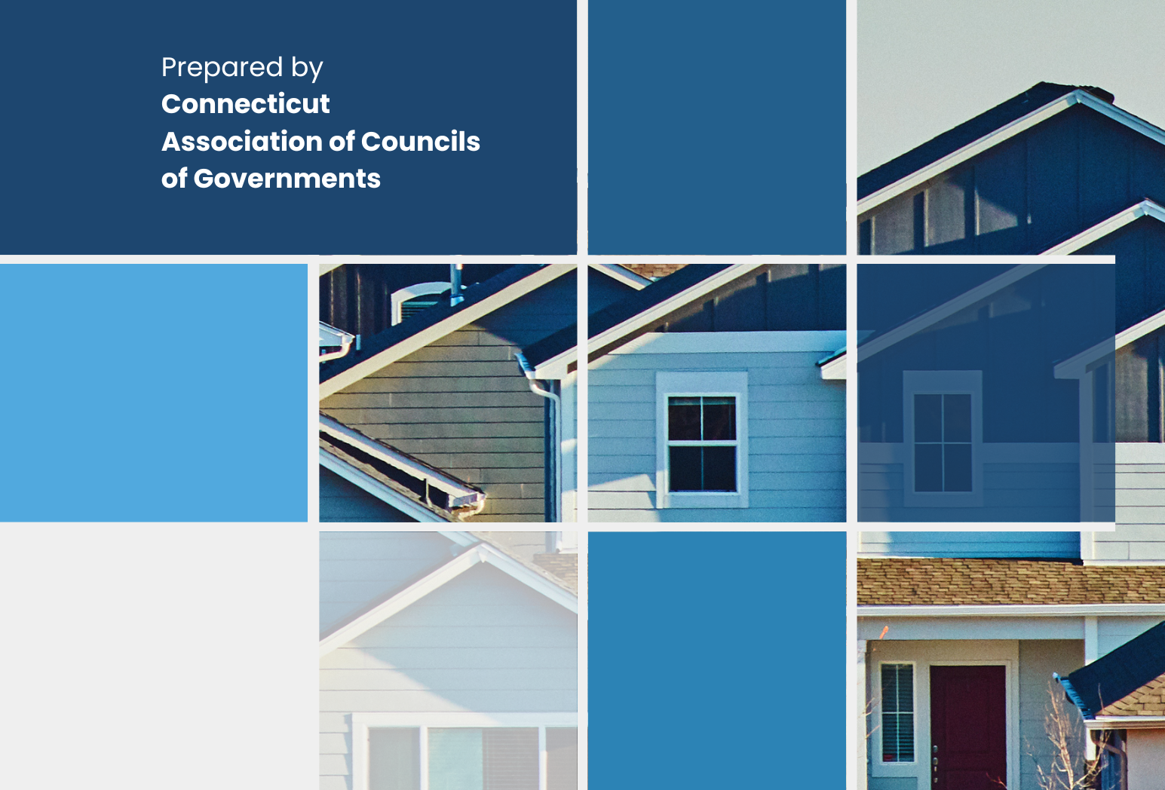
Breaking Down SS PA 25-1
An Act Concerning Housing Growth
A Summary Overview of the Zoning Provisions
March 5, 2026
Caitlin Palmer, AICP
Director of Regional Planning & Development, CRCOG
Notes:
CP
Originated as H.B 8002 and signed into law by Governor Lamont on November 26, 2025
53 Sections, including 20 new Sections

Slide 2
Disclaimer!
Not all Sections of the Act are being covered today.
This summary is for informational purposes and is not legal advice. Consult your local counsel and the full text of SS PA 25-1 for more information.
Some Sections of the Act could be interpreted differently than presented today, which may impact how implementation is handled locally.
Notes:
53 Sections, including 20 new Sections to statutes

Slide 3
Agenda
FYI:
DOH Developed Housing Projects
Wastewater Study
8-30g Threshold Study
Also:
Funding Highlights
Next Steps
Early Actions:
Protest Petitions
Hostile Architecture
PHDZs (optional)
TOCs (optional)
ADUs in TOD
Future Actions:
Parking Minimums
Parking Exceptions
Fee in Lieu of Parking*
Middle Housing
Summary Review*
Manufactured Homes
Housing Growth Plans

Slide 4
PA 25-1 | An Act Concerning Housing Growth
Section 48 | DOH Developed Housing Projects
Enables the Commissioner of the Department of Housing (DOH) to develop a housing project on state-owned land and can sell, lease or manage such project or units under specific conditions.
Before developing, a report must be submitted to the Council on Housing Development regarding identification of suitable property, consistency with Housing Growth Plans, and additional criteria.
If project is sold or leased, right of first refusal to eligible Housing Authority

Slide 5
PA 25-1 | An Act Concerning Housing Growth
Two Studies Commissioned:
Section 33 | State-wide Wastewater Capacity Study
OPM to evaluate capacity, flows, physical conditions, compliance, and vulnerabilities; identify areas underserved and existing capacity limitation; make recommendations for investment
Due July 1, 2026
Section 42 | 8-30g Threshold Study
Majority Leaders’ Roundtable to review issues and benefits of changing the exemption threshold from a percentage to a flat numerical value or an alternative model
Published February 2026: Study Results

Slide 6
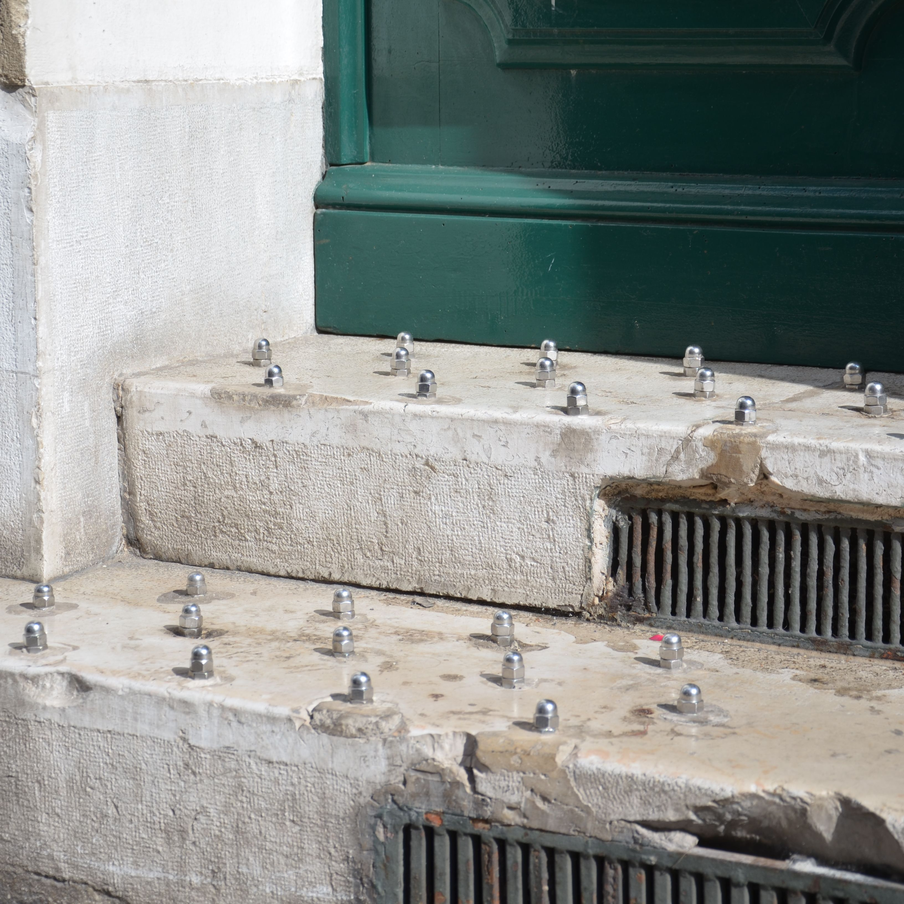
Early Actions
(effective Jan. 1, 2026)
Protest Petitions
Hostile Architecture
PHDZs (optional)
TOCs (optional)
ADUs in TOD

Slide 7
PA 25-1 | An Act Concerning Housing Growth
Section 24 | Protest Petitions
Increased necessary amount of land and/or lots owned by protest petitioners from 20% to 50%
Lowered threshold for commission to overrule petition from 2/3 majority to simple majority

Slide 8
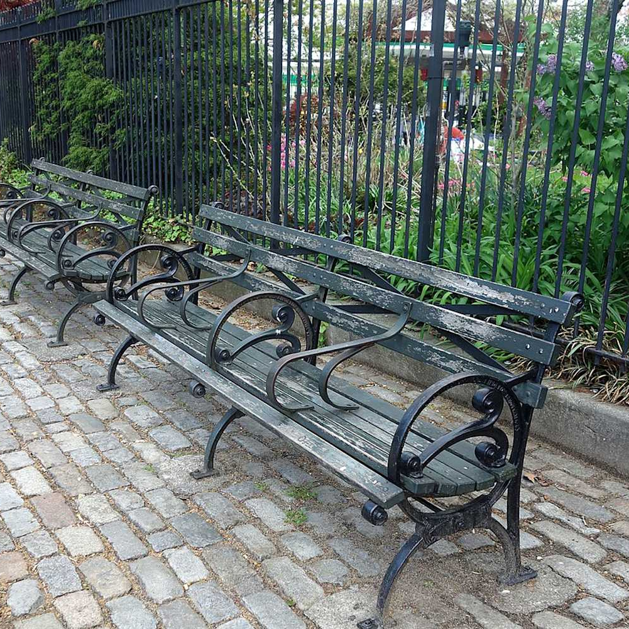
PA 25-1 | An Act Concerning Housing Growth
Section 26 | Hostile Architecture
Prohibits municipalities from installing or constructing Hostile Architecture in/on any publicly accessible municipal building or property
Effective January 1, 2026
If municipality receives a complaint, it must be removed
Hostile Architecture is any building or structure that is designed or intended primarily for the purpose of preventing a person experiencing homelessness from sitting or lying in the building or on the structure at street level.
Does not include design elements intended to prevent individuals from skateboarding or rollerblading.

Slide 9
PA 25-1 | An Act Concerning Housing Growth
OPTIONAL
Sections 8-10 | Priority Housing Development Zone (PHDZ)
Definitions (Section 8)
Process to establish a PHDZ (Section 9)
Approval process for a PHDZ (Section 10)
It is OPTIONAL to establish a Priority Housing Development Zone. Approval of a PHDZ is issued by the Department of Housing.
Some requirements of the PHDZ include:
Area of the zone must be at least 10% of the total Developable Land (§4) in the municipality
Must permit “multifamily housing” (3+ units) as of right
Must permit minimum densities subject only to site plan or subdivision approval:
  4 units/acre of single-family detached,
  6 units/acre of duplex or townhouse, and
  10 units/acre of multifamily.
Why? Establishing a PHDZ is a new process municipalities can use to earn HUE points.
“HUE” = housing unit-equivalent point for purposes of
CGS Sec. 8-30g
Notes:
Per Rebecca at OPM: PHDZs are similar to Incentive Housing Zones (§8-13m – §8-13x)
Towns with IHZs already approved (and should/could probably explore this option pretty easily):
Barkhamsted
Canaan
East Lyme
New London
Old Saybrook
Redding
Sharon
Torrington
Wallingford
Watertown
Westbrook
Windham

Slide 10
PA 25-1 | An Act Concerning Housing Growth
OPTIONAL
Section 10 | Priority Housing Development Zone (PHDZ) Approval
DoH Commissioner reviews and approves PHDZs upon municipal request. DoH's approval is a final letter of eligibility.
DoH Commissioner may rescind a final letter of eligibility, within her discretion, if after one year, there is a lack of progress toward construction of dwelling units within PHDZ.
Are the regulations for the PHDZ likely to substantially increase the production of new dwelling units necessary to meet housing need in the zone?
Are the regulations consistent with the municipality's housing growth plan (regional or municipal)?
Lack of progress indicated by a lack of building permits or other indications of progress toward construction of dwelling units in the zone.
Commissioner considers market conditions in the municipality and the state.

Slide 11
PA 25-1 | An Act Concerning Housing Growth
OPTIONAL
Sections 11-12 | Transit-Oriented Communities
It is OPTIONAL to become a TOC.
To qualify as a TOC, the municipality must meet certain transit conditions AND adopt a Transit Oriented District with location and minimum zoning requirements.
Why? TOC municipalities are eligible for certain fiscal incentives such as Housing Growth Program funds (Sec. 15), increased school construction reimbursement (Sec. 46), and sewer improvement loans (Sec. 47)
Municipalities can have a TOD district and NOT become a TOC

Slide 12
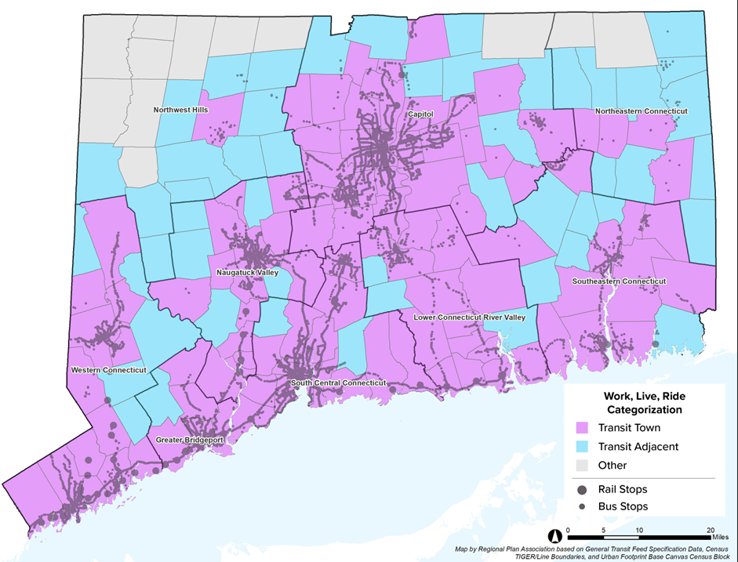
PA 25-1 | An Act Concerning Housing Growth
OPTIONAL
Sections 11-12 | Transit-Oriented Communities
Program Eligibility
Existing or planned rapid transit station in the community
At least one regular bus service route in the community (≤60 min. headway during peaks)
Adjacent to communities with either of the above

Slide 13
PA 25-1 | An Act Concerning Housing Growth
OPTIONAL
Sections 11-12 | Transit-Oriented Communities
Transit Oriented Districts are required to:
Have an adequate area to support densification
Consider local and regional housing needs
Enable specific residential uses as of right:
  Transit Community Middle Housing (2-9 units)
  10+ unit set-aside developments
  100% affordable developments on municipal, housing authority, non-profit or religious lands
  Conversion of residential or commercial to the above types of developments (may still require first floor commercial*)
Require certain inclusionary provisions on any 10+ unit developments that are not permitted as of right
Existing or new Transit Oriented Districts do not automatically become a Transit-Oriented Community
TOD districts adopted by a municipality prior to January 1, 2026, may be “grandfathered” and seek exemptions from law and guidelines upon request

Slide 14
PA 25-1 | An Act Concerning Housing Growth
OPTIONAL
Sections 11-12 | Transit-Oriented Communities
Section 12
Adds Transit-Oriented Districts established pursuant to §11 to the definition of Housing Growth Zone for the purposes of the Connecticut Municipal Development Authority (CMDA).
About CMDA (CGS §8-169, not established via PA-25-1)
Created to stimulate economic and transit-oriented development, encourage housing development, and provide financial and technical support to municipalities
Any municipality (except those in CRDA) may opt to join CMDA via certified resolution of the legislative body (alone or jointly)
Municipalities must create a Housing Growth Zone with regulations that are “likely to substantially increase the production of new dwelling units” as determined by CMDA

Slide 15

PA 25-1 | An Act Concerning Housing Growth
Section 13 | Accessory Dwelling Units
If a municipality designates a Transit-Oriented District (as defined in §11) the municipality must allow any property owner in the district who has owned their property for 3+ years to develop an accessory apartment on that property as of right.
This applies regardless of whether a municipality has previously opted out of state ADU regulations.
A municipality may adopt structural architectural requirements in the zoning regulations for the Transit-Oriented District that an accessory apartment must comply with.

Slide 16
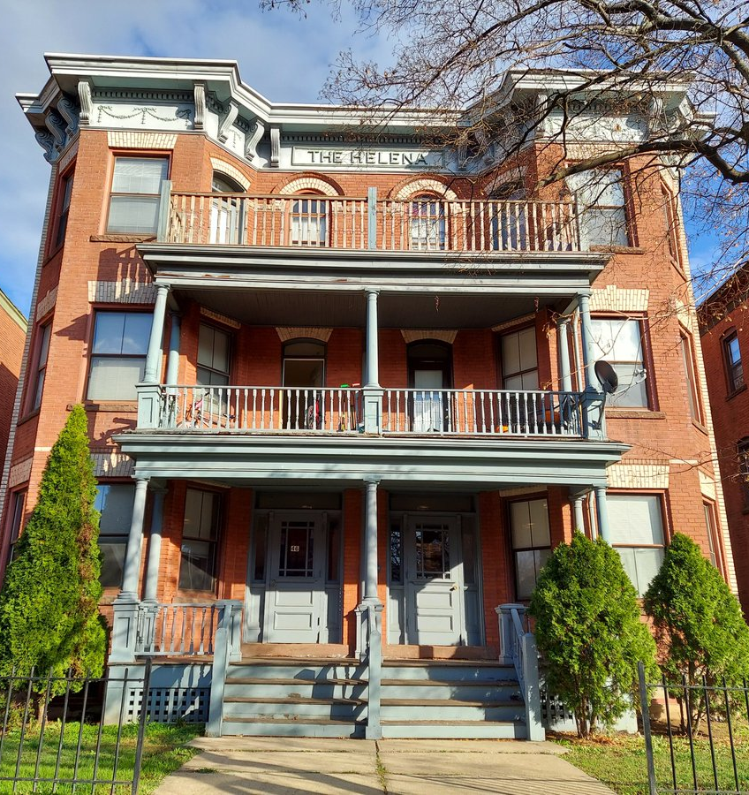
Future Actions
(effective July 1, 2026)
Mobile Manufactured Homes
Transit Community Middle Housing
Summary Review*
Parking Minimums
Parking Exceptions
Parking Fee in Lieu*
AND Housing Growth Plans

Slide 17
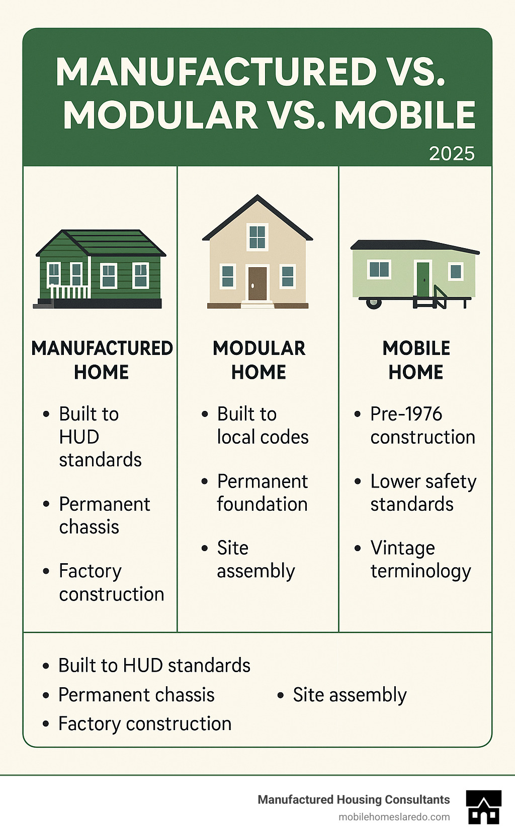

PA 25-1 | An Act Concerning Housing Growth
Section 18 | Mobile Manufactured Homes
Section 18
Eliminated the 22’ width reference to mobile manufactured homes.
If a manufactured home is built to federal manufactured home construction and safety standards, municipalities cannot subject this housing type to conditions and requirements that substantially differ from other residential uses.

Slide 18
PA 25-1 | An Act Concerning Housing Growth
Sections 16 | Transit Community Middle Housing
As of July 1, 2026, municipalities are required to allow for the development of:
Transit Community Middle Housing or Mixed-Use Development…
On any “lot zoned for” commercial or mixed-use development…
Subject only to Summary Review
May also allow for this middle housing on any lot zoned for residential use… Why expand where middle housing allowed?
0.25 HUE point for each middle housing unit with a CO issued

Slide 19
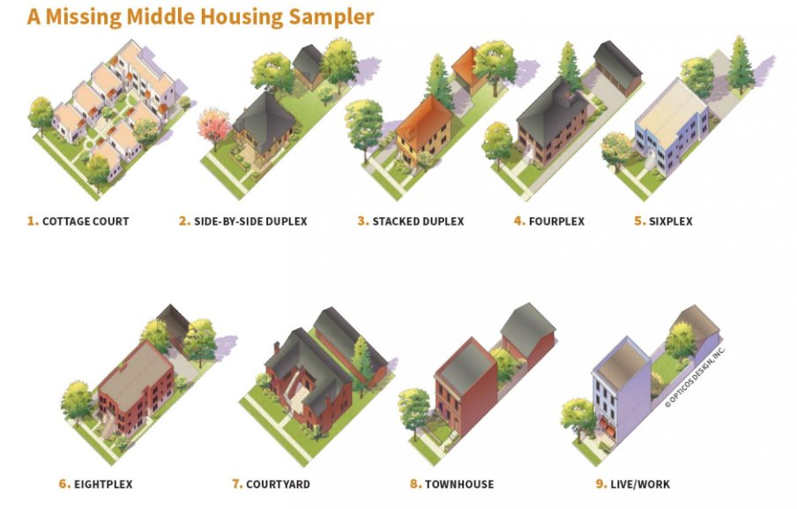
PA 25-1 | An Act Concerning Housing Growth
Section 16 | Transit Community Middle Housing
Transit Community Middle Housing (defined §11)
A residential building containing 2-9 units
Including, but not limited to, townhouses, duplexes, triplexes, perfect sixes, and cottage clusters
Notes:
Despite the name, this has no relationship to transit or Transit-Oriented Communities.
“Middle housing” is also used in the Act and has a different definition.
Cottage clusters are not “contained” in a residential building but are a series of buildings.
Source: Congress for the New Urbanism

Slide 20
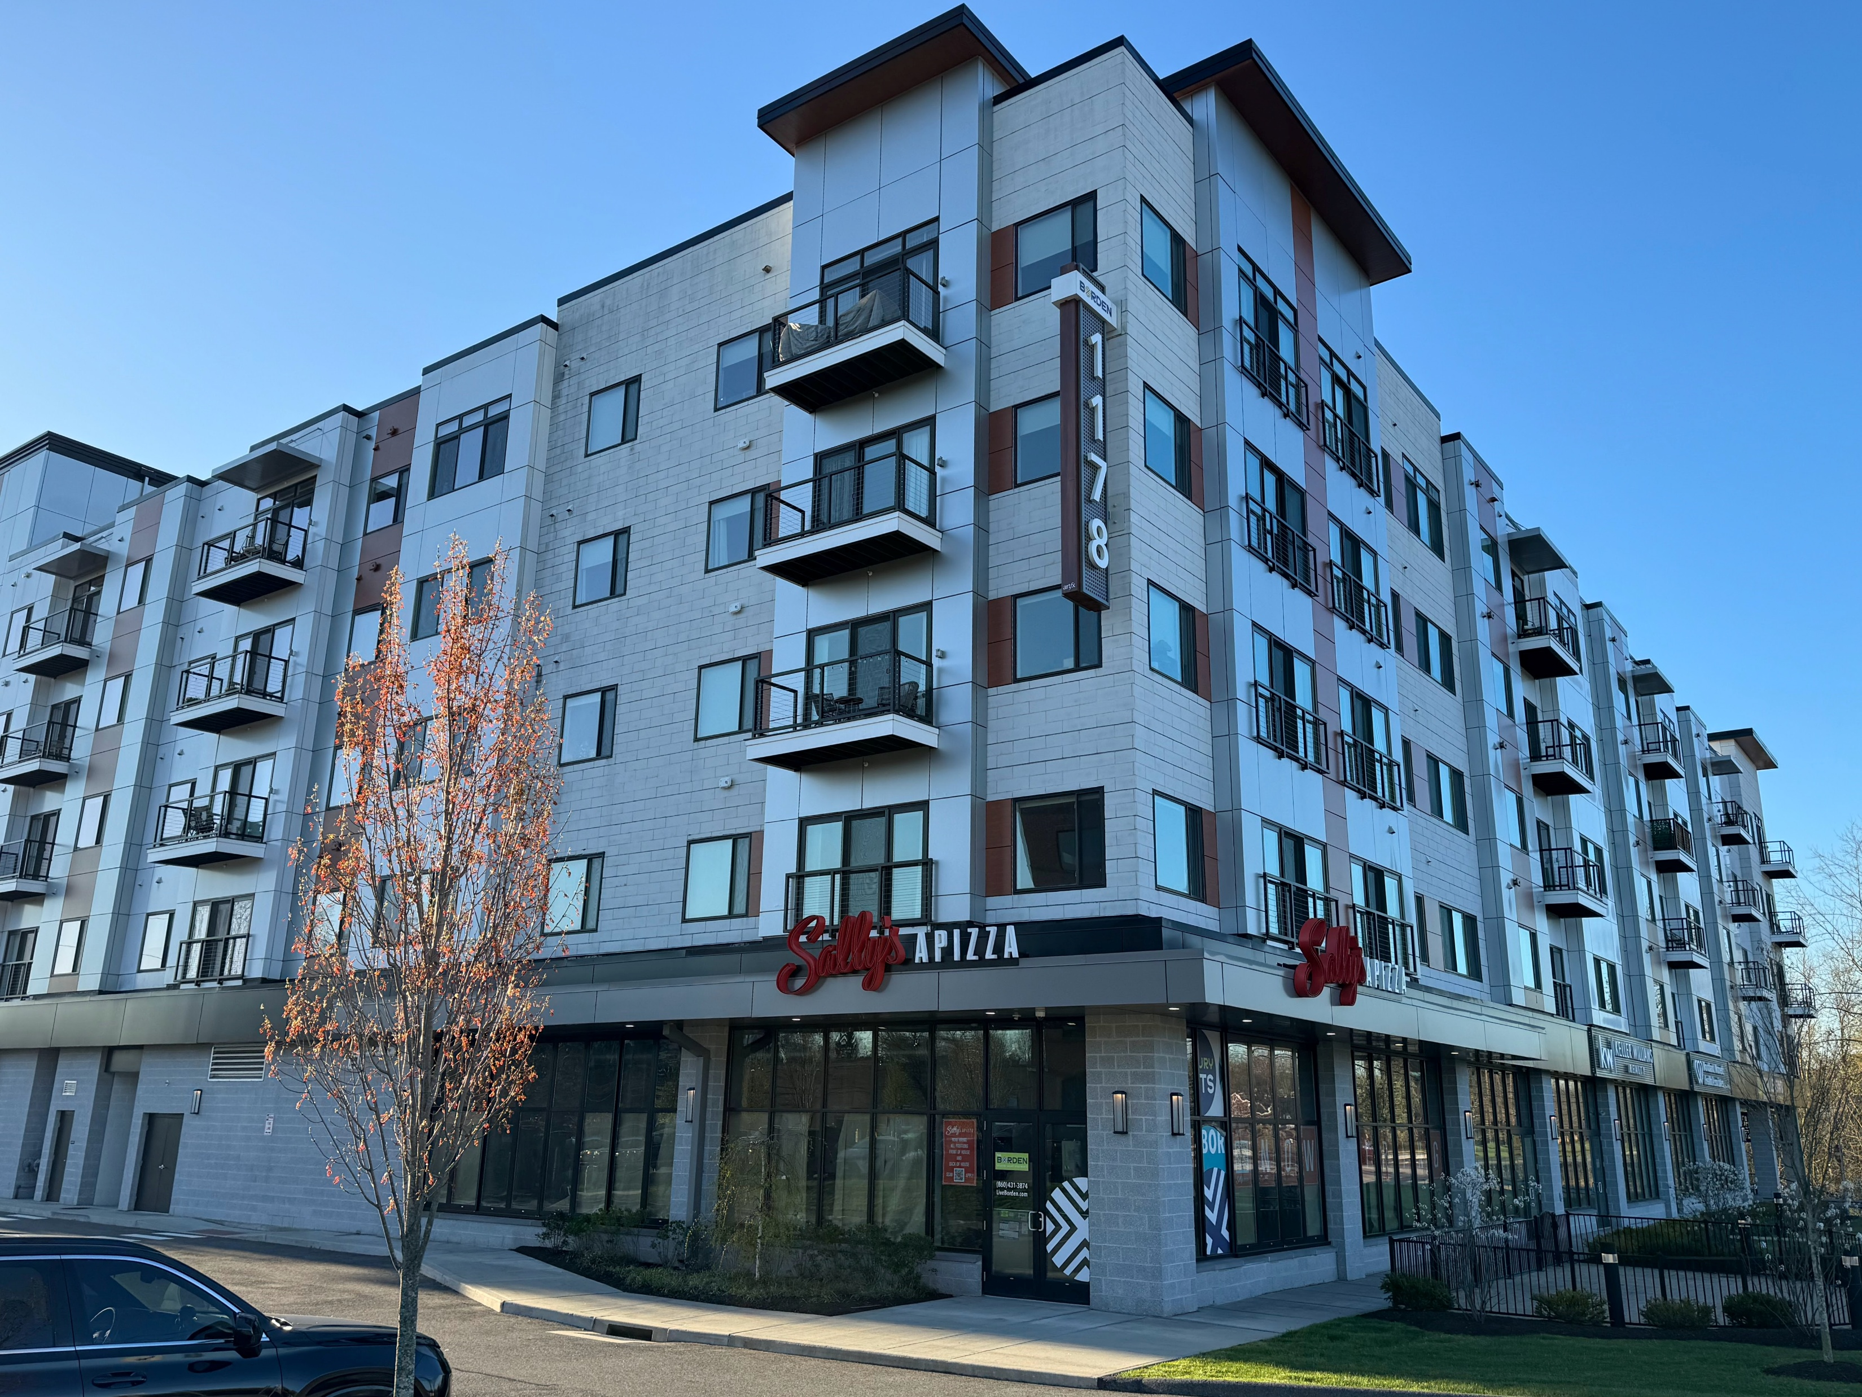
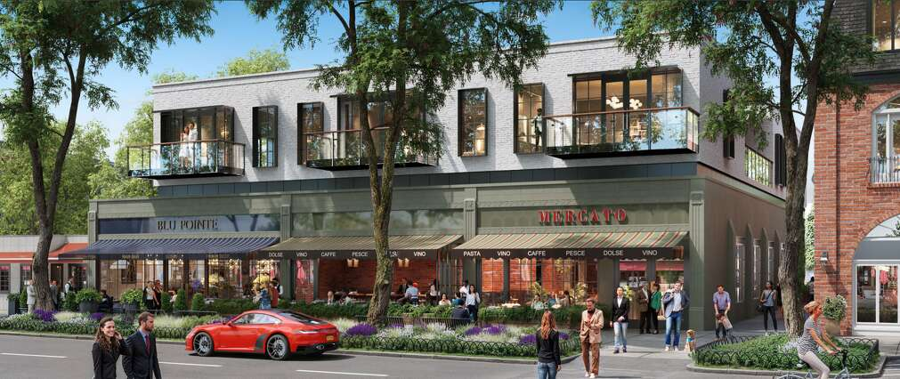
PA 25-1 | An Act Concerning Housing Growth
Source: CRCOG
Section 16 | Transit Community Middle Housing
Mixed-Use Development
A development containing both residential and nonresidential uses in any single building
Notes:
Defined in CGS Sec. 8-1a(b)(7)
Source: CT Insider, Courtesy of Market Hospitality Group

Slide 21
PA 25-1 | An Act Concerning Housing Growth
Section 17 | Summary Review
Summary Review (effective January 1)
An existing process (CGS Sec. 8-2r(a), although SS PA 25-1 did make minor modifications (see underlined)
  Able to be approved in accordance with the terms of a zoning regulation or regulations, including, but not limited to, requirements concerning setbacks, lot size and building frontage, applicable to a proposed development, and​…
  Without requiring that a public hearing be held, a variance, special permit or special exception be granted or some other discretionary zoning action be taken, other than…
  A determination that a site plan is in conformance with applicable zoning regulations, and ​that public health and safety will not be substantially impacted.

Slide 22
PA 25-1 | An Act Concerning Housing Growth
Section 17 | Summary Review
Considerations: | As of Right CGS 8-1a(3) | Summary Review CGS 8-2r(a)
Must comply with zoning regulations | ✓ | ✓
May NOT require a public hearing (or other discretionary zoning action) | ✓* | ✓
Determination that public health and safety will not be substantially impacted |  | ✓

Slide 23

PA 25-1 | An Act Concerning Housing Growth
Sections 18 & 19 | Parking
Section 18
Amends CGS 8-2 (Zoning Enabling Statute) – Zoning regulations SHALL NOT:
“Require a minimum number of off-street motor vehicle parking spaces for any residential development except as provided by Section 19”
Section 19
Prohibits municipalities from rejecting an application solely for failing to conform with any requirement of off-street parking spaces for any residential development “except as provided for in … (b) and (d)”
Note:
There is no “opt-out” provision.
Municipalities can still regulate parking maximums.

Slide 24
PA 25-1 | An Act Concerning Housing Growth
Sections 18 & 19 | Parking
Exceptions:
Developments >16 Units: May require off-street parking but must allow developer to submit a Parking Needs Assessment proving less parking is required.
Developments < 16 Units: May only require off-street parking if in a Conservation and Traffic Mitigation District and must allow developer to submit a Parking Needs Assessment proving less parking is required. ​
Note:
Developments of exactly 16 units are not accounted for

Slide 25
PA 25-1 | An Act Concerning Housing Growth
OPTIONAL
Sections 18 & 19 | Parking
Conservation and Traffic Mitigation District
May designate a district of up to 4% of municipal land area​
Up to two districts permitted (which may be contiguous), for a total of up to 8% of municipal land area
Municipalities submit a property description of the district(s) to OPM
For example…
2%
4%
2%
4%
6%
4%
Sure!
Sure!
Nope.

Slide 26
PA 25-1 | An Act Concerning Housing Growth
Sections 18 & 19 | Parking
If Parking Needs Assessment is submitted by the developer, a municipality must condition approval of the project on the lesser of:​
The amount of parking recommended in the needs assessment, or
One off-street parking space for every studio/one-bedroom unit and two off-street parking spaces for every two or more-bedroom unit​
Notes:
Contents of a parking needs assessment:
(c) A parking needs assessment submitted pursuant to subsection (b)
of this section shall be paid for by the proposed developer and shall
include an analysis of (1) available existing public and private parking
that may be used by residents of the proposed development, (2) public
transportation options that may be used by residents of the proposed
development that mitigate the need for off-street parking, (3) projected
future needs for off-street parking for such proposed development, and
(4) any relevant local traffic, parking or safety study

Slide 27
PA 25-1 | An Act Concerning Housing Growth
Essentially aligns with parking changes per Sections 18 & 19
Section 21 | Parking
Section 21 (effective January 1)
Limits the situations in which a municipality may allow for fee in lieu of providing parking spaces.​
A municipality may now only allow a developer to pay a parking fee in lieu of providing parking spaces for:​
Any commercial development​
Residential or mixed-use development of 16 or more units​

Slide 28
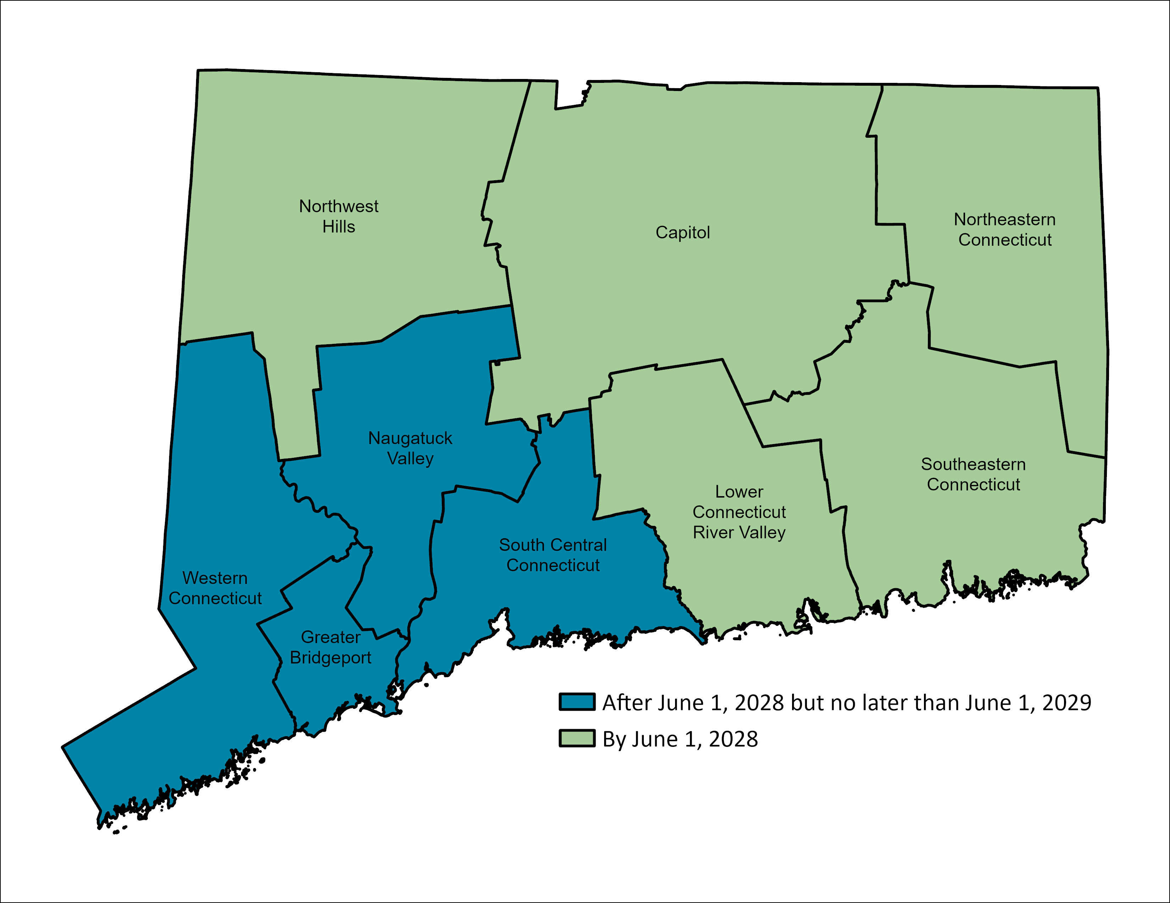
PA 25-1 | An Act Concerning Housing Growth
Section 4-6 and 7 | Housing Growth Plans
Definitions (Section 4)
Municipal Housing Growth Plans (Section 5)
Regional Housing Growth Plans (Section 6)
Regional Housing Needs & Affordable Housing Goals (Section 7)
CRCOG Housing Growth Plans
Due June 1, 2028 + Every 5 Years
There are two pathways to comply with the Housing Growth Plan requirements:
You do not have to decide until
June 2027.
CGS Sec. 8-30j plans repealed by Section 53
Municipal Housing Growth Plan
Regional Housing Growth Plan

Slide 29
PA 25-1 | An Act Concerning Housing Growth
By December 1, 2026
State will determine Housing Growth Targets for the state and each COG.
By June 1, 2027
Each COG will work with its members to establish local Recommended Affordable Housing Goal.
Within 30 days of receipt of municipal Recommended Affordable Housing Goal
Municipality decides whether to opt-in to Regional Housing Growth Plan or establish a Municipal Housing Growth Plan.
Important Initial Timeline:
COLLABORATE!
Notes:
Collaborate Animation
There's time: You don't need to make a decision yet – collaborative partnership

Slide 30
PA 25-1 | An Act Concerning Housing Growth
Section 7 | Affordable Housing Goals
By June 1, 2027, each council of governments will [work with its members to] establish a Recommended Affordable Housing Goal for each municipality.
The methodology must include factors, such as:
Consideration to affirmatively further fair housing
Appropriate regional metrics (e.g., cost-burden, overcrowding)
Proximity to:
  Current or planned transportation projects,
  Commercial or industrial zones with significant employment opportunities, and
  Downtown areas (Sec. 11).
Availability of Developable Land (Sec. 4)
Share of multifamily housing stock
Adjustments for communities with a higher equalized net grand list per capita, higher median income, lower percentage of its population below the federal poverty threshold, or lower percentage of its population living in multifamily housing
COLLABORATE!
Notes:
Collaborate Animation

Slide 31
PA 25-1 | An Act Concerning Housing Growth
Sections 5-6 | Housing Growth Plans
Municipal Housing Growth Plan Requirements (Section 5)
Regional Housing Growth Plan Requirements (Section 6)
Plan Requirements
Similar requirements for Municipal and Regional Housing Growth Plans, examples include:
Identify zones or parcels to help meet the affordable housing goal for residential uses by summary review
Identify strategies to increase affordable housing (i.e., accessibility for IDD population, diverse housing types)
Inventory Developable Land (Sec. 4)
Identify projected infrastructure needs
Note
Plan requirements are different for AENGLC communities.
Failure to submit a HGP results in ineligibility for CGS Sec. 8-30g moratoria.
COLLABORATE!
Notes:
Collaborate Animation

Slide 32
PA 25-1 | An Act Concerning Housing Growth
Applicable AENGLC
municipalities include:
20. Plymouth*
19. Brooklyn
18. Sterling
17. Bristol*
16. Plainfield
15. Torrington
14.Ansonia*
13. Sprague
12. Naugatuck*
11. New London
10. Meriden
9. West Haven*
8. New Haven*
7.Norwich
6. East Hartford
5. Bridgeport*
4. Waterbury*
3. Windham
2. New Britian
1. Hartford
* indicates municipalities who will need to look at the 2028 AENGLC List.
Sections 5-6 | Housing Growth Plans
Municipal Housing Growth Plan Requirements (Section 5)
Regional Housing Growth Plan Requirements (Section 6)
Plan Requirements
Similar requirements for Municipal and Regional Housing Growth Plans, examples include:
Identify zones or parcels to help meet the affordable housing goal for residential uses by summary review
Identify strategies to increase affordable housing (i.e., accessibility for IDD population, diverse housing types)
Inventory Developable Land (Sec. 4)
Identify projected infrastructure needs
Note
Plan requirements are different for AENGLC communities.
Failure to submit a HGP results in ineligibility for CGS Sec. 8-30g moratoria.

Slide 33
PA 25-1 | An Act Concerning Housing Growth
Unlocking the Funding
2028
2026
2028
 | Housing Growth Program (Sec. 15) | School Construction Reimbursement (Sec. 46) | Water Quality Project Loans (Sec. 47)
Housing Growth Plan | ● | ○ | ○
TOC Transit-Oriented District | ○ | ○ | ○
CMDA Development District | ○ | ○ | ○
Additional Criteria TBD | ○
● = Requirement “Yes, AND”
○ = Requirement “Yes, OR”
Notes:
Section 15 – Housing Growth Program
Will be established by July 1, 2028
Grants by OPM to municipalities for costs related to construction, improvement, expansion of infrastructure associated with development new dwelling units (water lines, sewer, roads, bike/ped/transit infrastructure)

Slide 34
PA 25-1 | An Act Concerning Housing Growth
Timing is Everything…
Early Actions | July 2026 | 2027 | 2028 | 2029
Zoning Changes: ADUs in TOD Hostile Architecture Protest Petitions Fee In-Lieu of Parking Summary Review TOCs (optional) PHDZs (optional) | Zoning Changes: Parking Minimums Parking Exceptions TC Middle Housing Manufactured Homes | Opt-In or Out of Regional Housing Growth Plan (Sec. 5) | Housing Growth Plans Due (1st Group – July) | Housing Growth Plans Due (2nd Group - July)
OPM Guidance (March) | OPM land inventory tools (July) | OPM Regional Targets (December 2026) | Housing Growth Program
Notes:
Timing is everything

Slide 35
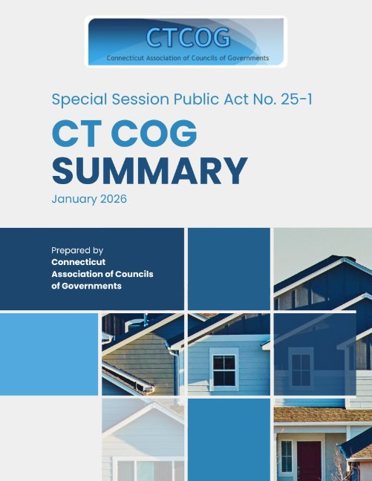

What’s Next?
CTCOG Summary Document & Deliverables -----------→
CRCOG Middle Housing Technical Assistance
SN Villalba, Housing Planner Starting March 23rd!
Additional thematic webinars and workshops! - TBD
Notes:
Link to Summary Doc: https://s3.us-east-1.amazonaws.com/GBRC_Open/HB+Review+021026.pdf

Slide 36
&
Q A

